Slide 1
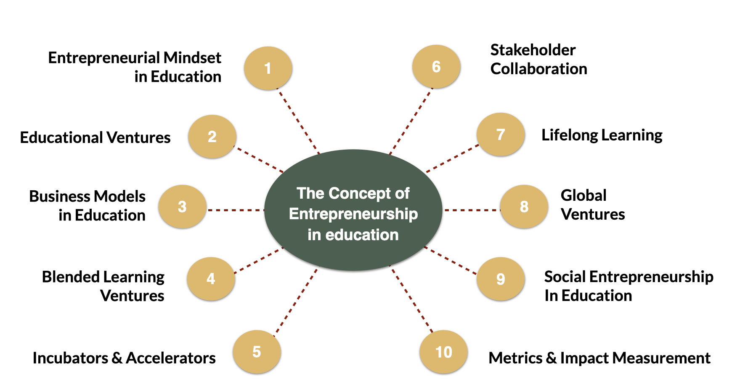
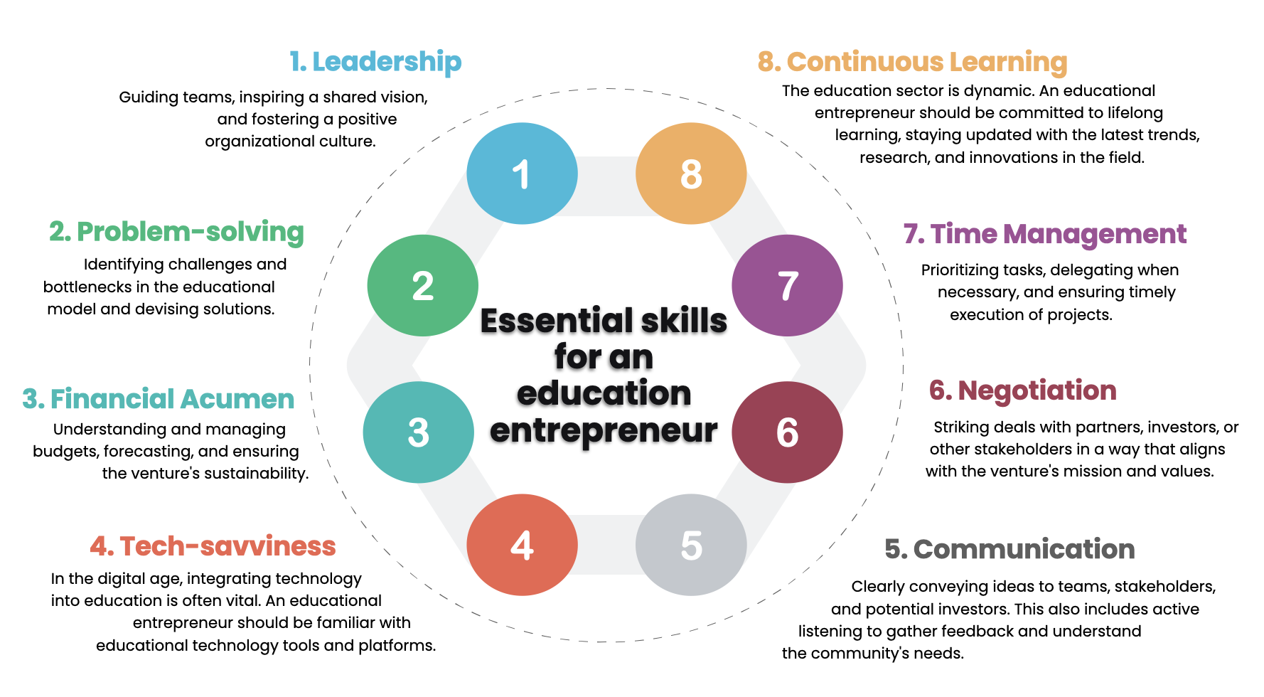
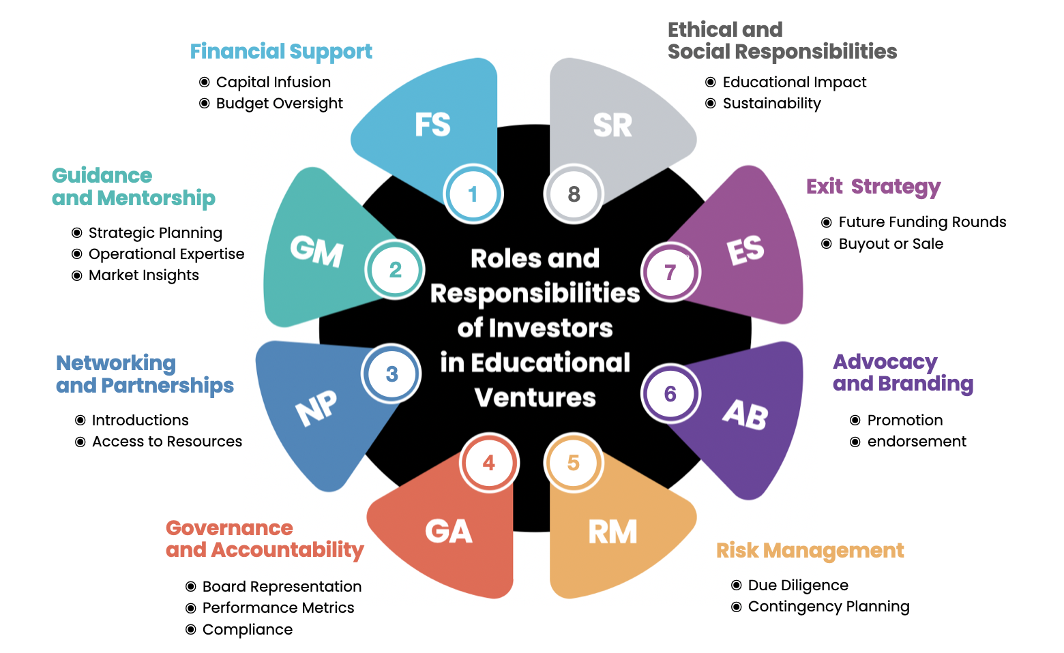
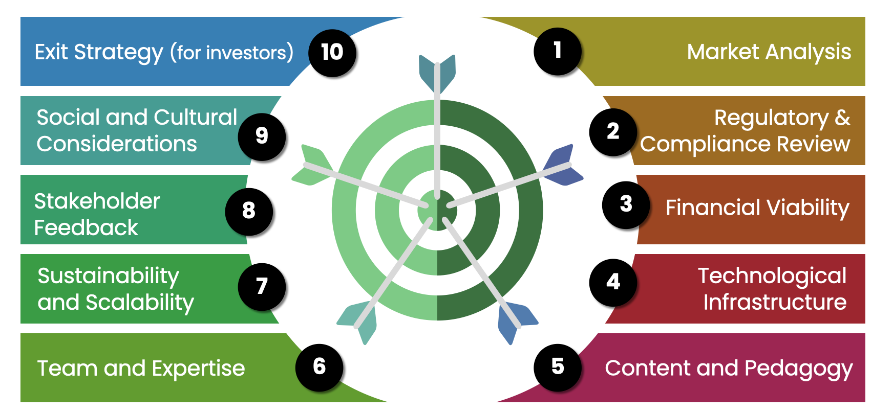
Summary
Notes:
After studying the course EAS 6308 Entrepreneurship and Ventures in Education 2 times and this is the 3rd time.
From now I will introduce you how to link concepts, theories and your ideas, towards defining the topic of doing Independent Study or IS.
在学习了2次EAS 6308创业和教育风险投资课程后，这是第三次。
从现在开始，我将向您介绍如何将概念、理论和您的想法联系起来，以确定进行独立研究或IS的主题。

Slide 2
Characteristics
and Necessary Skills
for Educational
Business Entrepreneurs
Notes:
An example from Topic 2 in our LMS that mentions to the characteristics and skills necessary for educational business entrepreneurs.
我们LMS主题2的一个例子，提到了教育企业家所需的特征和技能。

Slide 3
1. Leadership
8. Continuous Learning
Guiding teams, inspiring a shared vision,
and fostering a positive
organizational culture.
The education sector is dynamic. An educational
entrepreneur should be committed to lifelong
learning, staying updated with the latest trends,
research, and innovations in the field.
1
8
2. Problem-solving
7. Time Management
2
7
Identifying challenges and
bottlenecks in the educational
model and devising solutions.
Prioritizing tasks, delegating when
necessary, and ensuring timely
execution of projects.
Essential skills
for an
education
entrepreneur
3. Financial Acumen
3
6
6. Negotiation
Understanding and managing
budgets, forecasting, and ensuring
the venture's sustainability.
Striking deals with partners, investors, or
other stakeholders in a way that aligns
with the venture's mission and values.
4
5
4. Tech-savviness
5. Communication
In the digital age, integrating technology
into education is often vital. An educational
entrepreneur should be familiar with
educational technology tools and platforms.
Clearly conveying ideas to teams, stakeholders,
and potential investors. This also includes active
listening to gather feedback and understand
the community's needs.
Notes:
The Essential skills for an education entrepreneur include these skills.
1. Leadership
2. Problem-solving
3. Financial Acumen
4. Tech-savviness
5. Communication
6. Negotiation
7. Time Management
8. Continuous Learning
These information you can set name the research you are interested. and create a research framework as follows:
__________________
教育企业家的基本技能包括这些技能。
1.带领
2.解决问题
3.金融敏锐
4.技术精明
5.通讯
6.谈判
7.时间管理
8.持续学习
您可以设置这些信息来命名您感兴趣的研究，并创建如下研究框架：

Slide 4
Conceptual Framework
A Study of Necessary Skills for Educational Business Entrepreneurs
Opinion on the necessary skills for educational business entrepreneurs
General Information
1. Leadership
2. Problem-solving
3. Financial Acumen
4. Tech-savviness
5. Communication
6. Negotiation
7. Time Management
8. Continuous Learning
1. Gender
2. Age
3. Occupation
4. Education
5. Work experience
Notes:
Examples of research frameworks on “A study of necessary skills for educational business entrepreneurs”
On the left is the General Information framework, which is General information and characteristics of questionnaire participant. Includes Gender, Age, Occupation, Education, and Work experience variables, or more depending on your interests.
The right frame is an opinion about the necessary skills for education business entrepreneur. It consists of variables: Leadership, Problem-solving, Financial Acumen, Tech-savviness, Communication, Negotiation, Time Management and Continuous Learning.
Then take these variables to create a query to get the answers you need in the next order.
———————-
关于“教育企业家必要技能的研究”的研究框架示例
-左边是一般信息框架，这是问卷参与者的一般信息和特征。
包括性别、年龄、职业、教育和工作经验变量，或更多，具体取决于您的兴趣。
-正确的框架是关于教育企业家的必要技能的意见。
它由以下变量组成：领导力、解决问题、财务敏锐性、技术智慧、沟通、谈判、时间管理和持续学习。
然后用这些变量创建一个查询，以在下一个顺序获得您需要的答案。
********************
General Information (General information and characteristics of questionnaire participant)
1. Gender
Male
Female
2. Age
less than 30 years old
30 – 39 years old
40 – 49 years old
more than50 years old
3. Occupation
Government Officer/state enterprise
Private Employee
Self-employed
Other, please……..
4. Education
High School
Vocational School
Bachelor’s Degree
Master’s Degree
Doctoral Degree
5. Work experience
5 years or less
6-10 years
11-15 years
16-20 years
more than 20 years
Opinion on the necessary skills for educational business entrepreneurs
1. Leadership
2. Problem-solving
3. Financial Acumen
4. Tech-savviness
5. Communication
6. Negotiation
7. Time Management
8. Continuous Learning

Slide 5
Assessment of Educational Business Development Opportunities
Notes:
At the Topic 3 on our LMS is the Assessment of educational business development opportunities.
我们LMS的主题3是评估教育业务发展机会。

Slide 6
Framework of Assessment of educational
business development opportunities
Exit Strategy (for investors)
10
1
Market Analysis
Social and Cultural Considerations
Regulatory &
Compliance Review
9
2
Stakeholder Feedback
8
3
Financial Viability
Sustainability
and Scalability
Technological
Infrastructure
7
4
Team and Expertise
6
5
Content and Pedagogy
Notes:
Which has presented 10 educational business development opportunities assessment frameworks, including
1. Market Analysis
2. Regulatory and Compliance Review
3. Financial Viability
4. Technological Infrastructure
5. Content and Pedagogy
6. Team and Expertise
7. Sustainability and Scalability
8. Stakeholder Feedback
9. Social and Cultural Considerations
10. Exit Strategy (for investors)
If you have any doubts in these assessment frameworks, you can research to find the answer.
By studying the assessment framework for educational business development opportunities in your context.
它提出了10个教育商业发展机会评估框架，包括
1.市场分析
2.监管和合规审查
3.财务可行性
4.技术基础设施
5.内容和教育学
6.团队和专业知识
7.可持续性和可扩展性
8.利益相关者反馈
9.社会和文化考虑
还有，
10。退出策略（面向投资者）
如果您对这些评估框架有任何疑问，您可以进行研究以找到答案。
通过研究您背景下的教育业务发展机会的评估框架。

Slide 7
Conceptual Framework
A Study of Assessment of Educational Business Development Opportunities
Opinion on the assessing educational business development opportunities
General Information
1. Market Analysis
2. Regulatory and Compliance Review
3. Financial Viability
4. Technological Infrastructure
5. Content and Pedagogy
6. Team and Expertise
7. Sustainability and Scalability
8. Stakeholder Feedback
9. Social and Cultural Considerations
10. Exit Strategy
1. Gender
2. Age
3. Occupation
4. Education
5. Work experience
Notes:
Examples of research frameworks on “A study of Assessment of educational business development opportunities”.
On the left is the General Information framework, which is General information and characteristics of questionnaire participant. Includes Gender, Age, Occupation, Education, and Work experience variables, or more depending on your interests.
The right frame is an opinion about the assessing educational business development opportunities. It consists of variables: Market Analysis, Regulatory and Compliance Review, Financial Viability, Technological Infrastructure, Content and Pedagogy, Team and Expertise, Sustainability and Scalability, Stakeholder Feedback, Social and Cultural Considerations And, Exit Strategy (for investors).
Then take these variables to create a query to get the answers you need in the next order.
关于“教育业务发展机会评估研究”的研究框架示例。
左边是一般信息框架，这是问卷参与者的一般信息和特征。包括性别、年龄、职业、教育和工作经验变量，或更多，具体取决于您的兴趣。
正确的框架是关于评估教育业务发展机会的意见。它由变量组成：市场分析、监管和合规审查、财务可行性、技术基础设施、内容和教育学、团队和专业知识、可持续性和可扩展性、利益相关者反馈、社会和文化考虑因素以及退出战略（针对投资者）。
然后用这些变量创建一个查询，以在下一个顺序获得您需要的答案。
General Information (General information and characteristics of questionnaire participant)
1. Gender
Male
Female
2. Age
less than 30 years old
30 – 39 years old
40 – 49 years old
more than50 years old
3. Occupation
Government Officer/state enterprise
Private Employee
Self-employed
Other, please……..
4. Education
High School
Vocational School
Bachelor’s Degree
Master’s Degree
Doctoral Degree
5. Work experience
5 years or less
6-10 years
11-15 years
16-20 years
more than 20 years
Opinion on the assessing educational business development opportunities
1. Market Analysis
2. Regulatory and Compliance Review
3. Financial Viability
4. Technological Infrastructure
5. Content and Pedagogy
6. Team and Expertise
7. Sustainability and Scalability
8. Stakeholder Feedback
9. Social and Cultural Considerations
10. Exit Strategy

Slide 8
Roles and
Responsibilities
of Investors
in Educational Ventures
Notes:
At the Topic 4 on our LMS is the Roles and Responsibilities of Investors in Educational Ventures.
我们LMS的主题4是教育风险投资投资者的作用和责任。

Slide 9
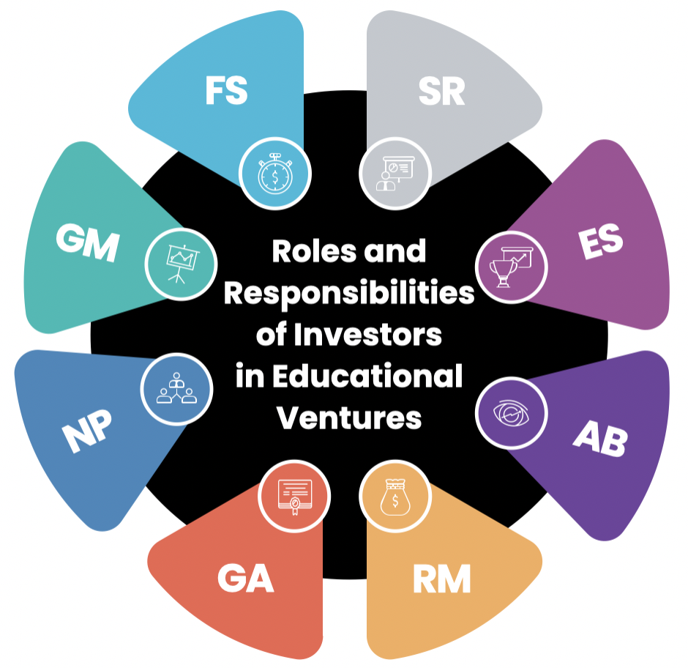
Ethical and
Social Responsibilities
Financial Support
Capital Infusion
Budget Oversight
Educational Impact
Sustainability
Guidance
and Mentorship
1
8
Exit Strategy
Strategic Planning
Operational Expertise
Market Insights
Future Funding Rounds
Buyout or Sale
2
7
Networking
and Partnerships
3
Advocacy
and Branding
6
Introductions
Access to Resources
Promotion
endorsement
4
5
Governance
and Accountability
Risk Management
Board Representation
Performance Metrics
Compliance
Due Diligence
Contingency Planning
Notes:
Investors play an important role in the development and growth of educational enterprises, not just financing. They have the following roles and responsibilities in educational ventures:
1. Financial Support ==> การสนับสนุนทางการเงิน
2. Guidance and Mentorship ==> คําแนะนําและการให้คําปรึกษา
3. Networking and Partnerships ==> เครือข่ายและความร่วมมือ
4. Governance and Accountability ==> ธรรมาภิบาลและความรับผิดชอบ
5. Risk Management ==> การบริหารความเสี่ยง
6. Advocacy and Branding ==> การสนับสนุนและการสร้างแบรนด์
7. Exit Strategy ==> กลยุทธ์การถอนตัวออกจากธุรกิจ
8. Ethical and Social Responsibilities ==> ความรับผิดชอบทางจริยธรรมและสังคม:
If you have doubts about the roles and responsibilities of these investors' educational ventures, you can do your research to find the answer.
By studying the Roles and Responsibilities of Investors in Educational Ventures in your context.
投资者在教育企业的发展和发展中发挥着重要作用，而不仅仅是融资。他们在教育企业中具有以下角色和责任：
1.财政支持
2.指导和指导
3.网络和伙伴关系
4.治理和问责制
5.风险管理
6.宣传和品牌
7.退出策略
8.道德和社会责任
如果您对这些投资者的教育企业的作用和责任有疑问，您可以进行研究以找到答案。
通过研究投资者在您的背景下在教育风险投资中的作用和责任。

Slide 10
Conceptual Framework
A study of Roles and Responsibilities of Investors in Educational Ventures
Opinion on the roles and responsibilities of investors in educational ventures
General Information
1. Gender
2. Age
3. Occupation
4. Education
5. Work experience
1. Financial Support
2. Guidance and Mentorship
3. Networking and Partnerships
4. Governance and Accountability
5. Risk Management
6. Advocacy and Branding
7. Exit Strategy
8. Ethical and Social Responsibilities
Notes:
Examples of research frameworks on “A study of Roles and Responsibilities of Investors in Educational Ventures”.
On the left is the General Information framework, which is General information and characteristics of questionnaire participant. Includes Gender, Age, Occupation, Education, and Work experience variables, or more depending on your interests.
The right frame is an opinion about the roles and responsibilities of investors in educational ventures. It consists of variables: Financial Support, Guidance and Mentorship, Networking and Partnerships, Governance and Accountability, Risk Management, Advocacy and Branding, Exit Strategy, and Ethical and Social Responsibilities.
Then take these variables to create a query to get the answers you need in the next order.
关于“教育企业投资者的作用和责任研究”的研究框架示例。
左边是一般信息框架，这是问卷参与者的一般信息和特征。包括性别、年龄、职业、教育和工作经验变量，或更多，具体取决于您的兴趣。
正确的框架是对投资者在教育企业中的作用和责任的看法。它由变量组成：财务支持、指导和指导、网络和伙伴关系、治理和问责制、风险管理、倡导和品牌、退出战略以及道德和社会责任。
然后用这些变量创建一个查询，以在下一个顺序获得您需要的答案。
————
ตัวอย่างกรอบแนวคิดการวิจัยเรื่อง การศึกษาบทบาทและความรับผิดชอบของนักลงทุนในกิจการการศึกษา
ด้านซ้ายเป็นกรอบข้อมูลทั่วไป ซึ่งเป็นข้อมูลทั่วไปและลักษณะของผู้เข้าร่วมแบบสอบถาม ประกอบด้วยตัวแปร Gender, Age, Occupation, Education, and Work experience หรือจะมากกว่านี้แล้วแต่ความสนใจของคุณ
ส่วนกรอบด้านขวาเป็นความคิดเห็นเกี่ยวกับบทบาทและความรับผิดชอบของนักลงทุนในกิจการการศึกษา ประกอบด้วยตัวแปร ก การสนับสนุนทางการเงิน, คําแนะนําและการให้คําปรึกษา, เครือข่ายและความร่วมมือ, ธรรมาภิบาลและความรับผิดชอบ, การบริหารความเสี่ยง, การสนับสนุนและการสร้างแบรนด์, กลยุทธ์การถอนตัวออกจากธุรกิจ และความรับผิดชอบทางจริยธรรมและสังคม
จากนั้นก็นำตัวแปรเหล่านี้ไปสร้างแบบสอบถามเพื่อให้ได้คำตอบที่คุณต้องการในลำดับต่อไป
********************
General Information (General information and characteristics of questionnaire participant)
1. Gender
Male
Female
2. Age
less than 30 years old
30 – 39 years old
40 – 49 years old
more than50 years old
3. Occupation
Government Officer/state enterprise
Private Employee
Self-employed
Other, please……..
4. Education
High School
Vocational School
Bachelor’s Degree
Master’s Degree
Doctoral Degree
5. Work experience
5 years or less
6-10 years
11-15 years
16-20 years
more than 20 years
Opinion on the roles and responsibilities of investors in educational ventures
1. Financial Support
2. Guidance and Mentorship
3. Networking and Partnerships
4. Governance and Accountability
5. Risk Management
6. Advocacy and Branding
7. Exit Strategy
8. Ethical and Social Responsibilities

Slide 11
Concepts of entrepreneurship and business ventures
Entrepreneurial Mindset
in Education
1
6
Stakeholder Collaboration
Educational Ventures
2
7
Lifelong Learning
Business Models
in Education
The Concept of Entrepreneurship
in education
3
8
Global Ventures
Blended Learning
Ventures
4
9
Social Entrepreneurship
In Education
5
10
Incubators & Accelerators
Metrics & Impact Measurement
Notes:
At the Topic 1 on our LMS is the Concepts of entrepreneurship and business ventures. Consists of
—————-
1. Entrepreneurial Mindset in Education ==> ความคิดของผู้ประกอบการในการศึกษา
2. Educational Ventures ==> การลงทุนด้านการศึกษา
3. Business Models in Education ==> โมเดลธุรกิจในการศึกษา
4. Blended Learning Ventures ==> การลงทุนในการเรียนรู้แบบผสมผสานกัน
5. Incubators & Accelerators ==> ศูนย์บ่มเพาะและตัวเร่งความเร็ว
6. Stakeholder Collaboration ==> การทํางานร่วมกันของผู้มีส่วนได้ส่วนเสีย
7. Lifelong Learning ==> การเรียนรู้ตลอดชีวิต
8. Global Ventures ==> การลงทุนทั่วโลก
9. Social Entrepreneurship in Education ==> ผู้ประกอบการทางสังคมในการศึกษา:
10. Metrics & Impact Measurement ==> การวัดตัวชี้วัดและผลกระทบ:
我们LMS的主题1是创业和商业企业的概念。由
1.教育中的创业心态
2.教育风险投资
3.教育中的商业模式
4.混合学习企业
5.孵化器和加速器
6.利益相关者协作
7.终身学习
8.全球风险投资
9.教育中的社会企业家精神
10.指标和影响测量

Slide 12
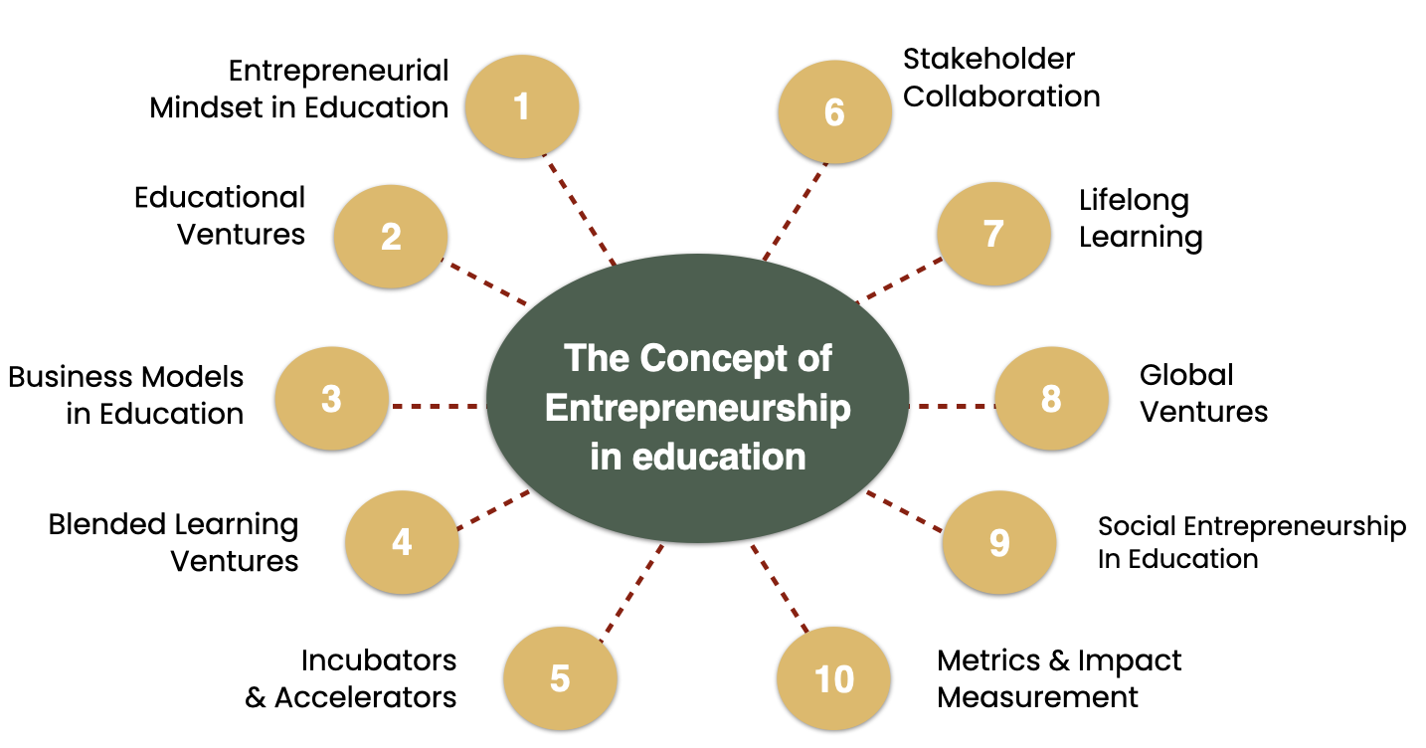
Can put these data in the background and significance of the problem. To begin, introduce readers to existing phenomena, trends, or problems, as well as a review of literature related to a critical examination of relevant, recent, and academic research demonstrating what you know, what theories exist, and more research is needed.
Background
and
Significance
of the Problem
Notes:
You can put these data in the background and significance of the problem—in the introduction to your research report.
To begin, introduce readers to existing phenomena, trends, or problems, as well as a review of literature related to a critical examination of relevant, recent, and academic research demonstrating what you know, what theories exist, and more research is needed.
您可以在研究报告的导言中将这些数据放在问题的背景和意义中。
首先，向读者介绍现有的现象、趋势或问题，以及回顾与相关、近期和学术研究的批判性审查相关的文献，证明你所知道的，存在哪些理论，并且需要更多的研究。

Slide 13
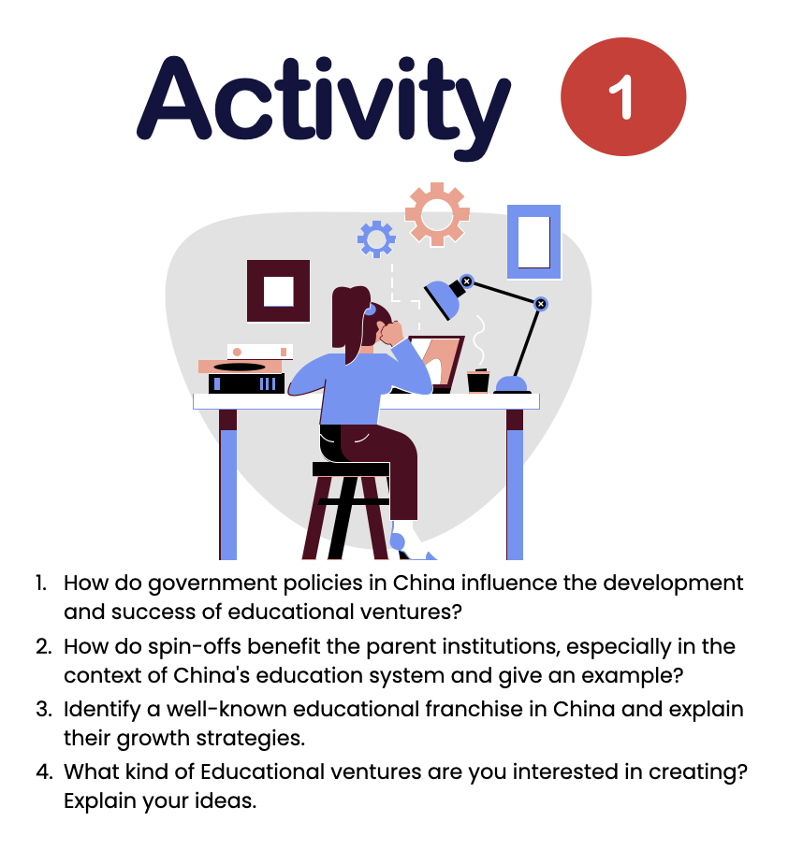
Background
and
Significance
of the Problem
Literature
Reviews
Extend to submit Activity 1 until December 23, 2023
Notes:
You will understand the content when you research the answers in Activity 1.
And can use the information in the research's Background and Significance of the Problem and Literature Reviews. If you are interested in researching these issues
I will extend your time to submit Activity 1 until December 23, 2023.
Although this subject does not have an exam, it collects points from classroom participation and submits assignments.
当您研究活动1中的答案时，您将理解内容。
并且可以使用研究背景和问题的意义以及文献评论中的信息。如果您有兴趣研究这些问题
我将把您提交活动1的时间延长到2023年12月23日。
虽然这个科目没有考试，但它从课堂参与中收集分数并提交作业。

Slide 14
Knowledge to Research Topics
Topic 1
Topic 2
Put these data in the background and significance of the problem
A Study of Necessary Skills for Educational Business Entrepreneurs
Topic 3
Topic 4
A Study of Assessment of Educational Business Development Opportunities
A study of Roles and Responsibilities of Investors in Educational Ventures
Notes:
This is an example of applying all the knowledge gained from studying in this course to research. #
The content in Topic 2 can study research on A Study of Necessary Skills for Educational Business Entrepreneurs. #
The content in Topic 3 can do research on A Study of Assessment of Educational Business Development Opportunities. #
The content in Topic 4 can do research on A Study of Roles and Responsibilities of Investors in Educational Ventures. #
The content in Topic 1 can be used in the Background and Significance of the Problem and Literature Reviews of all 3 Title.
In these 3 examples, you can do research to find answers from samples in the context of your country.
这是一个将本课程学习中获得的所有知识应用于研究的例子。
主题2的内容可以研究教育商业企业家的必要技能研究。
主题3的内容可以对教育商业发展机会评估进行研究。
主题4的内容可以研究投资者在教育风险投资中的作用和责任。
主题1的内容可用于所有3个标题的问题和文献评论的背景和意义。
在这3个例子中，您可以进行研究，从您所在国家的样本中找到答案。

