Slide 1

Online Education Business Management in Efficiency
Present By: Assist.Prof.Dr.Phongsak Phakamach
RICE, RMUTR, Thailand

Slide 2





My Objective for Today
“Online Educator”

Slide 3
Learning Objective
☑ Understand the meaning of the word “Online Education Business Management”
☑ Know the concepts and stages of online education business management.
☑ Know how to use it to create valuable work.
☑ Able to apply knowledge to become a quality educational innovator in the future.

Slide 4


Presentation Topics
Meaning
Forms and main characteristics
Management Procedure
“Online Educator”
Case studies
Conclusion and discussion

Slide 5
Micro Education Businesses Are The Future & How To Start With Zero Dollars
https://www.youtube.com/watch?v=6XSim-zigGA
5 Education Technology Trends 2023
https://www.youtube.com/watch?v=xMajRhCYCnQ

Slide 6
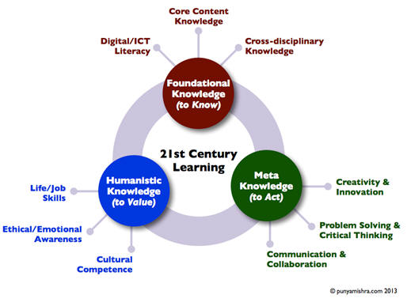
21st Century Learning

Slide 7

21st Century Learning

Slide 8
Entrepreneurship Online
Entrepreneurship online has become one of the best alternatives for many people who like or get along with everything related to technology. In addition, you can combine it with your current job, you can do it from home and many times you do not need a big investment to start. Sounds good, doesn’t it?
One thing you need to be clear about before you start is that not all that glitters is gold. Going online and creating an ecommerce is not something you can do overnight. It will take you many hours and it will take you a lot of effort to come up with an idea that really works and that you can translate into an online business.

Slide 9
The 3 main challenges teachers face in today’s classroom
Balancing the different learning needs of students.
Respecting expectations from school/university admins.
Helping parents and students meet long-term goals.

Slide 10

Question???
What interests you about this online education business management?
❖ What do you want student/people to know about this online education business management?

Slide 11
1. Meaning of“Online Education”
Online learning is another form of educational innovation that can transform traditional learning methods into new learning methods that use technology to help teach. In addition, the other meaning also refers to distance learning and web site learning.

Slide 12
Meaning of“Educational Innovation”
Educational innovation refers to the introduction of new things that may be in the form of ideas or actions, including any invention, into the education system in the hope of changing existing ones to make the education management system more efficient. This enables learners to learn quickly. Motivate you to study and save more time in studying.

Slide 13

Meaning of“Educational Technology”
Educational technology refers to the science of educational methods, which encompasses the use of systematic methods to improve the efficiency of education. Educational technology encompasses three components: materials, equipment, and methods.

Slide 14

2022’s top 8 classroom challenges, according to teachers
❶Lack of teamwork, empathy, and support between students

Slide 15


❷Teachers working too many roles at the same time
❸No time to deal with bodily functions!

Slide 16


❹Teachers being made accountable for more than they should
❺Not enough time to plan

Slide 17


❻Excessive paperwork for data collection
❼Keeping up with the expectations of school/University admins

Slide 18


❽Applying a prescribed curriculum to all types of students

Slide 19
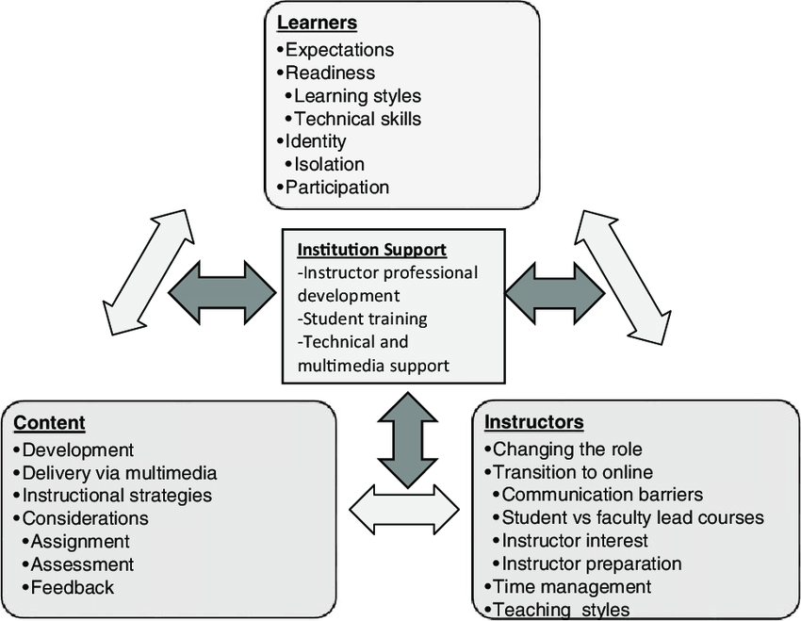
2. Model of “Online Education”
Online Education Component

Slide 20
Main characteristics of online teaching
1. Students can be anyone, anywhere. Study anytime It is important to follow the convenience of the learners because the online school has opened a website that is available 24 hours a day.
2. There are all types of media presented on the website, such as text, still images, animations (Multimedia), audio and video, which will stimulate the interest of learners in learning as well. It also makes it easier to visualize content.
3. Students can choose the subject according to their needs.
4. Documents on the website with links to other sources of knowledge broaden the scope of learning and allow for deeper learning.

Slide 21
Courseware
Courseware refers to content and learning techniques that are transformed into electronic media and can consist of Class Notes, Scanned Images, Textbooks, Tutorials, and Assignments of instructors presented with Internet, intranet, and extranet technologies.
Teaching materials such as training materials, coursebooks, instructor's guides, student's guides, technical guides, self-paced multimedia and PowerPoint teaching materials, etc.

Slide 22
Courseware
CAI, WBI and e-Book
CAI (Computer Assisted Instruction) refers to computer-assisted instruction programs created in the form of electronic files. To train learners to learn things through computers, where students will be able to learn and interact with the lessons.
WBI (Web-Based Instruction) refers to computer-aided instruction delivered over the Internet. Students can learn on the Internet by keying the URL they want to study, WBI will be born before e-Learning and developed into the current e-Learning.
e-Book refers to the development of various aspects of knowledge in the form of electronic books by learning through computers and networks.

Slide 23
e-Learning
Technology-based learning, which covers many learning methods such as Computer-Based Learning, Web-Based Learning or Teaching and Learning Development through the Website or Applications, which is a teaching and learning management system that connects learners and instructors and between learners and learners (Learning Management System).

Slide 24

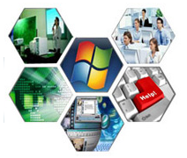
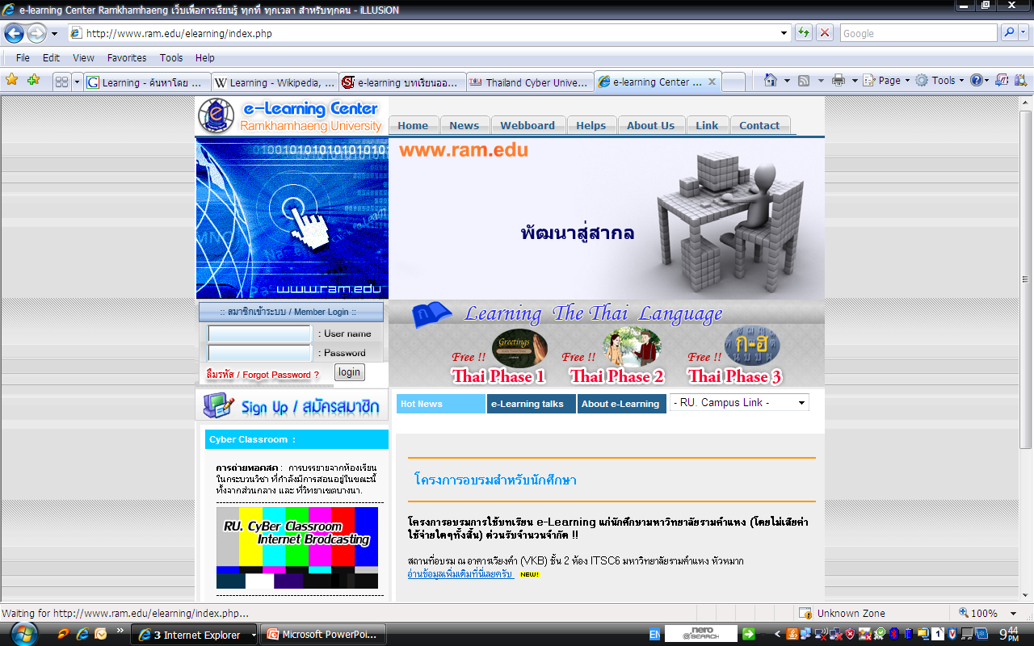
e-Learning
Electronic learning or e-learning is a general term used to refer to Internet-based networked computer-enhanced learning. A specific and always more diffused e-learning is mobile learning (m-Learning), it uses different mobile telecommunication equipments, such as cellular phones.

Slide 25
The e-Learning embracer 6 attributes or philosophies
1. e-learning is learning on internet-aged steroid, real time, 24/7/365, anywhere, anytime and networked.
2. e-learning embracer the learning process from assessment through testing and sometimes certification.
3. web-delivered, typically assembling learning experiences on the fly from the freshest information.

Slide 26
The e-Learning embracer 6 attributes or philosophies
4. Provides a mix of learning methods, Virtual classroom, simulation and collaboration.
5. Incorporates registration, payment and charge-backs, monitoring learner progress, administering tests and exams, Maintaining learner records.
6. Learner centric and personalized 1:1

Slide 27
Benefits of teaching materials“e-Courseware”
1. Increase flexibility in time and place.
2. Cost Savings.
3. Choose a subject of interest.
4. It is accurately conveyed and interesting.
5. Expand opportunities for exchange of ideas
6. Tracking learner progress.
7. Learning technology goes hand in hand with lessons learned.

Slide 28
Courseware Produce
The production of teaching materials has steps as follows:
1. Preparation
2. Design Instruction
3. Flow-Chart Lesson
4. Story Board
5. Program Lesson
6. Production
7. Evaluation and Revise

Slide 29
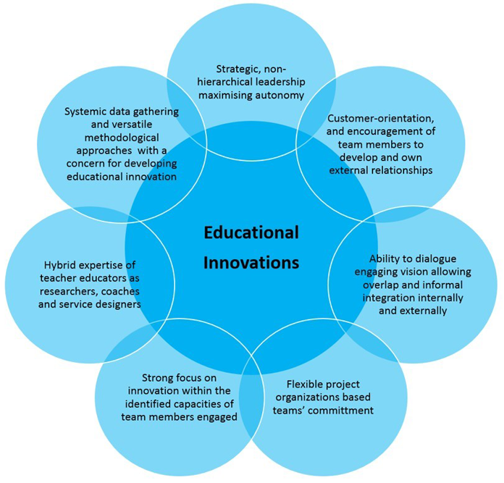

Global
Education
R&D

Slide 30
3.Online Education Business Management Process
Four Steps to an Effective Innovation Process
❶Observe Your Customers to Uncover New Problems—and Opportunities
❷Create New Solutions
❸Prototype and Learn in the Market
❹Implement the Best Ideas

Slide 31
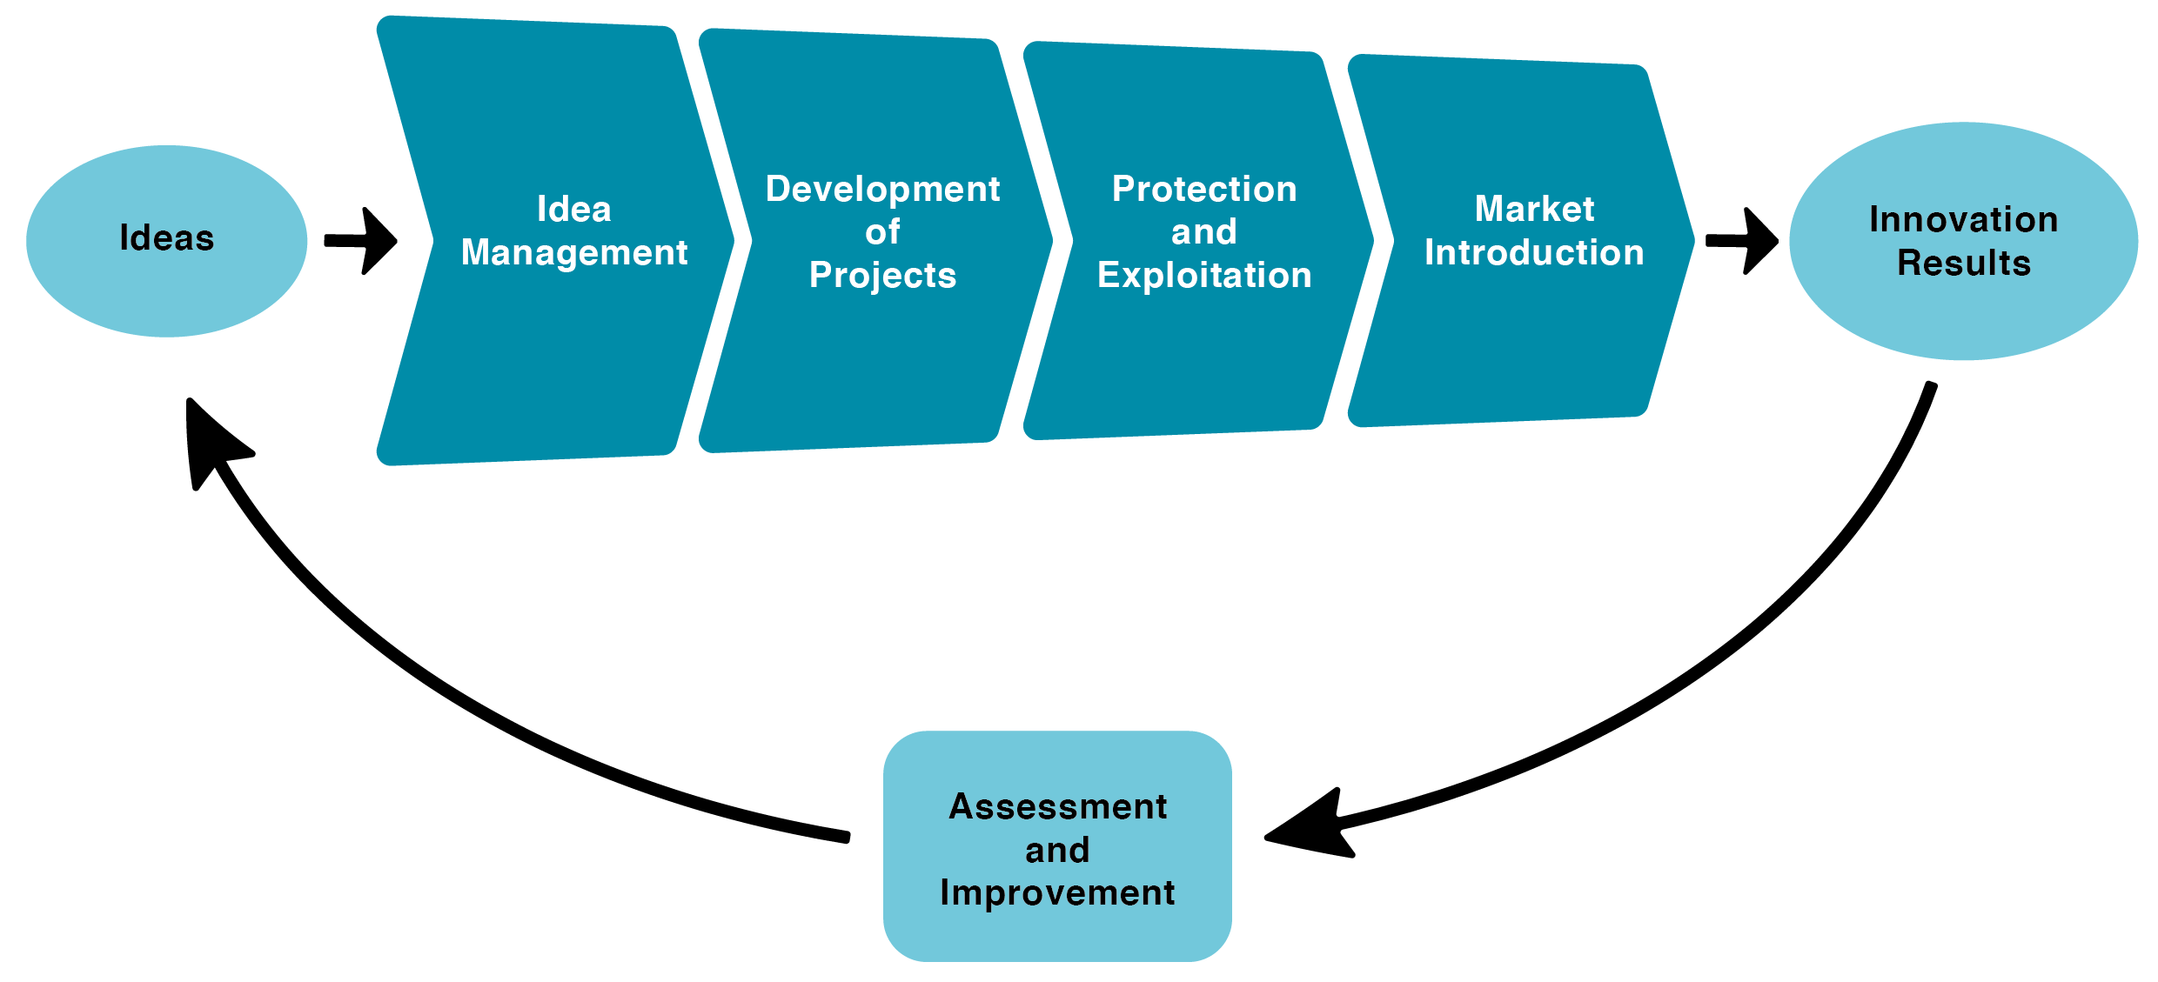
Innovation Development Process

Slide 32
Educational Innovation
Innovation in teaching style
Innovation in instructional practices
Innovation in class organisation
Innovation in the use of textbooks in classrooms
Innovation in the methods of assessment used in classrooms
Innovation in the availability of computers and the internet in the classroom
Innovation in the use of computers in the classroom
Innovation in the provision of special education in schools
Innovation in the extent of teacher collaboration in schools
Innovation in feedback mechanisms in schools
Innovation in evaluation and hiring in schools
Innovation in schools’ external relations

Slide 33
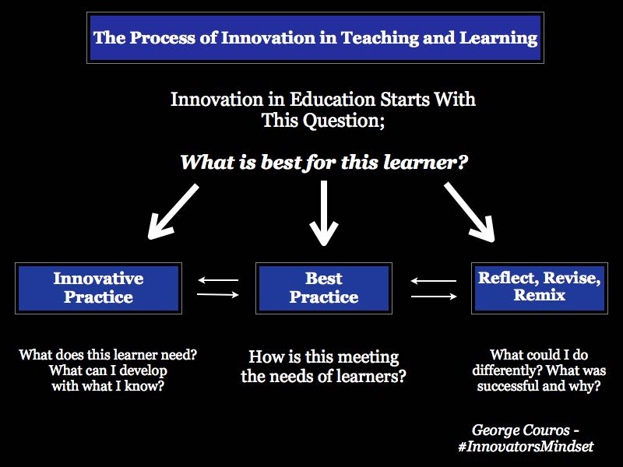

Slide 34
How to Start an Online Business: 6 Steps to Consider
1. Investigate, observe and learn from your competition
2. Create a business plan
3. Creates a minimum viable product
4. Create your website
5. Legally formalize your business
6. Create an online marketing strategy

Slide 35
Before going online: analyze your business idea
1. Your product has something different that can replace something already on the market. You have to be able to convince your target audience that yours is better, but are you clear on how to do it?
2. It’s a business idea with a future. Automation, technology, user experience and globalization are changing the world. Is your business idea ready to adapt to the changes?
3. It’s a scalable business. We say that a company is scalable when they have a very strong growth potential, being able to increase their profits by making a much smaller investment in their infrastructure
4. You know the buying cycle of the product. It is one of the points you should not forget when making predictions about how much you are going to enter. A product with a purchase cycle of 2 months is not the same as a product with a purchase cycle of 3 years.

Slide 36

To start setting up your website you need:
(1) A web hosting plan: the space provided by a web server for a page to be visible and operational 24 hours a day from anywhere in the world.
(2) A domain: in other words, the URL address of your website. You need to choose a domain name that identifies your business idea and that your customers can easily remember.
(3) SSL Certificate: simply essential. The security of a website is very important, not only for your visitors, but also for Google.

Slide 37
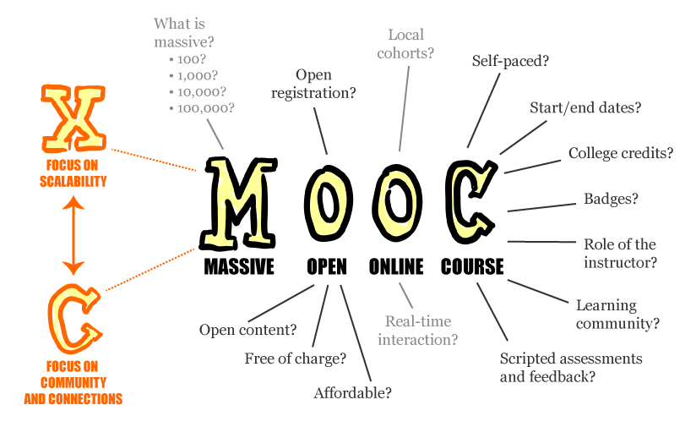
4. Case studies“Online Education Business”

Slide 38

Education Platform (Connect to Learn)

Slide 39

Learning Online Platform

Slide 40
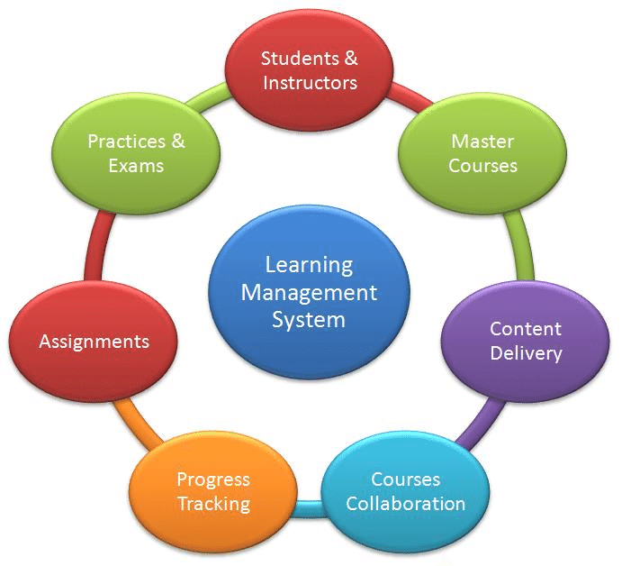
LMS Model

Slide 41
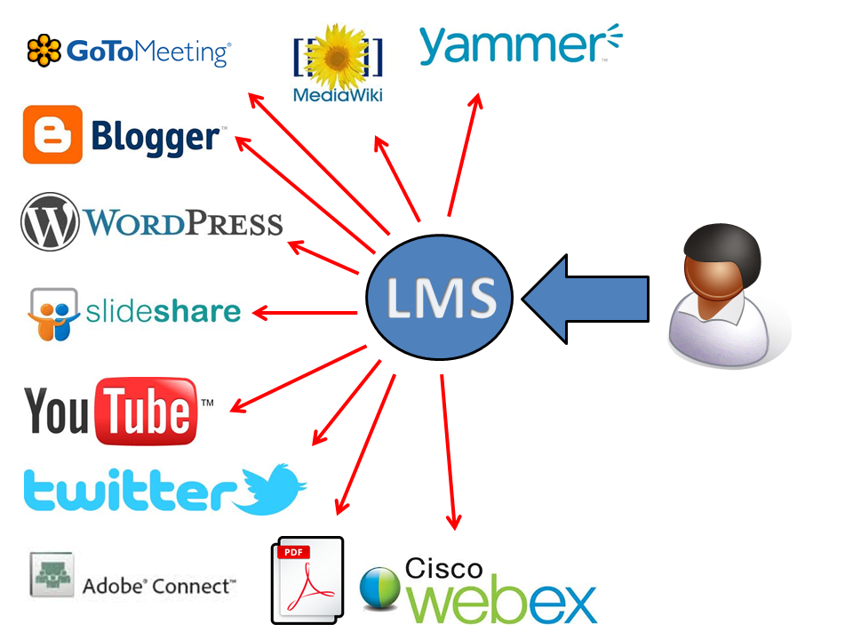
LMS Process and Applications

Slide 42
5 tips to build your own successful online business.
❶A business idea as the heart of a successful online business.
❷Taxes and Legal.
❸No online business without a professional website.
❹Without advertising nothing going on.
❺Believe in yourself.

Slide 43

5.Conclusion and discussion
Creative Thinking:
Innovative Solutions to Complex Challenges

Slide 44
Insights for learning
IF YOU HEAR, YOU FORGET.
IF YOU SEE, YOU REMEMBER.
IF YOU DO, YOU LEARN.
“Online Educator”

Slide 45



Thank you for your attention

