Slide 1

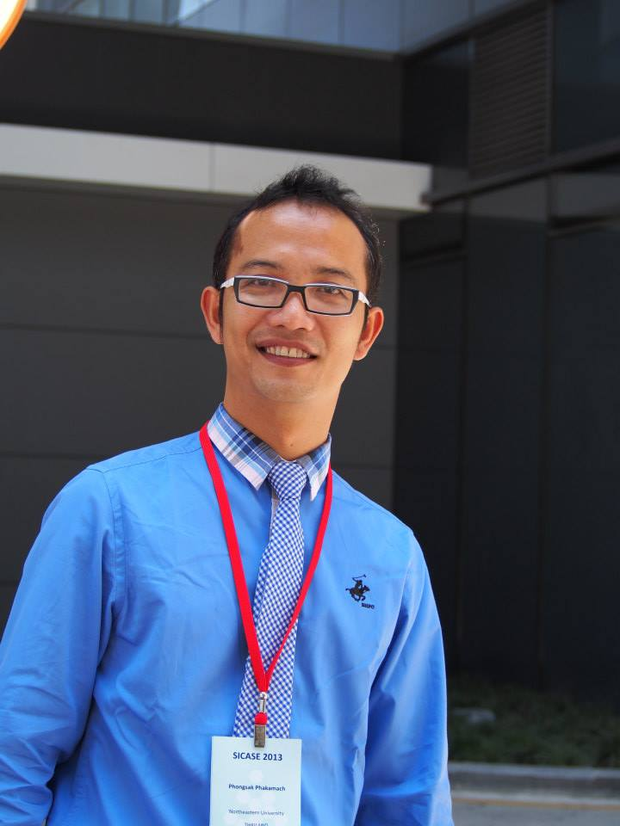
Leaders of Change
Change Management in the Digital Era Education
Present By: Assist.Prof.Dr.Phongsak Phakamach
RICE, RMUTR, Thailand

Slide 2



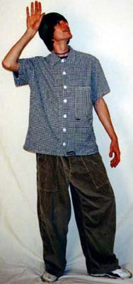


My Objective for Today
“Leaders of Change”

Slide 3
Learning Objective
☑ Understand the meaning of “Leaders of Change, Change Management in the Digital Era Education”
☑ Know the concepts of transformational leadership and digital educational transformation management.
☑ Know how to lead and manage change.
☑ Able to apply knowledge to become a leader in quality digital education.

Slide 4


Presentation Topics
Meaning
Concepts and theories
Format, method, procedure
“Leaders of Change”
Case studies
Conclusion and discussion

Slide 5
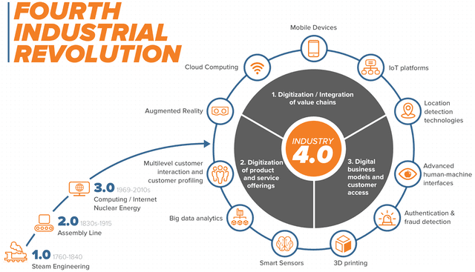
Disruptive Learning Strategy for Modern Learners
https://www.youtube.com/watch?v=HlGiCBtOmAQ

Slide 6
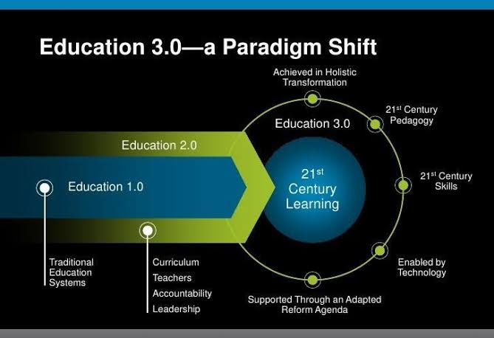
Changing Education Paradigm
https://www.capss.org/educational-transformation

Slide 7
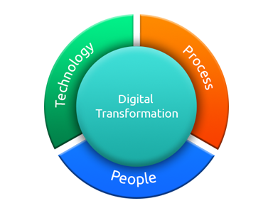
Digital Transformation

Slide 8
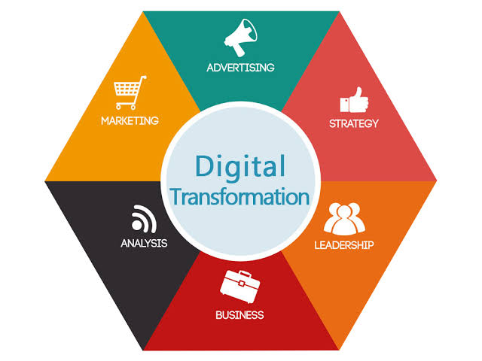
Digital Transformation

Slide 9




Slide 10
Digital Transformation:
1. Thai people use the internet in the world on average 10.56 minutes/day, indicating that Internet Access Thailand is very good.
2. It is a great opportunity for the Community Network to create new business opportunities or Modern E-Commerce using Big Data.
3. Creating people to drive Big Data for national development is the most important thing, so Thailand needs the most people who are experts in Data Science.
4. We need to research more of what's happening in the world, such as UAV, Big Data, IoT, Virtual Reality, Augmented Reality, and Smart City, which will help improve the quality of life for Thai people.

Slide 11
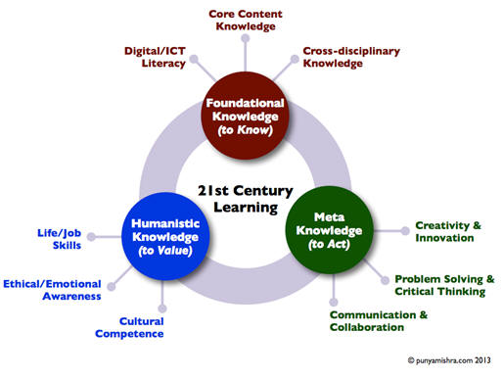
21st Century Learning

Slide 12
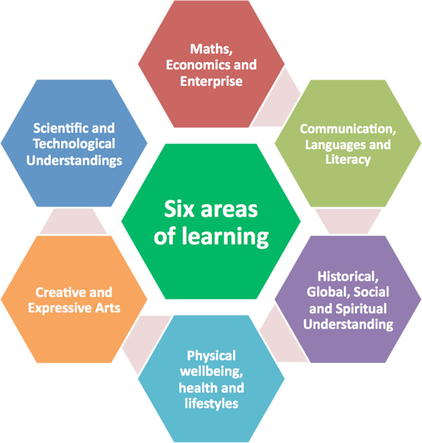
Six Areas of Learning

Slide 13
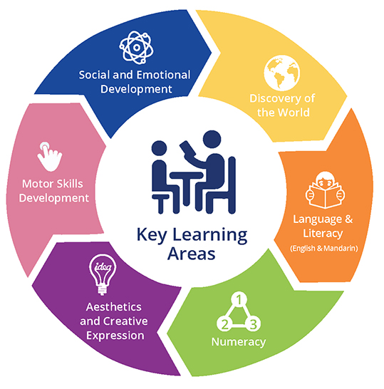
Key Learning Areas

Slide 14

Social Media Age

Slide 15

Digital Transformation in Education

Slide 16
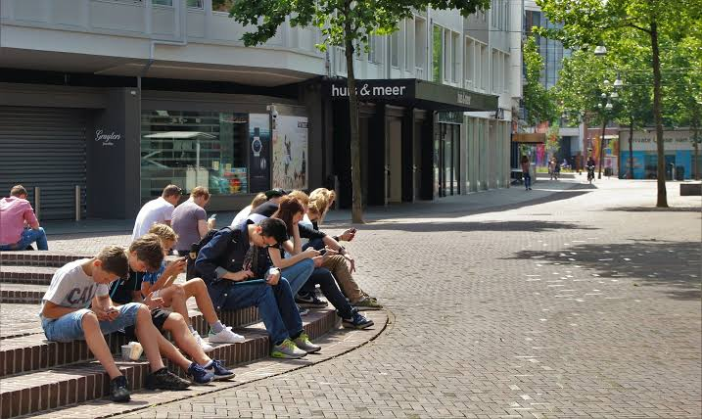
Digital Transformation in Education

Slide 17

Digital Transformation Trends in the Education Sector

Slide 18

Question???
What kind of leaders do you want?
Which aspects of leadership would you like to develop?
What make an outstanding leader in an organization?

Slide 19

Three Levels of Change Management
Individual Change Management
Organizational/Initiative Change Management
Enterprise Change Management Capability

Slide 20

1. Meaning of “Change Management”
Change management is the discipline that guides how we prepare, equip and support individuals to successfully adopt change in order to drive organizational success and outcomes.

Slide 21
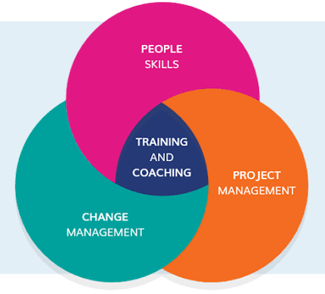
Significance of “Change Management”
Remark Change management is faced with the fundamental difficulties of integration and navigation, and human factors. Change management must also take into account the human aspect where emotions and how they are handled play a significant role in implementing change successfully.

Slide 22

Meaning of“Leaders”
A leader is one who influences or leads others.
How to be a good leader and change the world?

Slide 23

Meaning of“Leadership”
"Leadership is a function of knowing yourself, having a vision that is well communicated, building trust among colleagues, and taking effective action to realize your own leadership potential."
Prof.Warren Bennis

Slide 24

“All teachers are leaders”
“All teachers should have opportunities to be leaders. They lead learning for, and with, all learners with whom they engage. They also work with, and support the development of, colleagues and other partners”.

Slide 25
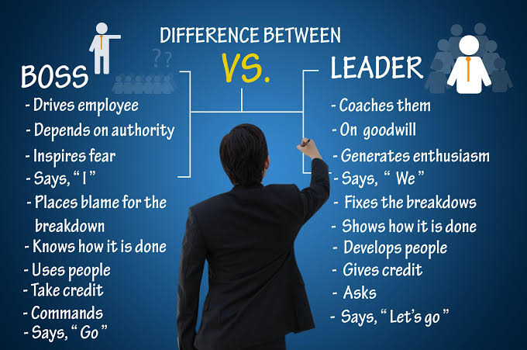
Boss VS. Leader

Slide 26
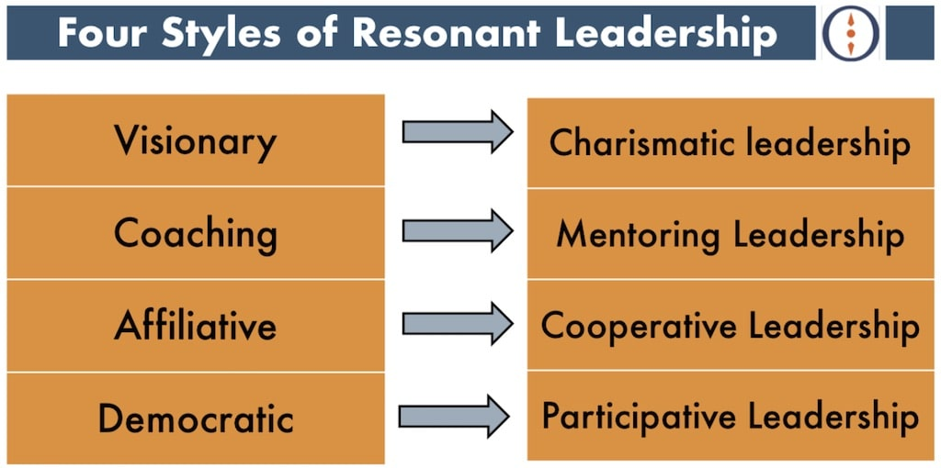
4 styles of leadership that make up an effective leader:

Slide 27
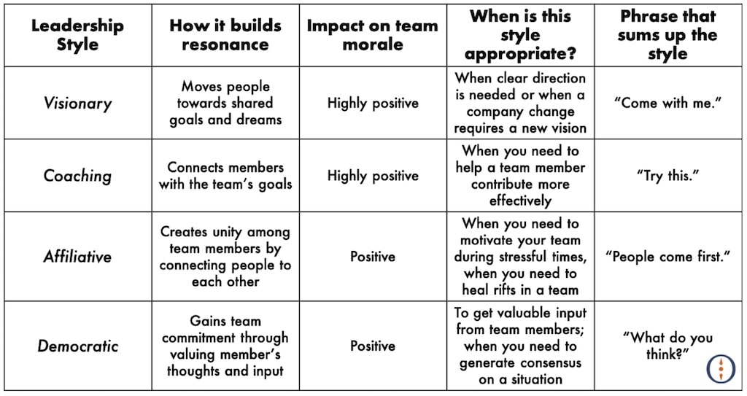
4 styles of leadership that make up an effective leader:

Slide 28
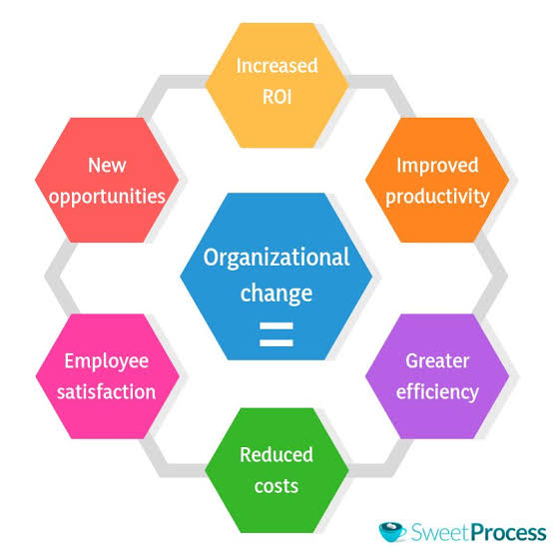
Organization Change

Slide 29
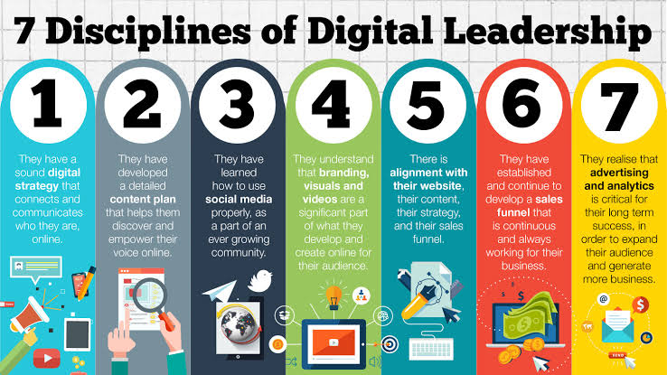
“Digital Leadership”

Slide 30

The Most in-Demand Skills in Digital Leadership
❶Communication

Slide 31
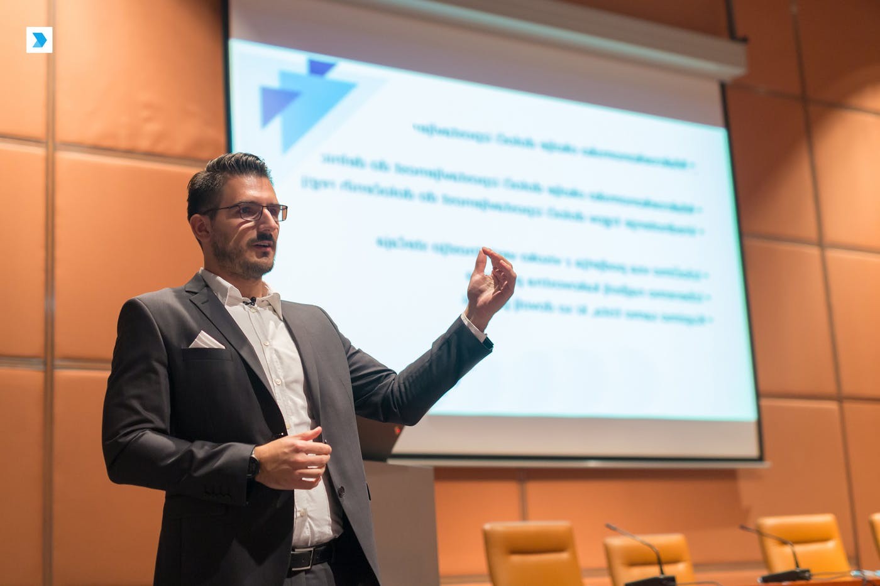
The Most in-Demand Skills in Digital Leadership
❷Vision

Slide 32

The Most in-Demand Skills in Digital Leadership
❸Digital Literacy

Slide 33

The Most in-Demand Skills in Digital Leadership
❹Strategy

Slide 34


The Most in-Demand Skills in Digital Leadership
❺Innovation
Kohler Numi
Kuri

Slide 35

The Most in-Demand Skills in Digital Leadership
❻Risk-Taking

Slide 36

The Most in-Demand Skills in Digital Leadership
❼Adaptability

Slide 37

The Most in-Demand Skills in Digital Leadership
❽Talent Spotting

Slide 38

2. Model of “Change Management”

Slide 39

Change Management Foundation and Model
❶Determine Need for Change
❷Prepare & Plan for Change
❸Implement the Change
❹Sustain the Change

Slide 40
The Goal of Change: Improving an Organization by Altering How Work is Done
When you introduce a change to the organization, you are ultimately going to be impacting one or more of the following:
❶Processes
❷Systems
❸Organization structure
❹Job roles

Slide 41
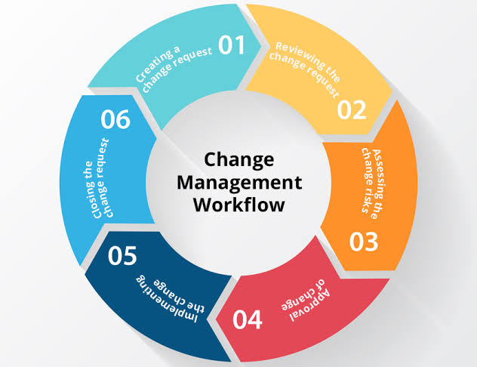
Change Management Workflow

Slide 42
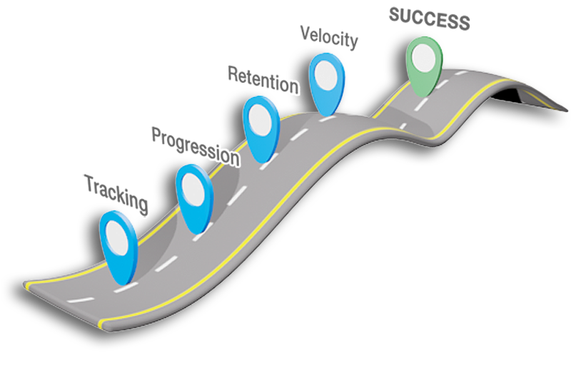
Change Management Roadmap

Slide 43
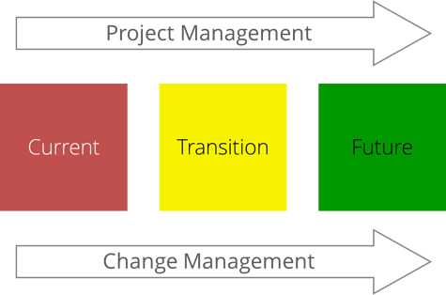
Change Management Definitions
Change management is the process, tools and techniques to manage the people side of change to achieve the required business outcome.
Change management incorporates the organizational tools that can be utilized to help individuals make successful personal transitions resulting in the adoption and realization of change.

Slide 44

Innovative Leadership

Slide 45
Innovative Leadership Development
Leading to Learn
Leading to Think
Leading to Change
Leading to Innovate

Slide 46
Traditional Leadership VS. Innovative Leadership
Traditional Leadership | Innovative Leadership
One-Way | Interactive
Concerned with being right | Concerned with being real
Follows the manual | Improvises when appropriate
Loves to avoid mistakes | Loves to learn from mistakes
Reliability | Validity
Orchestra model | Jazz ensemble
Community in harmony | Community in conversation
Wants to be right | Hopes to be right
Open to limited feedback | Open to unlimited critique
Sustaining order | Taking risks
Closed system | Open system

Slide 47
7 characteristics Innovative Leaders in common
❶The Influencer
❷Forward Thinkers, Present-day Doers, and Past Forgetters
❸Open-mindedness
❹High Emotional Intelligence

Slide 48

7 characteristics Innovative Leaders in common
❺People of Action
❻Observers
❼Transparency

Slide 49
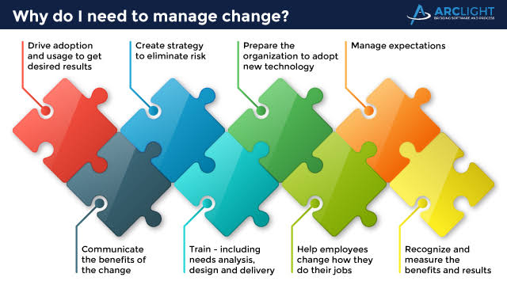
3. Process of “Change Management”
Why do I need to manage change?

Slide 50
John Kotter's 8-Step Process for Leading Change
❶Create a Sense of Urgency
❷Build a Guiding Coalition
❸Form a Strategic Vision and Initiatives
❹Enlist a Volunteer Army

Slide 51
John Kotter's 8-Step Process for Leading Change
❺Enable Action by Removing Barriers
❻Generate Short-Term Wins
❼Sustain Acceleration
❽Institute Change

Slide 52
Five Steps to an Effective Change Management Process
❶Request for Change
❷Impact Analysis
❸Improve/Deny
❹Implement Change
❺Review/Report

Slide 53
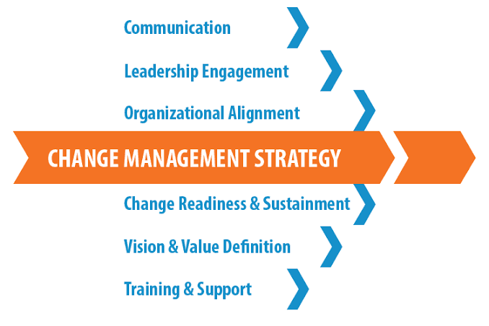
Change Management Strategy 1

Slide 54
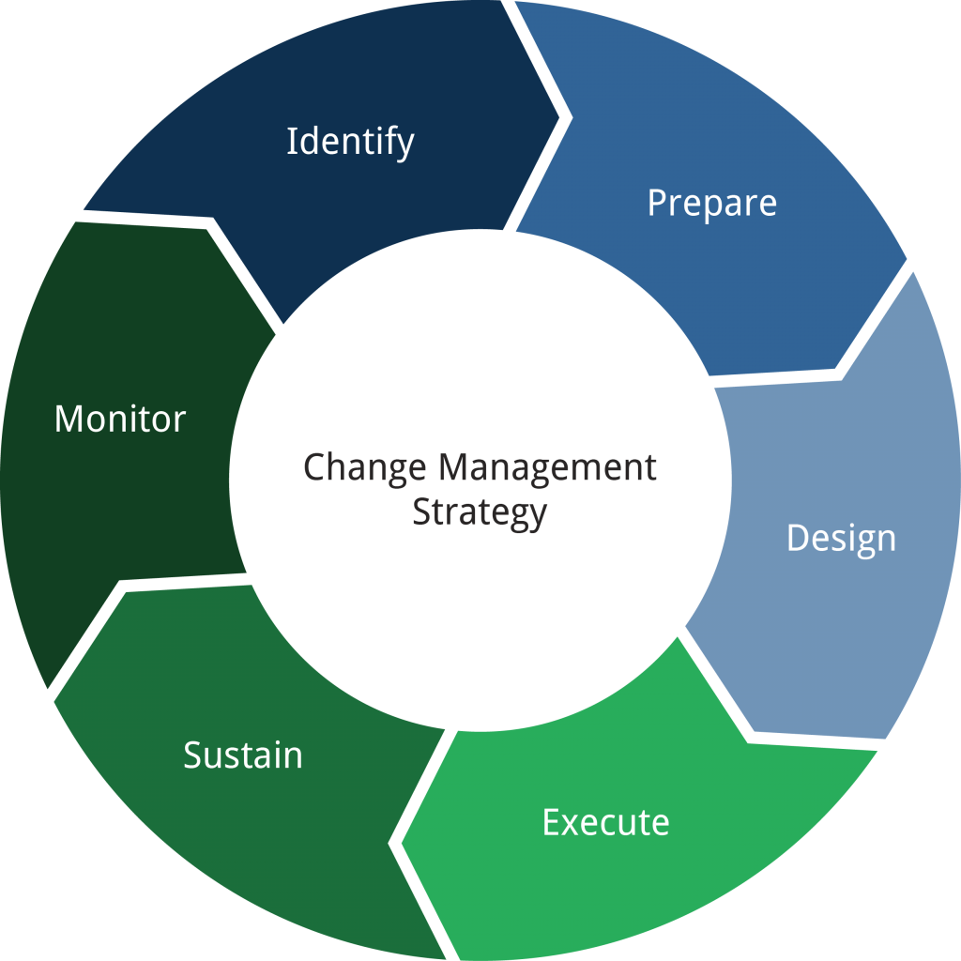
Change Management Strategy 2

Slide 55
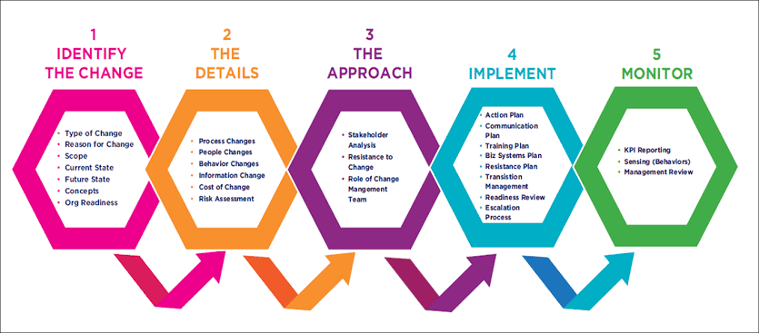
Change Management Strategy 3

Slide 56
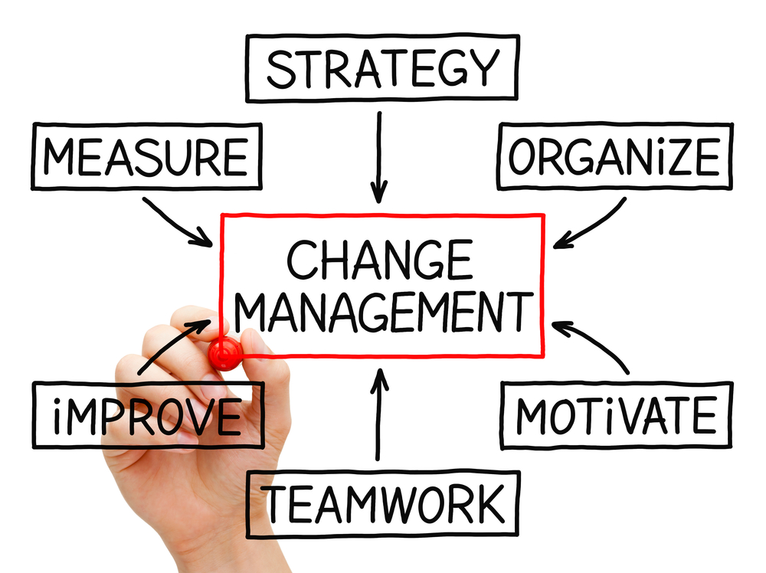
Change Management Summary

Slide 57
Supporting Tools and Components for Implementing Change Management Processes
❶Product or Business Roadmaps
❷Readiness Assessments
❸Training Tutorials and Education Sessions
❹Stakeholder Feedback Forums

Slide 58
Supporting Tools and Components for Implementing Change Management Processes
❺Post Mortem Review
❻Measurements and Analytics
❼Resistance Management
❽Continuous Improvement Plan

Slide 59
8 Essential Steps for an Effective Change Management Process
❶Identify What Will Be Improved
❷Present a Solid Business Case to Stakeholders
❸Plan for the Change
❹Provide Resources and Use Data for Evaluation

Slide 60
8 Essential Steps for an Effective Change Management Process
❺Communication
❻Monitor and Manage Resistance, Dependencies, and Budgeting Risks
❼Celebrate Success
❽Review, Revise and Continuously Improve

Slide 61
System Leadership: A Proposition
‘System leaders’ care about and work for the success of other schools as well as their own. They measure their success in terms of improving student learning and increasing achievement, and strive to both raise the bar and narrow the gap(s). Crucially they are willing to shoulder system leadership roles in the belief that in order to change the larger system you have to engage with it in a meaningful way.’

Slide 62
System leaders share five striking characteristics, they:
measure their success in terms of improving student learning and strive to both raise the bar and narrow the gap(s).
are fundamentally committed to the improvement of teaching and learning.
develop their schools as personal and professional learning communities.
strive for equity and inclusion through acting on context and culture.
understand that in order to change the larger system you have to engage with it in a meaningful way.

Slide 63
System Leadership Roles
A range of emerging roles, including:
  Lead a successful educational improvement partnership
  Executive Headship or partnering another school facing difficulties i.e. run two or more schools (or ‘softer’ partnership)
  Lead in extremely challenging circumstances or become an Academy Principal.
  Civic or Community leadership to broker and shape partnerships across local communities to support welfare and potential.
  Change agent or school leader able to identify best practice and then transfer and refine it to support improvement elsewhere.

Slide 64
So, for Transformation, System Leadership needs to be reflected at three levels:
System leadership at the school level – with, at essence, school Heads becoming almost as concerned about the success of other schools as they are about their own.
System leadership at the local level – with practical principles widely shared and used as a basis for local alignment with specific programmes developed for the most at risk groups.
System leadership at the national level – with social justice, moral purpose and a commitment to the success of every learner providing the focus for transformation and collaboration system wide.

Slide 65
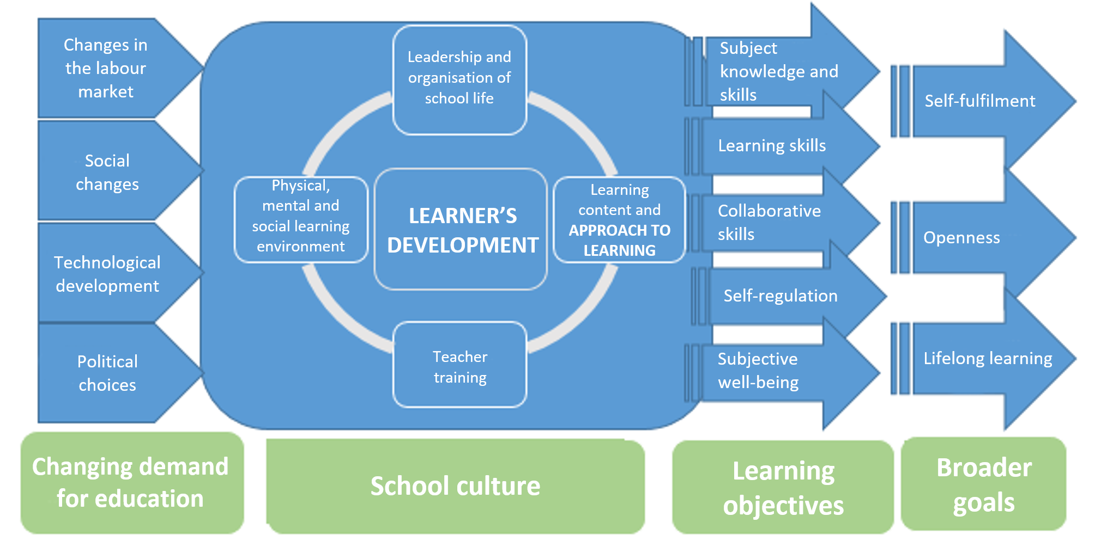
4. Case Study if “Change Management”
School

Slide 66
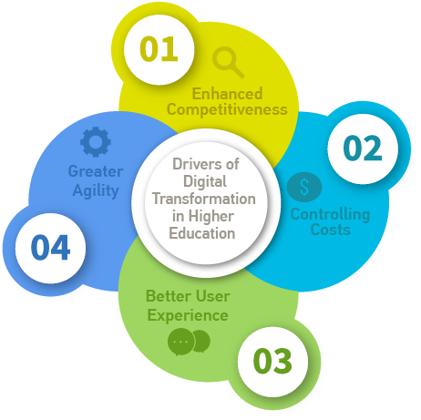
University

Slide 67
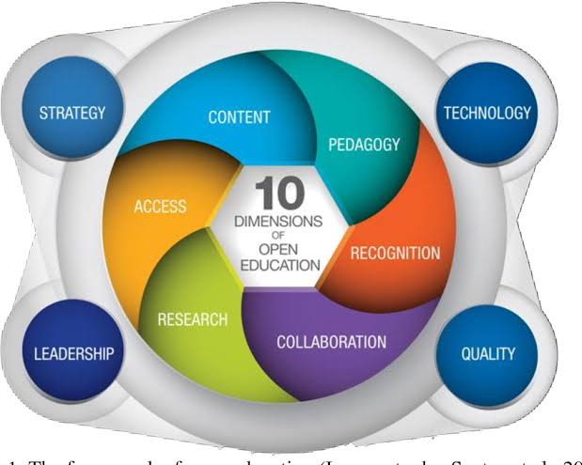
Visionary Leadership for Digital Transformation

Slide 68

How to Design Thinking : 5 Tips
Listening
User empathy
Whole-brain thinking
Collaboration
Experimentation

Slide 69

Current Issues and Trends in Education
https://study.com/academy/lesson/current-issues-and-trends-in-education.html

Slide 70

5.Conclusion and discussion
Are you ready to lead?

Slide 71

Are you ready to change?

Slide 72
Insights for learning
IF YOU HEAR, YOU FORGET.
IF YOU SEE, YOU REMEMBER.
IF YOU DO, YOU LEARN.
“Leaders of Change”

Slide 73



Thank you for your attention

