Slide 1


Integrated Educational Management:
Meaning, Objectives, Scope, Functions, and New Directions for Educational Organizations.
Assist.Prof.Dr.Phongsak Phakamach
RICE, RMUTR, Thailand

Slide 2
Learning Objectives
Understand the meaning of “Integrated Educational Management: IEM”.
Know the concepts and procedures of integrated education management.
Know how to use it as a strategy for effective educational management and development.
Able to apply knowledge to become a quality educational innovator in the future.
1
2
3
4

Slide 3
Presentation Topics
1
Meaning
2
Nature
3
Objectives
4
Scope & Functions
5
Conclusion
3

Slide 4
Meaning
Educational Administration is regarded as the process of integrating the appropriate human and material resources that are made available and made effective for achieving the purposes of a programme of an educational institution (Hoy & Miskel, 2012)
Educational administration or educational management is a discipline within the study of education that examines the administrative theory and practice of education in general and educational institutions and educators in particular activities. The field ideally distinguishes itself from administration and management through its adherence to guiding principles of educational philosophy. (Wikipedia, 2020)

Slide 5
Nature of Educational Management:
1. Educational management doesn’t refer to any single process rather different processes or aspects constitute administration. These are planning, organizing, directing, Coordinating and evaluation
2. Educational management is a non-profit making task.
3. Educational management is primarily a social enterprise as it is more concerned with human resources than with material resources.
4. Educational management is more an art than a science. The reason is that human relationship prevailed here can’t be maintained by any set of formulae.
5. Educational management is similar to general administration in many ways, but it is also dissimilar to general administration in many more ways.
6. Educational management is a complex affair.

Slide 6
Nature of Integrated Educational Management:

Slide 7

Nature of Integrated Educational management:
Execution: The foundation of an institution list in Execution. Execution points out what resources are needed and the procurement sources.
These resources may include material resources, like the building, furniture, library, and laboratories; non-material resources, like personnel; other stakeholders, like students and parents; and abstract resources, such as vision, mission statement, ideology and values. The executive administrative body systematically plans, arranges, and uses these resources to achieve its goals.

Slide 8

Nature of Integrated Educational Management:
Direction: The vision and mission statement of the institution serves to direct the institution in its quest to achieve its goals. Integrated educational management ensures that the directives are upheld during curriculum construction and academic planning.

Slide 9

Nature of Integrated Educational Management:
Supervision: Supervision ensures that the plans are being executed according to the directives. Supervision thus enhances the quality of work done and the ensuing accomplishments.

Slide 10

Nature of Integrated Educational Management:
Advice/Stimulation: Integrated educational management analyses the work and manner in which work is done. It weighs the pros and cons and then plans to help remove the weaknesses and accomplish the set goals.

Slide 11

Nature of Integrated Educational Management:
Exploration: Integrated educational management initiates research and adopts and adapts to new methods and techniques to enhance learning opportunities.

Slide 12

Nature of Integrated Educational Management:
Leading/Assistance: Integrated educational management not only lays down the directives but also provides the requisite support system to enable the efficient and effective fruition of the set objectives or goals.

Slide 13
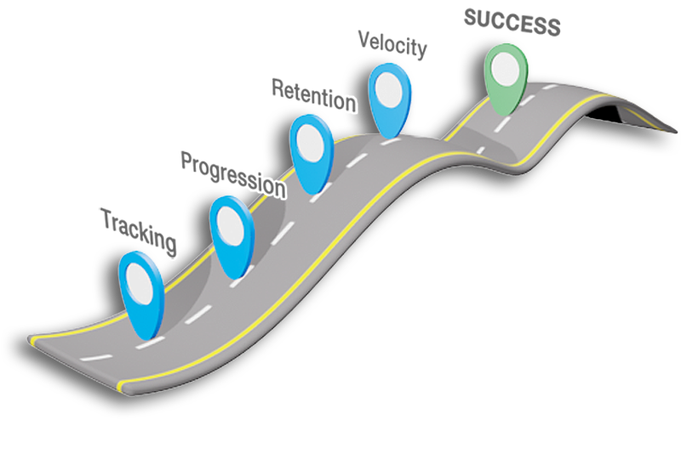
The goal of education administrators or executives
The goal of education administrators or executives is to smooth the institute’s overall process and make decisions that facilitate successful student learning. The administrator identifies and articulates a institute’s mission and goals and makes them happen by implementing programmes, delegating tasks and allocating resources. The effective leader is visionary and is collaborative, and passionate about the field of integrated educational management.

Slide 14
Objectives of Integrated Educational Management:
1. To provide proper education to students.
2. To Ensure Adequate Utilization of all resources.
14

Slide 15
Objectives of Integrated Educational Management:
3. To Ensure professional ethics and professional development among teachers.
4. To organize educational programmes for acquainting students.
15

Slide 16
Objectives of Integrated Educational Management:
5. To mobilize the community.
6. To organize co-curricular activities effectively for developing talents of students .

Slide 17
Objectives of Integrated Educational Management:
7. To get the work done.
8. To prepare students for taking their places in various vocations and avenues of life.
17

Slide 18
Objectives of Integrated Educational Management:
9. To train the students in developing scientific attitude and objective outlook among them towards all aspects and activities of life.
10. To ensure qualitative improvement of education.

Slide 19
Scope and Function of Integrated Educational Management
The integrated educational management encompasses all the levels of education in its jurisdiction.
1
2
3
4
5
Integrated educational management takes place at various levels.
It covers all forms of education.
Integrated educational management covers the following aspects relating to management in its jurisdiction.
It includes all types and strategies of management that encompasses the following.

Slide 20
1. The integrated educational management encompasses all the levels of education in its jurisdiction:
a. Pre-primary or pre-school Education
b. Elementary or primary Education.
c. Secondary Education.
d. Higher Secondary or Post secondary Education
e. Higher or tertiary Education.
It is educational management that determines what should be the nature and system of administration for all the above levels of education.
20

Slide 21
2. It covers all forms of education such as:
a. Formal Education
b. Non-formal Education and Adult Education
c. General Education
d. Vocational Education
e. Special Education
f. Teacher Education
g. Integrated Education and
h. Technical and professional Education including Engineering, Medical, MBA, and Computer Education
Here the educational management sets the systems of administration in accordance to the objectives and nature of all the levels of education.

Slide 22
3. It includes all types and strategies of management that encompasses the following:
a. Democratic Management
b. Autocratic Management
c. Nominal Management
d. Real Management

Slide 23
4. Integrated educational management covers the following aspects relating to management in its jurisdiction:
a. Planning
b. Organizing
c. Directing
d. Coordinating
e. Supervising
f. Controlling and
g. Evaluating

Slide 24
5. Integrated educational management takes place at various levels such as:
a. Central level
b. State level
c. District level
d. Block level
e. Institutional level
Out of these above levels, educational management has its ground reality and importance at the institutional level. Because it is the practical ground to test the significance of educational management in practice (Scheerens, 2013).

Slide 25
The following activities and programmes come under the scope of integrated educational management at the institutional level:
  a. Deciding the purposes of the institution or school.
  b. Planning for academic or curricular and co-curricular activities.
  c. Preparing the time table and the time schedules for various activities.
  d. Assigning duties and responsibilities to the staff members.
  e. Organizing curricular and co-curricular programmes.
  f. Directing and motivating the staff of the institution.
  g. Coordinating by efforts of people to achieve the purpose.
  h. Exercising control over the staff.
  i. Conducting periodical reviews about the progress, achievements and failures of the institution.

Slide 26

The following activities and programmes come under the scope of integrated educational management at the institutional level:
  j. Taking measures for staff development.
  k. Maintaining order and discipline.
  l. Management of materials.
  m. Management of finance.
  n. Maintaining records and registers up to date.
  o. Maintaining human relationships.
  p. Supervision of the work of teachers and other employees.
  q. Giving feedback to the teachers performing well and taking remedial measures for teachers not performing well.

Slide 27
Basic Functions of Integrated Educational Management:
The prime concern of management of any programme is proper accomplishment of the pre-fixed purposes and goals. This becomes possible through adequate utilization of both human and material resources with the purpose of bringing qualitative improvement of the programme. For this there is the necessity of different aspects of management which are accepted as the functions of management. In order to simplify it we can be said here that proper management of a programme needs various aspects that are regarded as the functions of management.
a. Planning
b. Organizing
c. Directing
d. Coordinating
e. Supervising
f. Controlling
g. Evaluating
27

Slide 28
Top 8 Functions of Integrated Educational Management:
Brief outlines of the eight functions of integrated educational management in general perspective are discussed.
1
Development of Human Personality:
2
Provide and Ensure Proper Utilisation of Human and Material Resources:
3
To Make the Learner Active in the Educational Programme:
4
Provide Adequate Physical Facilities
5
To Adhere the Legal Provision of the Programme Strictly:
6
Decision Making in Respect of Finance:
7
To Keep and Maintain Co-Operation with the Digital Society:
8
To Deal with the Problem of Curriculum Construction:

Slide 29
Conclusion:
Educational management is a process that includes the combined operation through which a country is maintained in good working conditions. It is a process of utilizing appropriate material in such a way as to promote effectively the development of human qualities. It includes all those techniques and procedures employed in operating the educational organization in accordance with established policies. Here the totality of resources are made available and made effective for accomplishing the purpose of an enterprise. Educational management includes functions like planning, organizing, financing, directing, supervising, inspecting and evaluation. It is also concerned with elements like setting up of goals of education, review, feedback and innovation.

Slide 30
Conclusion:
Education administrators or executive are employed in universities and colleges, schools, preschools, and daycare centres. They manage routine activities and provide instructional leadership at these institutions. They may also be employed at businesses, museums, correctional facilities, and community service organizations to direct their educational programs. The goal of the educational administrator is to keep the educational institution’s overall process flowing smoothly, making decisions that facilitate successful student learning. The administrator identifies and articulates a educational institution’s mission and goals and makes them happen by implementing programs, delegating tasks and allocating resources. The effective leader is visionary, collaborative and passionate about the field of integrated educational management.

Slide 31


THANK YOU

