Slide 1
Strategic Adaptive Leadership Development of Administrators of Eastern Vocational Education Institutions toward Excellence: A Focus on Thailand’s Vocational Education Management 4.0 Policy
RMUTR, Thailand

Slide 2
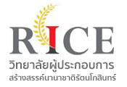
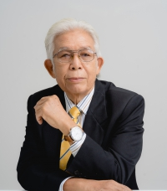
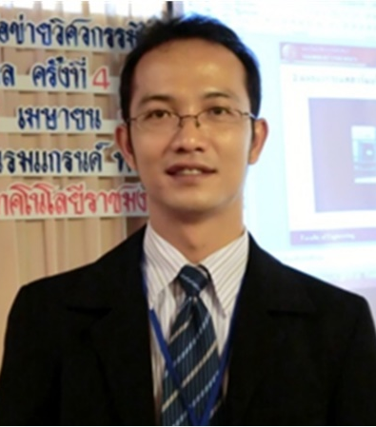
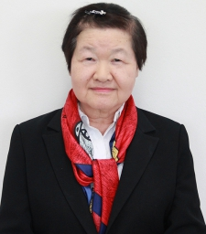
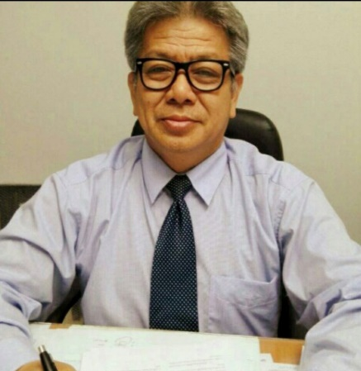
Staff Researchers
Dr.Prapatpong Senarith
Assist.Prof.Dr.Phongsak
Phakamach
Assoc.Prof.Dr.Ruja Pholsward
Dr.Darunee Panjarattanakorn
Assist.Prof.Dr.Samrerng Onsampant

Slide 3
Presentation Topics
1
Introduction
2
Research Objectives
3
Research Conceptual Framework
4
Research Methodology
3
5
Results

Slide 4
Presentation Topics
6
Conclusion and Discussion
7
Suggestions
4

Slide 5
Introduction
The mission of Thailand’s Vocational Education (VE) institutes is to provide vocational training for students with the competencies needed in the 21 Century.
Leaders need to change the direction of thinking and management to keep pace with inevitable changes, where a complete strategic plan covering the organization’s operations is required for organizational restructuring and implementation.

Slide 6
Introduction
Digital education, requires a specific model of management to maintain the quality of education and minimize its impact on teaching and learning. Strategic adaptive leadership of VE institutes is for administrators to strive for “excellence”.
The research study: identify the characteristics and elements in order to be able to provide a guideline for strategic adaptive leadership development for Eastern VE institutions toward excellence in accordance with Thailand’s VE Management 4.0 Policy.

Slide 7
Research Objectives
First, To identify the characteristics of strategic adaptive leadership of administrators of Eastern vocational education institutions toward excellence in accordance with Thailand’s Vocational Education Management 4.0 Policy.
Second, To analyze the elements of strategic adaptive leadership of administrators of Eastern vocational education institutions toward excellence in accordance with Thailand’s Vocational Education Management 4.0 Policy.
Third, To propose a guideline for the development of strategic adaptive leadership of administrators of Eastern vocational education institutions toward excellence in accordance with Thailand’s Vocational Education Management 4.0 Policy.

Slide 8
Research Conceptual Framework
Characteristics of Strategic Adaptive Leadership
1) Personal characteristics
2) Work development toward excellence
3) Human resource development and adaptation
Thailand’s Vocational Education Management Policy 4.0
The elements of strategic adaptive leadership of administrators of Eastern vocational education institutions towards excellence in accordance with Thailand’s Vocational Education Management Policy 4.0.
The context of VE institutions in the eastern part of Thailand
1) Ban Khai Technical College
2) Rayong Technical College
3) Chanthaburi Technical College
4) Chonburi Technical College
5) Map Ta Phut Technical College
6) Trat Technical College
7) Sattahip Technical College
8) Chonburi Vocational College
9) Science-Based Technology Vocational College (Chonburi)
10) Office of Strategic Development and Vocational Cooperation
Guidelines for Strategic Adaptive Leadership Development of Administrators of Eastern Vocational Education Institutions towards Excellence in Accordance with Thailand’s Vocational Education Management Policy 4.0
8

Slide 9
Research Methodology
☑Population and Samples
The population: teachers and educational personnel from 9 institutions in 4 eastern provinces--Chonburi, Rayong, Chanthaburi and Trat.
The sample size: determined by Taro Yamane’s formula for calculating the number of participants. Quantitative, used the proportional method and the simple random sampling method to obtain a sample of 622 people. Qualitative, approached 15 experts in VE administration by convenience sampling, according to the specified qualifications.

Slide 10
Research Methodology
☑Research Instruments
The quantitative tool: five-level rating scale questionnaire based on Likert’s methodology.
The qualitative tool: semi-structure interview guide and focus group discussion guide.

Slide 11
Research Methodology
☑Data Analysis and Synthesis
Quantitative data: responses to the questionnaire were analyzed by SPSS Programs for percentage, mean, and standard deviation.
Qualitative data: analyzed by content with classified specifications.

Slide 12
Research Methodology
☑Research Procedure
Step 1: Study of the characteristics: (1) documentary analysis, (2) empirical data from 15 successful administrators’ in-depth interviews.
Step 2: Analysis of the elements: create a questionnaire from results in step 1 and submitted the participants’ responses for Exploratory Factor Analysis (EFA).
Step 3: Data Test: Data triangulation techniques was performed to determine whether they were similar, different or consistent to conclude the characteristics and elements.
Step 4: Confirmation of a guidelines draft:
Using connoisseurship approach and presentation the final guideline.

Slide 13
Results
1. Characteristics of Strategic Adaptive Leadership
(1) Personal characteristics: proactive, high expectations for job achievement and commitment to completion, flexible adaptation to the situation with a broad vision, creativity, action with dignity, and a democratic viewpoint.
(2) Strategic adaptive leadership development: develop clear systems and structures, supervise operations accordingly, promote teamwork by involving stakeholders in thinking and doing, hold regularly meetings with the staff for creative academic work, conduct research, and create innovations in VE for excellence.
(3) Adaptive leaders aim: preparing personnel with knowledge and ability to adjust teaching and learning through various methods.

Slide 14
Results
2. Elements of Strategic Adaptive Leadership
Elements | Element names | Number of items | Eigen Value | Percentage of variance
1. | Charisma Leadership and Inspirational Motivation | 16 | 16.767 | 22.446
2. | Individualized Consideration and Working as a Team | 15 | 15.532 | 17.009
3. | Adaptive Strategy and Challenges | 14 | 13.245 | 11.212
4. | Creating an Innovative Educational Organization | 13 | 11.198 | 9.004
5. | Building a Positive Corporate Culture | 12 | 9.502 | 7.372
6. | Creating a Creative Corporate Atmosphere and Shared Values) | 11 | 7.014 | 6.415
7. | Innovative Leadership Maturity | 10 | 5.761 | 5.002
8. | Mindset Modification and Intellectual Stimulation | 9 | 4.102 | 3.037
9. | Digital Skills Development toward Excellence | 8 | 3.729 | 2.202
Total |  |  |  | 83.69

Slide 15
Results
3. Guideline to Strategic Adaptive Leadership Development
(1) Five ways to develop: (1) exemplary practice by case studies, (2) teaching and training, (3) meditation, (4) learning exchange via the use of media, technology and innovation in modern education, and (5) model education and experiential learning.
(2) The development process: PIER process consisting of (i) Planning (P), (ii) Implement (I), (iii) Evaluation (E), and (iv) Reflection (R).
(3) Success factors: Adaptive leadership development courses, support for adaptive leadership development resources, continuous and systematic monitoring and evaluation, followed by national and international leadership development networks.

Slide 16
Conclusion and Discussion
1. Characteristics of Strategic Adaptive Leadership
1
Personal characteristics.
2
Strategic adaptive leadership development.
3
Adaptive leaders aim.
16

Slide 17
Conclusion and Discussion
2. Elements of Strategic Adaptive Leadership
Charisma Leadership
and Inspirational Motivation
Individualized Consideration
and Working as a Team
Adaptive Strategy and Challenges
The elements of strategic adaptive leadership of administrators of Eastern vocational education institutions towards excellence in accordance with Thailand’s Vocational Education Management Policy 4.0.
Creating an Innovative
Educational Organization
Building a Positive Corporate Culture
Creating a Creative Corporate Atmosphere
and Shared Values
Innovative Leadership Maturity
Mindset Modification and
Intellectual Stimulation
17
Digital Skills Development
Toward Excellence

Slide 18
Conclusion and Discussion
3. Guideline to Strategic Adaptive Leadership Development
1
Five ways to develop: (1) exemplary practice by case studies, (2) teaching and training, (3) meditation, (4) learning exchange via the use of media, technology and innovation in modern education, and (5) model education and experiential learning.
2
The PIER process: (1) Planning (P), (2) Implement (I), (3) Evaluation (E) and (4) Reflection (R) for VE institutions to develop the competencies in VE administrators.
18

Slide 19
Suggestions
1. Suggestions for applying the findings:
The behaviors for development 2 categories:
(i) academic and research-oriented behaviors, and (ii) functional competencies,
VE institution decision-makers need to value their faculty and staff talent groups and set a clear career path for their competencies development in keeping pace with the rapid transformation of education.

Slide 20
Suggestions
2. Suggestions for future research:
The future research on adaptive leadership may want to explore:
(i) participatory action research,
(ii) educational innovations expected of administrators, and
(iii) in-depth research in curriculum design and adjustment to catch up with the disruptive effects for sustainable development of the present time and beyond.

Slide 21
THANK YOU

