Slide 1

ChatGPT
Notes:
Let's start with ChatGPT first.
เรามาเริ่มกันที่ ChatGPT ก่อน

Slide 2

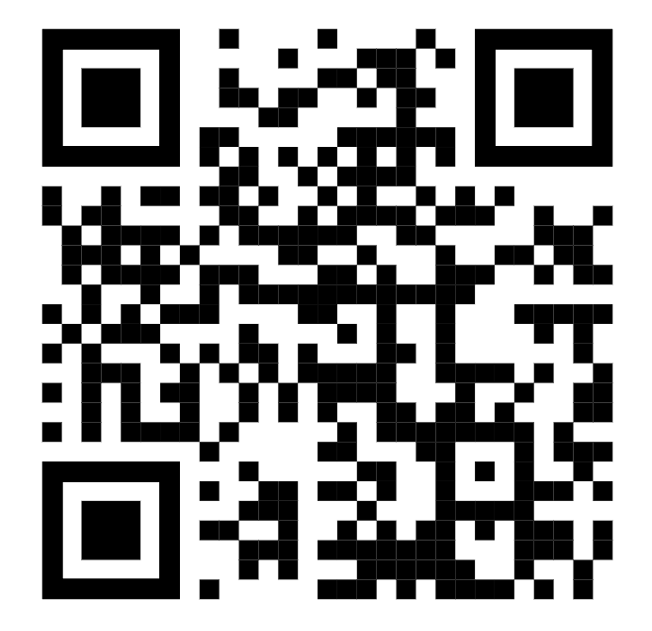

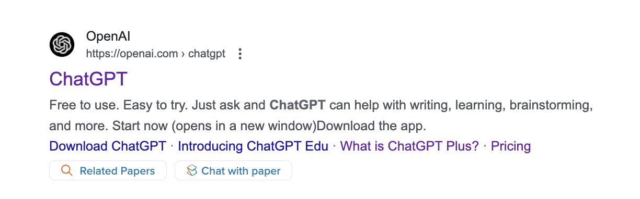
ChatGPT
https://openai.com/chatgpt/

Slide 3

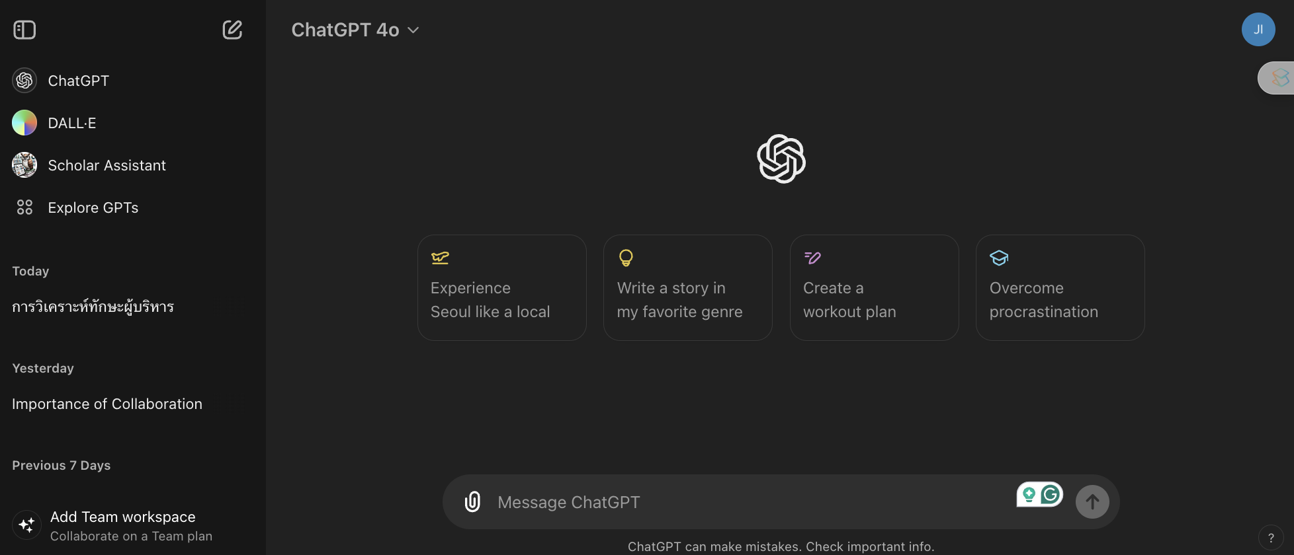

ChatGPT

Slide 4

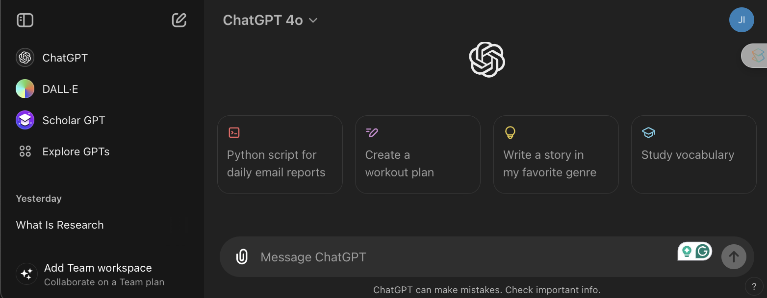



How do we write a command to instruct
ChatGPT to work?
Prompt mean a message or command sent to an artificial intelligence model to encourage AI to generate a response or perform a given action.
An example of a Prompt
could be a question, a work
order, or a description that requires the AI to work on.
Example a prompt:
Please explain the concept of Einstein's theory of relativity.
Please write an email requesting leave in Thai.
Explain the meaning of the word prompt in ChatGPT.

Slide 5

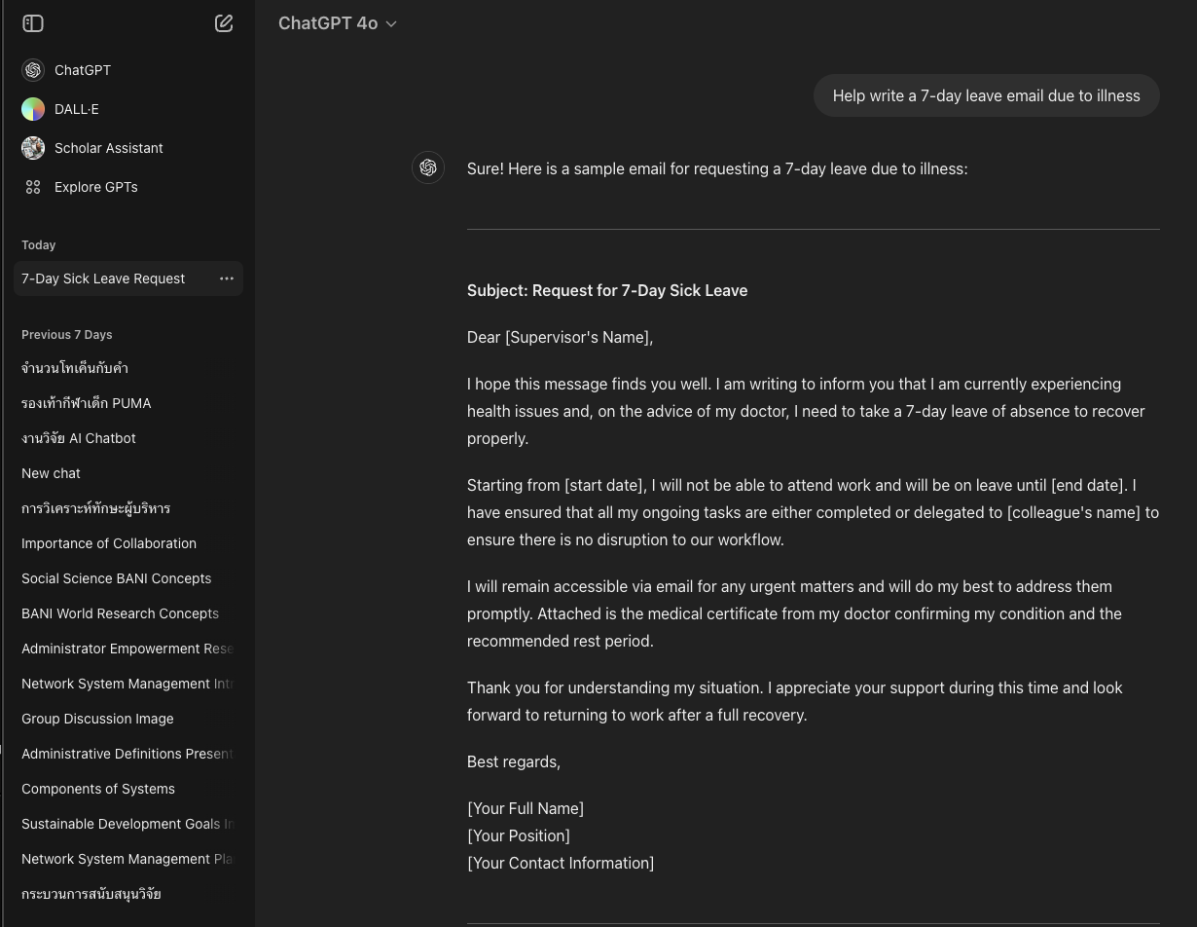
ChatGPT
Answer

Slide 6
ChatGPT
New chat

Slide 7
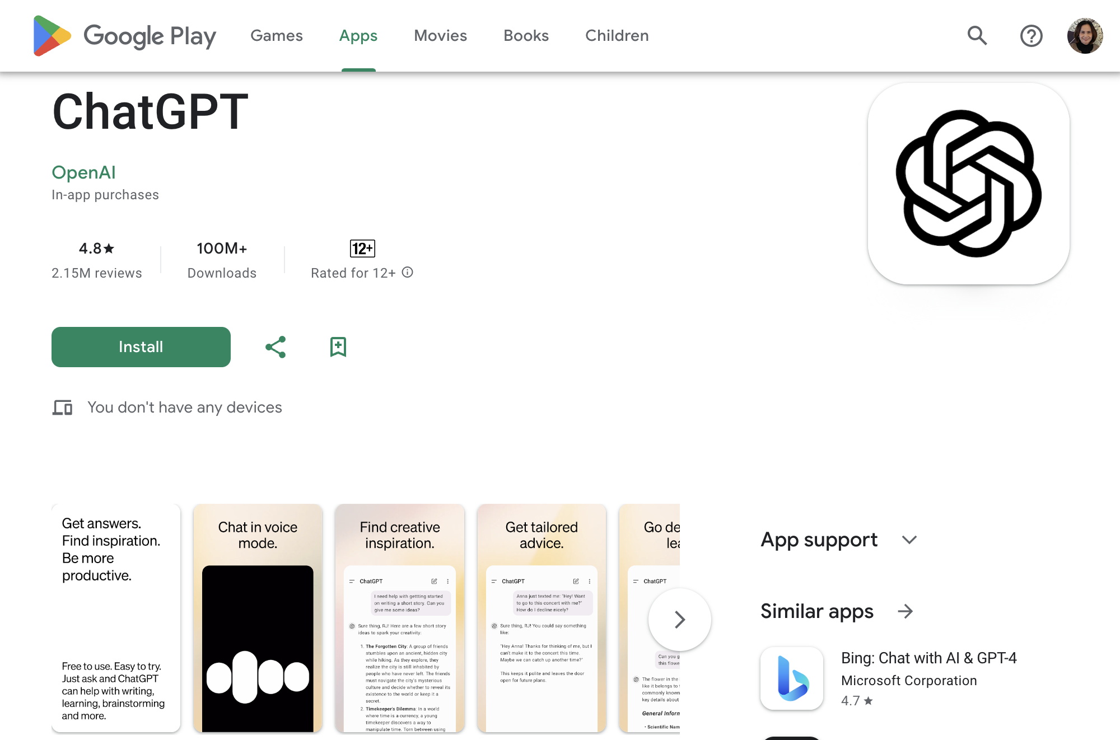

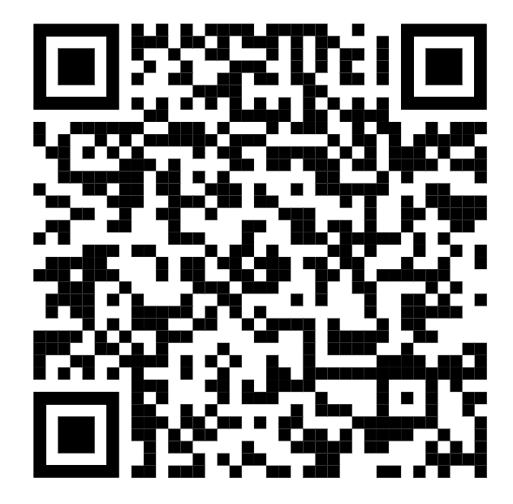
https://play.google.com/store/apps/details?id=com.openai.chatgpt
ChatGPT
Android

Slide 8

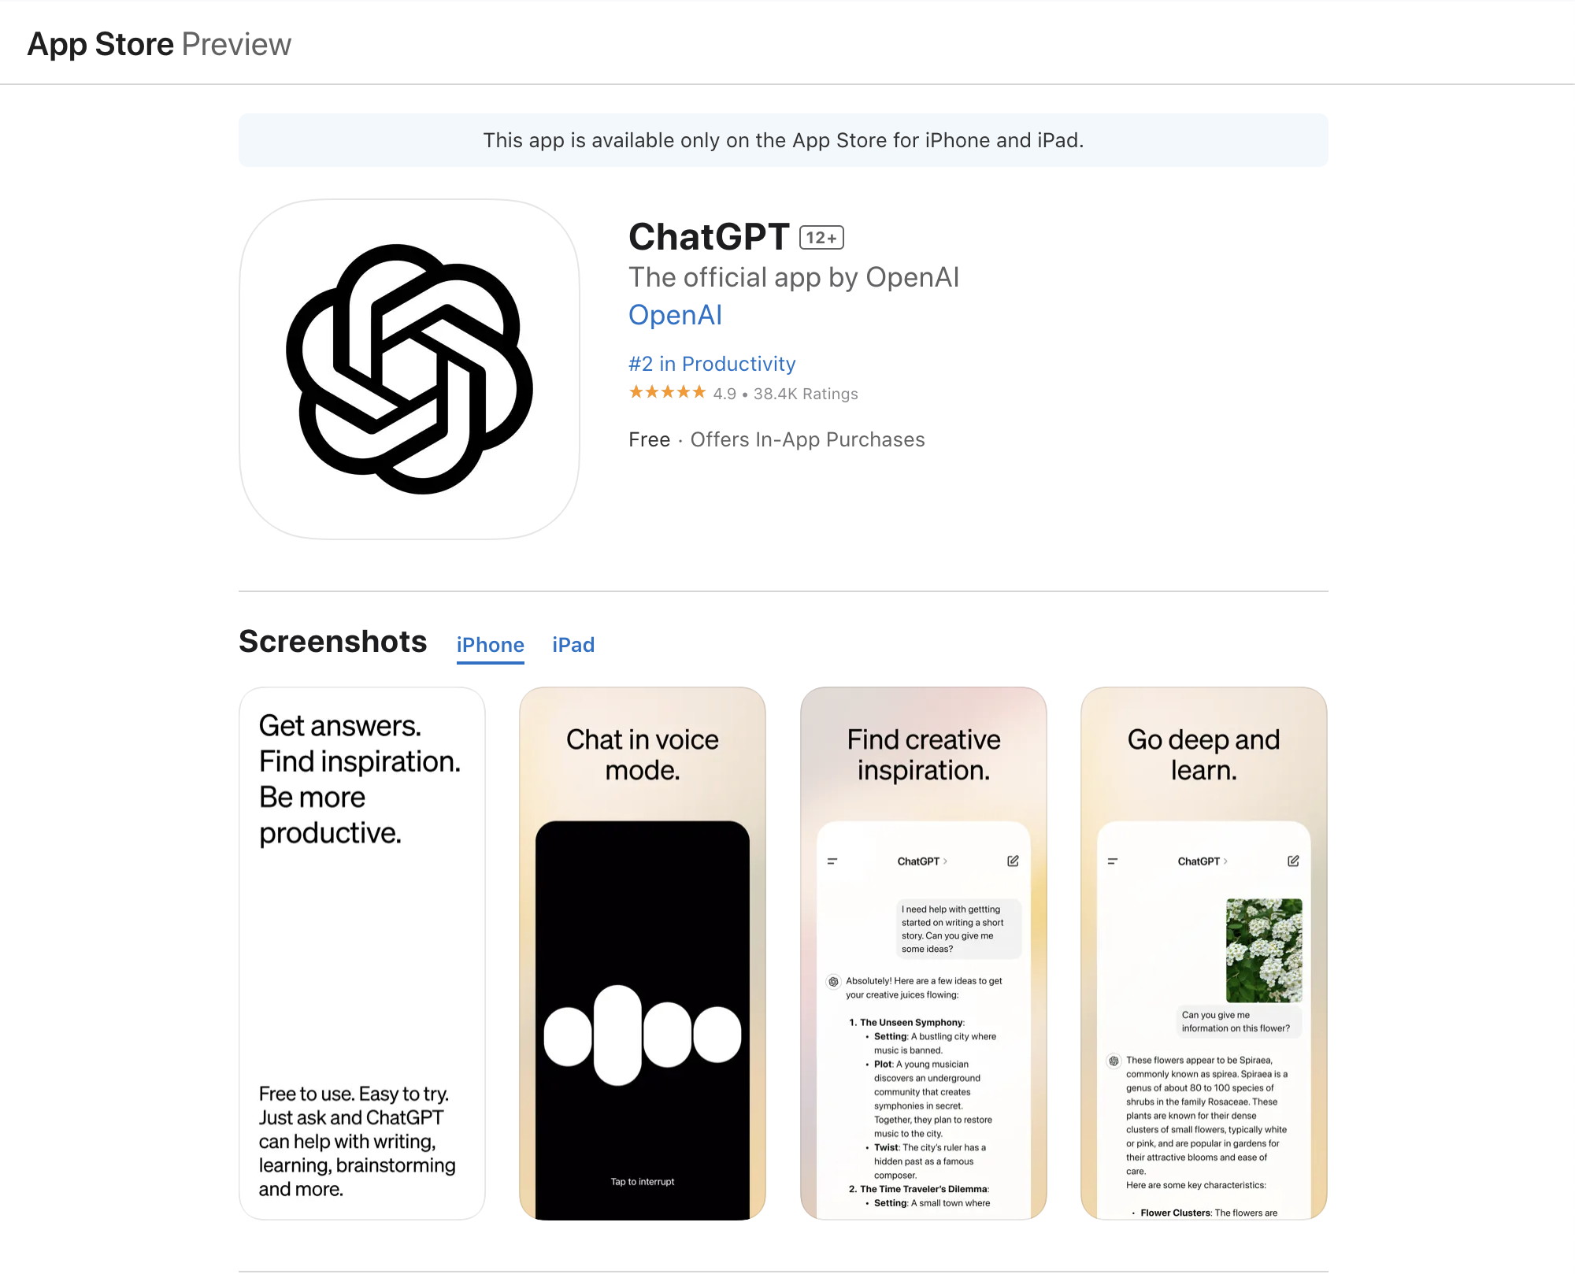

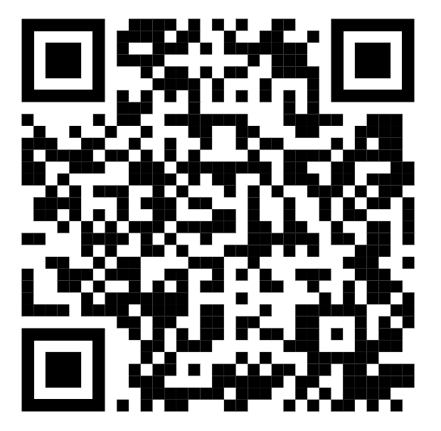
https://apps.apple.com/th/app/chatept/id6448311069
ChatGPT
iOS

Slide 9


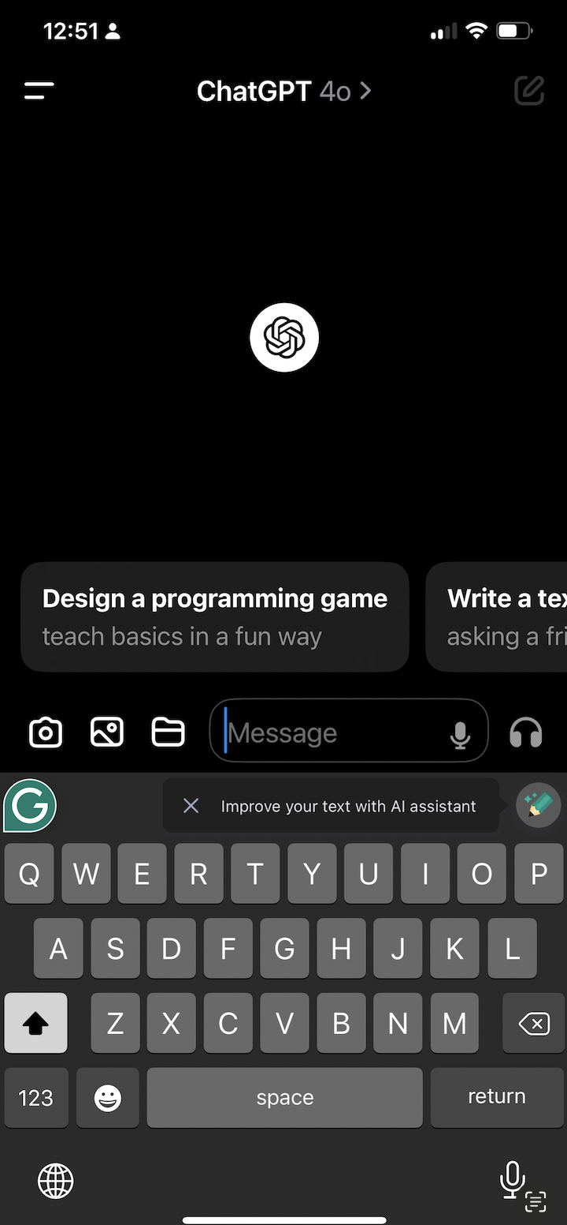
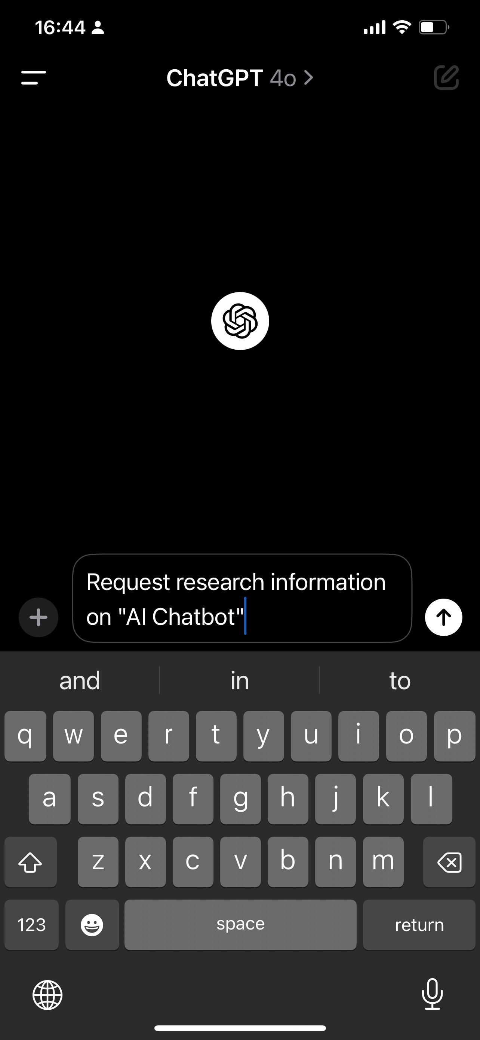
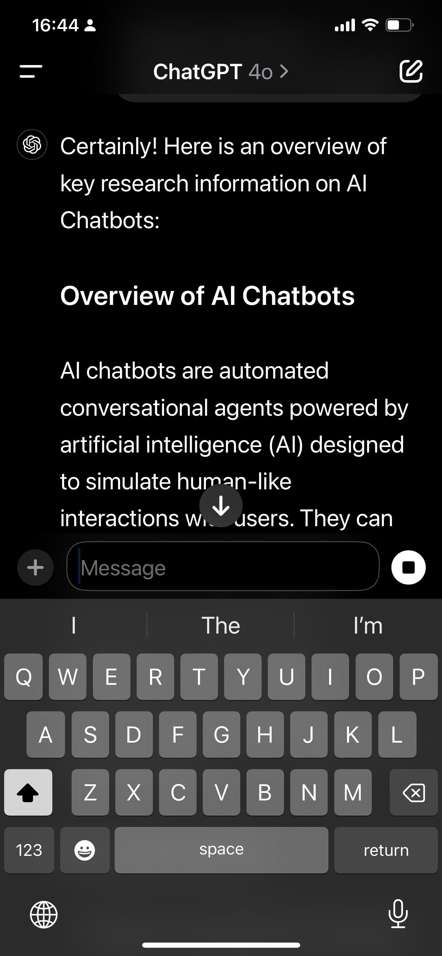
ChatGPT
App

Slide 10
Examples:
Essential skills
for the next 1-3 years
Choosing appropriate words: Using clear and specific language to make it easier for the AI to understand what is required.
01
Prompt Engineering
Prompt engineering involves the process of designing and customizing prompts so that AI models can effectively and accurately produce the desired results. This process includes selecting the right words, structuring the text, and experimenting with multiple prompts to find the best way to communicate
with AI models.
Structuring the text: By organizing words and sentences logically and clearly, you can maintain control and ensure the AI understands your requirements.
02
Using examples: Provide additional examples to help the AI understand the context and generate suitable responses.
03

Slide 11
Hallucination & Confabulation
Hallucination
Confabulation
Hallucination, in the context of artificial intelligence (AI), refers to the AI model generating information that is not consistent with reality or based on correct information.
This means that the AI might create the wrong answers or content that does not exist. It's crucial to understand these concepts as it empowers you to identify and mitigate instances of AI hallucination, ensuring the accuracy and reliability of AI systems, such as:
Confabulation: In the context of artificial intelligence or machine learning models, confabulation means that the model creates data or answers that seem to be reliable. But in reality, it is not correct or not based on real data; that is, the AI model may "compoint" without the intention to fill the gap of information or questions received, such as:
Providing incorrect answers to questions, generating information that does not match reality.
Creating non-existent content, such as stories or details
that have never actually happened, which can mislead users.
Distorted translation of text from one language to another.
Creating false data: AI may generate answers that seem to be accurate and reliable but are actually inconsistent with existing data.
Displaying Untrue Information: AI may create non-existent content or fill incomplete information with crafted details.

Slide 12
Awareness
When using this AI Chatbot, it's essential that experts verify
the responses, or we take on the responsibility of verifying
the responses ourselves. This ensures that we maintain
control and accuracy in our interactions.
The main reason for those who are not experts is that
when using AI Chatbots, a teacher, consultant, or expert must give advice. Because these AI Chatbots are not smart enough.
They still have hallucinations and confabulation.

Slide 13
Basic Prompt Template (1)
[Instruction] [Context/Information] [Output Format]
1. Instruction
1.
Instruction
Write any order, such as writing email, announcement, public relations, abstract, introduction, and summary.
2.
Context
Information
Basic Prompt
Should enter the relevant knowledge and more details about how you want, What is the information that you want to use?
2. Context/Information
3. Output Format
3.
Output Format
Can set the output, such as 100 words, one/ twoparagraph length, put in the answer table for children. These will make the results come out differently.

Slide 14
ChatGPT Plus

Slide 15


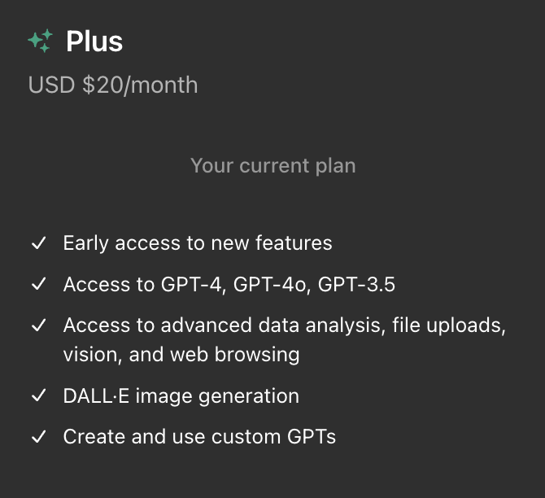

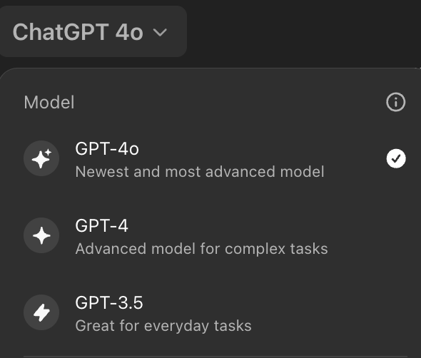
ChatGPT Plus

Slide 16

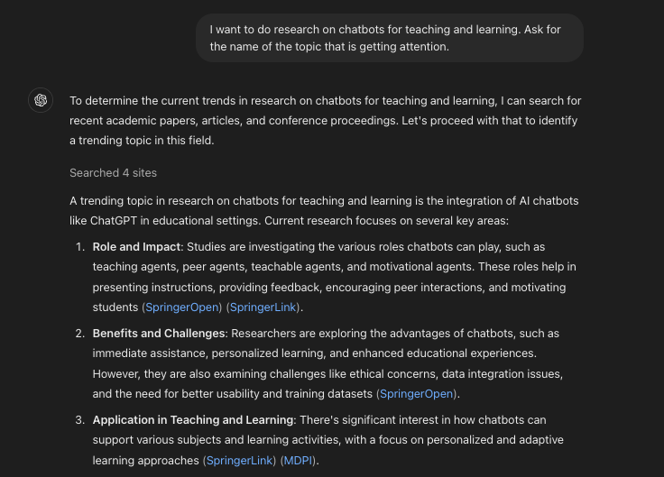
Research Topic [ChatGPT 4o]

Slide 17

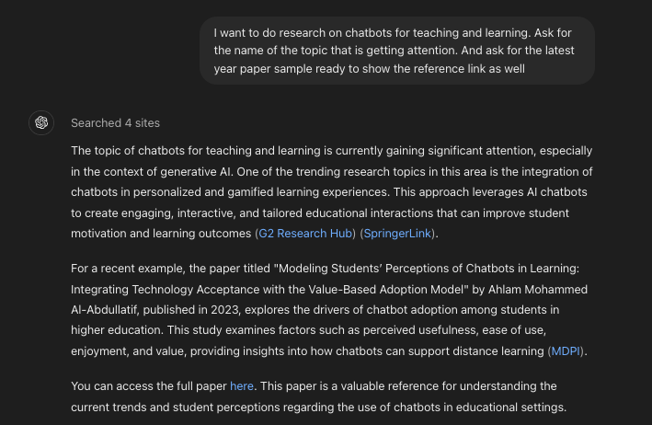
Research Topic + Related Research [ChatGPT 4o]

Slide 18
Introduction

Slide 19



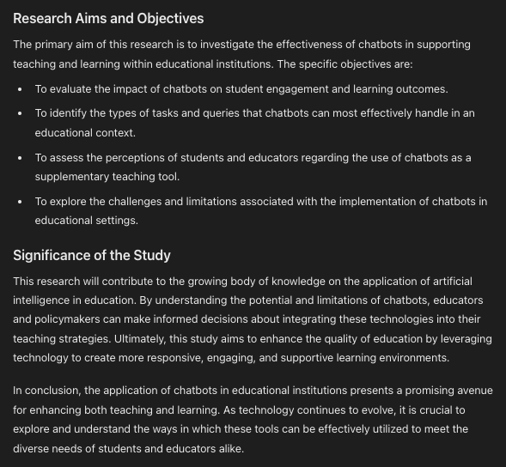
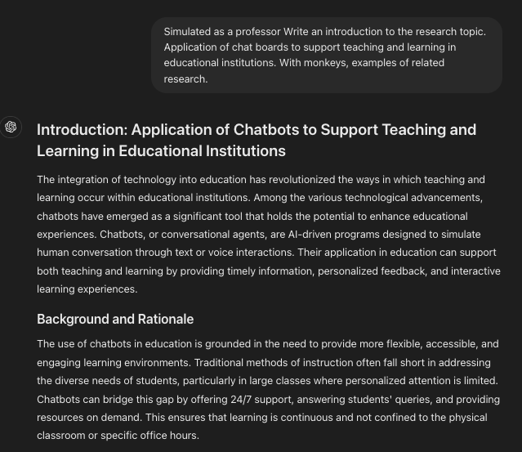
Introduction
4o
Notes:
Try ChatGPT to write an introduction.
'I will try to use the prompt that ''Simulated as a professor Write an introduction to the research topic. Application of chat boards to support teaching and learning in educational institutions. With monkeys, examples of related research.’''
About writing an introduction if we give enough details in context.
I think it's written an introduction to read about it.
We may polish a little more. Or will expand Can be arranged in the form of writing the introduction that we want.
Or if you think that a single ChatGPT may not be suitable.

Slide 20
Related Research
Notes:
ต่อมาดูเรื่องงานวิจัยที่เกี่ยวข้องกันค่ะ
let's look at the related research. (Literature review)

Slide 21


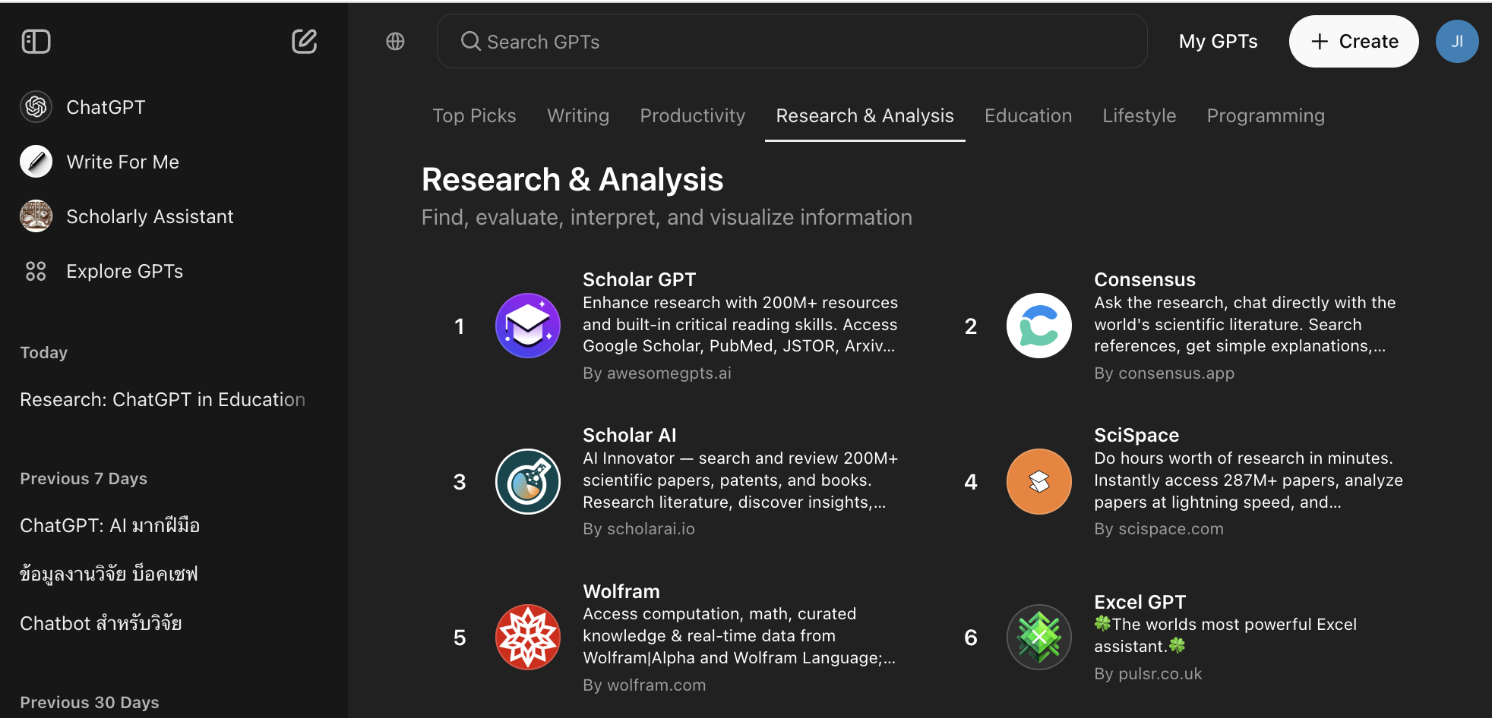
ChatGPT Plus [ Scholar GPT]
Notes:
Finding a reference is a necessary thing that we have to do first. Before we find the research topic Or even write an introduction.
We need to use a real-time tool to be more suitable. Of course, ChatGPT is not suitable for requesting reference.
But ChatGPT Plus will have Explore GPTs as an OpenAI program that allows users to access and take advantage of language models conveniently and diversely.
It allows users to understand and use the GPT (Generative Pre-trained Transformer) model to generate high-quality text or data.
Click on Explore GPTs and go to the Research & Analysis section and select Scholar GPT.
Scholar GPT has access to over 200 million Resources from Google Scholar and more.

Slide 22


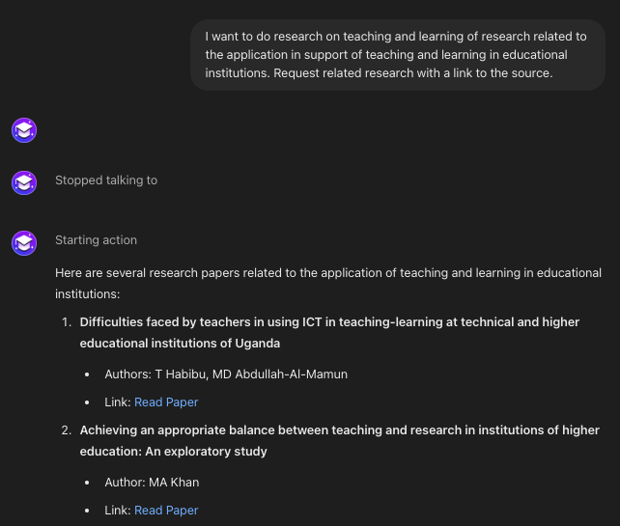
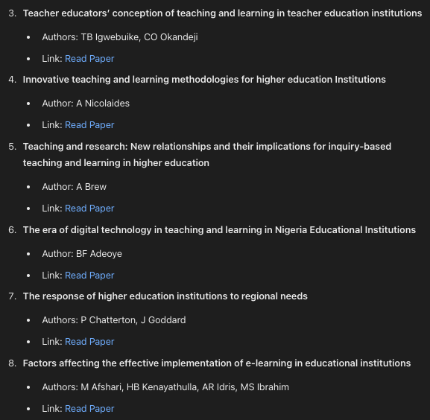
ChatGPT Plus [ Scholar GPT]
Notes:
Try using Scholar GPT to write a prompt. I want to do research on ChatGPT for teaching and learning, specifically, research related to the application of ChatGPT to support teaching and learning in educational institutions. Request related research with source links.
When it comes to intelligence, Scholar GPT surpasses Google Scholar. This tool not only finds information but also provides comprehensive summaries. Scholar GPT will find the paper with a reference and will tell us about this reference. Discuss something briefly to help us understand it first, which should save more time.

Slide 23
Research Design

Slide 24

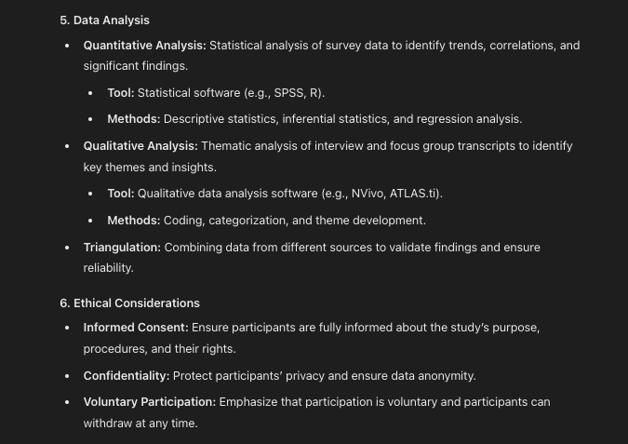

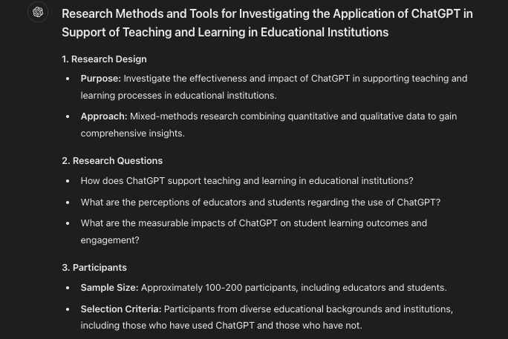
Research Design
4o
Notes:
Try ChatGPT 4o to help design research methods.
Let's write a prompt on the topic of application research, focusing on ChatGPT's support for teaching and learning in educational institutions and designing research methods and tools.
As a result, he told the purpose, the design method, how to select the sample, how to collect the sample, the research tools, and data analysis.
Although it may seem broad for those new to research, it can serve as a basic guideline before seeking further advice from an advisor.

Slide 25
Create Questionnaire

Slide 26

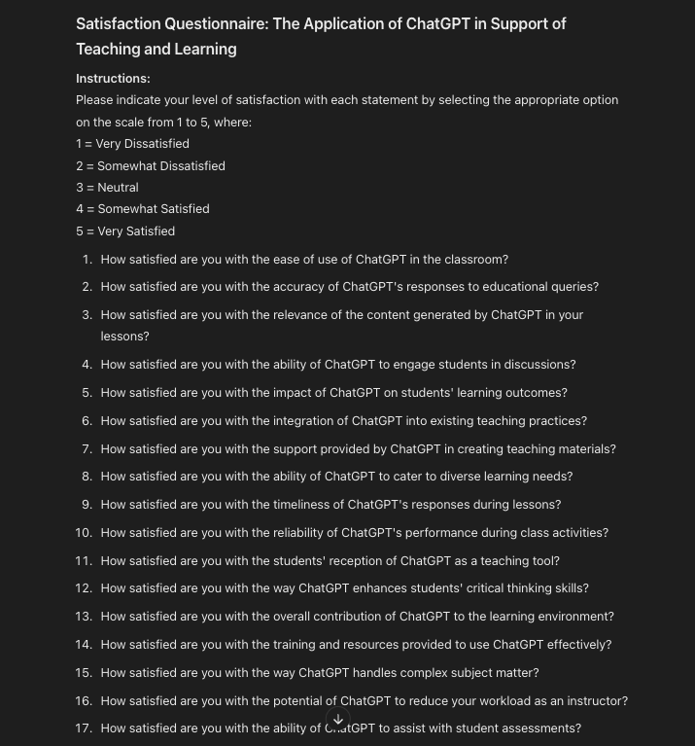

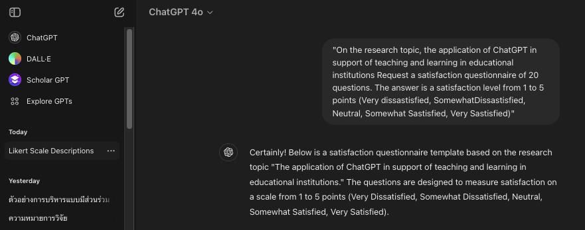

Create Questionnaire
4o
"On the research topic, the application of ChatGPT in support of teaching and learning in educational institutions Request a satisfaction questionnaire of 20 questions. The answer is a satisfaction level from 1 to 5 points (Very dissastisfied, SomewhatDissastisfied, Neutral, Somewhat Sastisfied, Very Sastisfied)"
Notes:
For example, write a prompt that
"On the research topic, the application of ChatGPT in support of teaching and learning in educational institutions Request a satisfaction questionnaire of 20 questions. The answer is a satisfaction level from 1 to 5 points (Very dissastisfied, SomewhatDissastisfied, Neutral, Somewhat Sastisfied, Very Sastisfied)"
ChatGPT can also give results.
(Read…)
Then we come to choose according to our needs. At least he Generage came first.
Save time to create 1 set of questionnaires.

Slide 27
Data Analysis

Slide 28


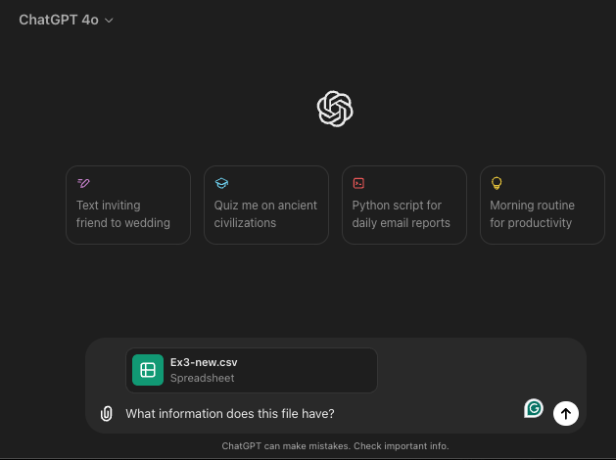
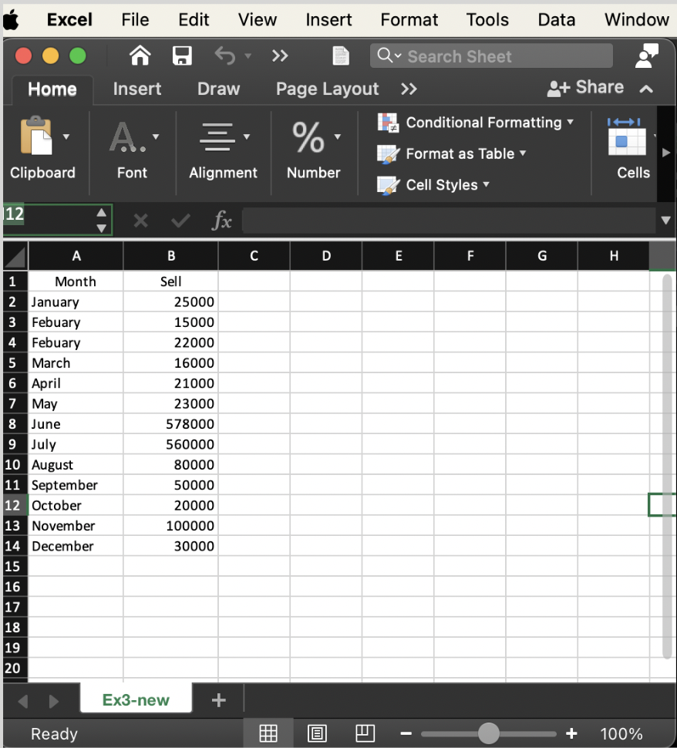
Data Analysis
4o
Notes:
ChatGPT 4o can upload files.
Try uploading Excel files (which is about sales each month) to the clip symbol or attachment.
Then write a prompt asking, 'What information does this file have?’

Slide 29


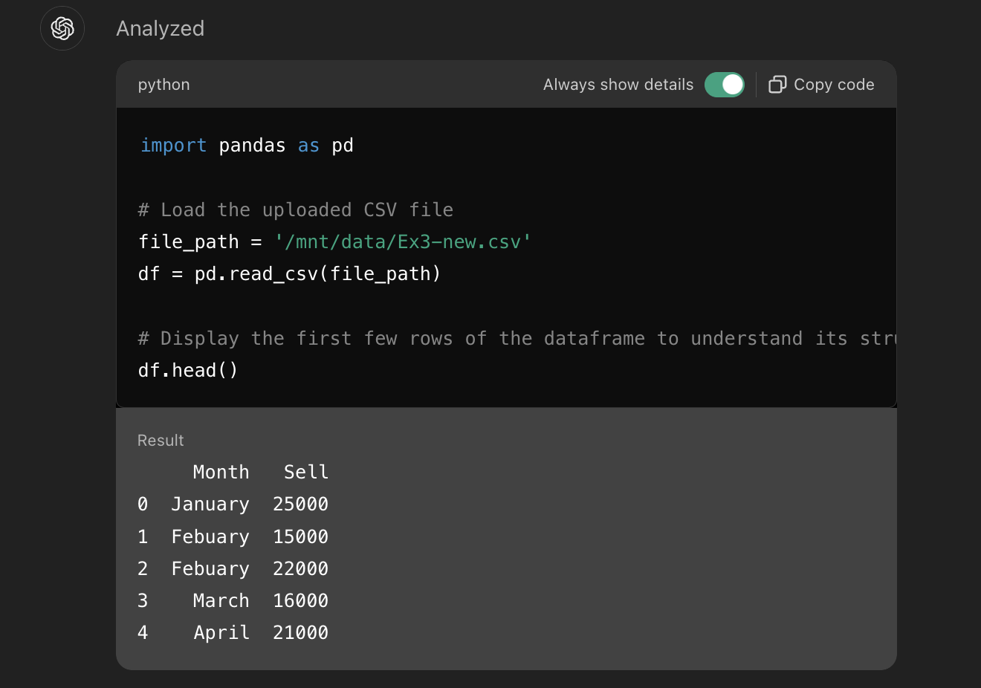
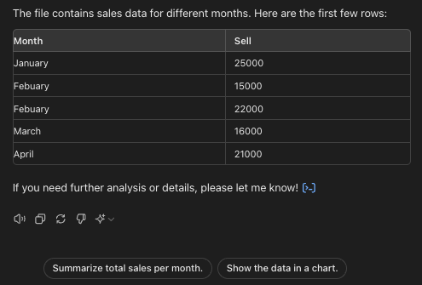
Data Analysis
4o
Notes:
Wait for ChatGPT 4o run the information first.
He will also show the details of the information in the file.
Below are also examples of lead questions.
Try clicking on Show sales of each month.

Slide 30

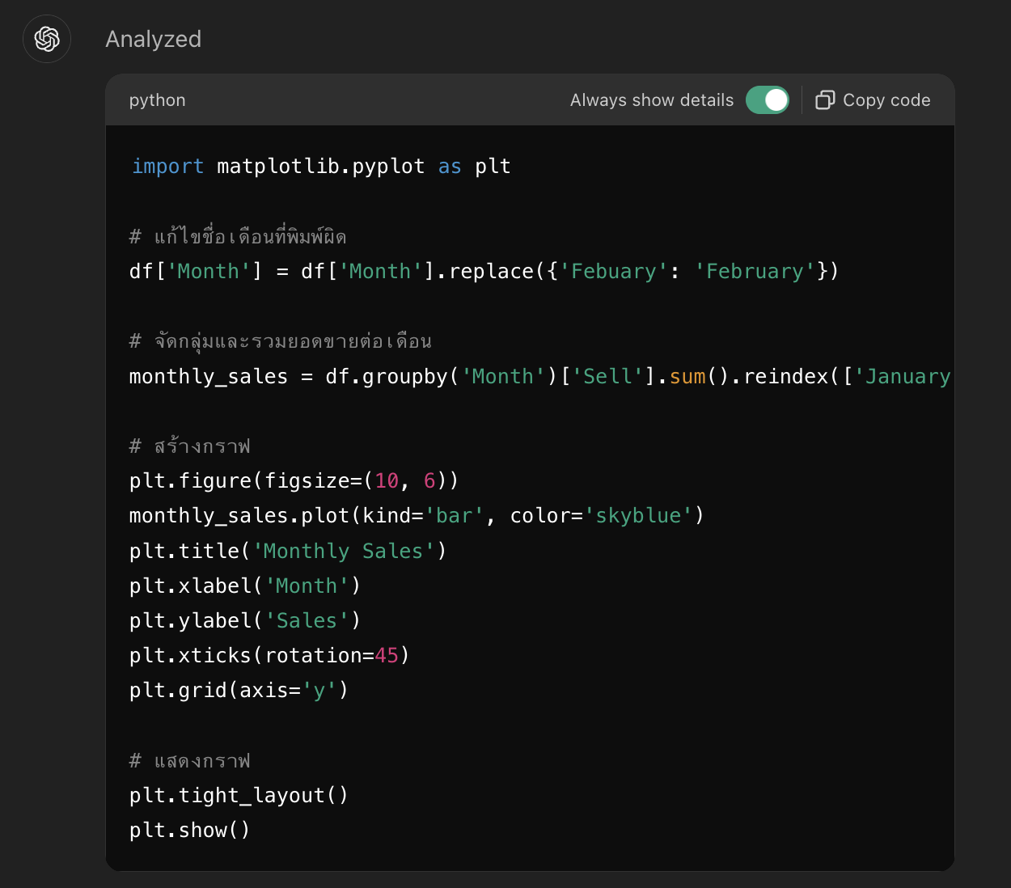

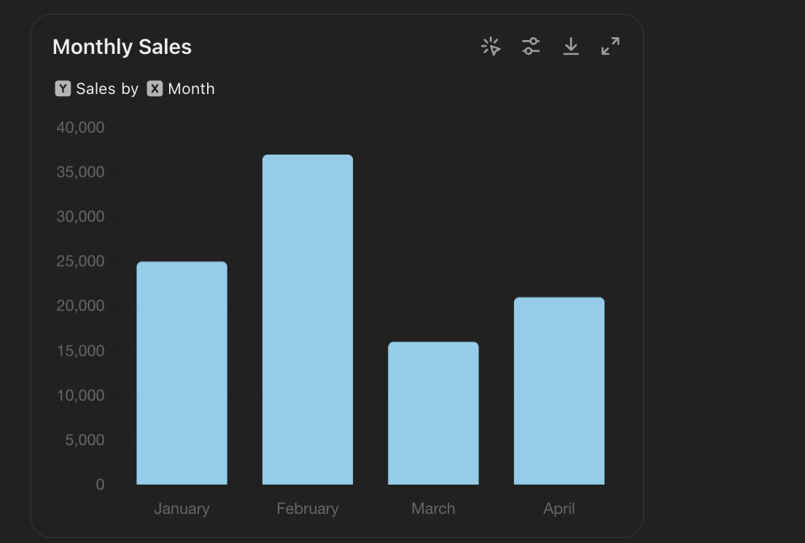
Data Analysis
4o
Notes:
Will receive the following results

Slide 31

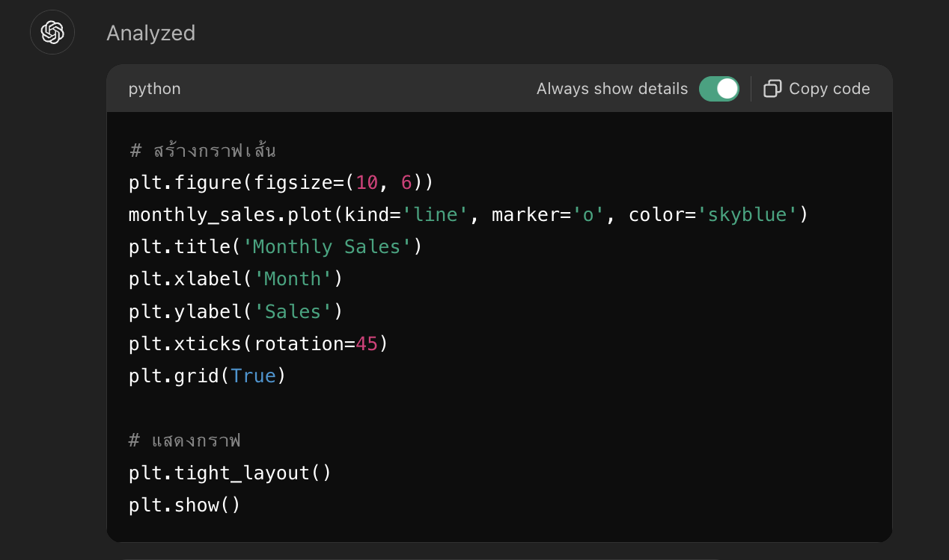

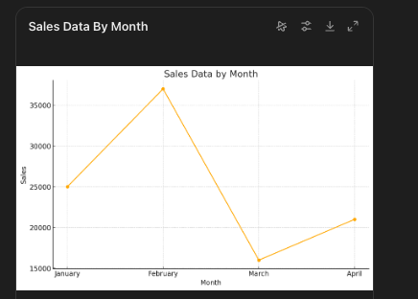

Data Analysis
4o
Notes:
You can order to change to other types of graphs.
Here it is changed to a line graph.

Slide 32

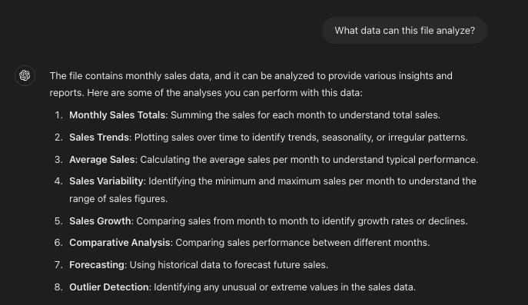
Data Analysis
4o
Notes:
Sometimes we can't figure out what datasets we have available, what they can do.
You can try asking AI Chatbot.
An example question is 'What data can this file analyze?’
Will get the following results.

Slide 33
Analysis of results

Slide 34

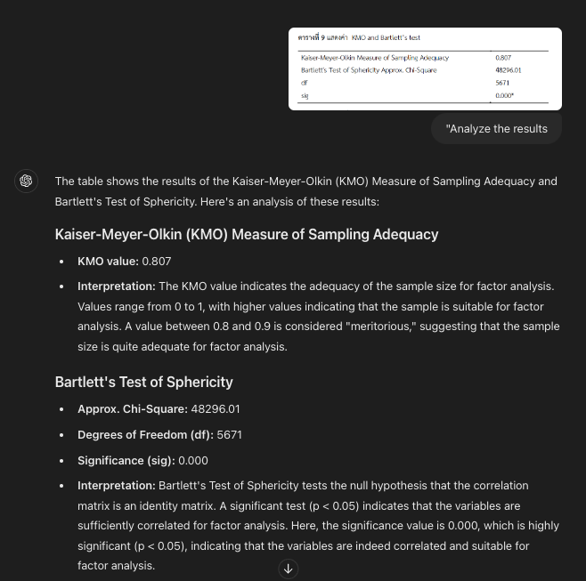

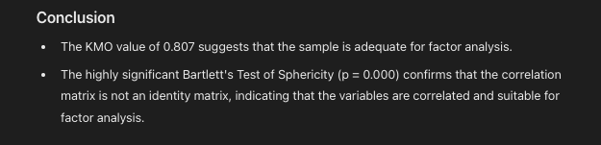
Analysis Results
4o
Analysis Results
Notes:
We can order ChatGPT 4o to summarize the results from the data analysis table.
By copying the table and writing the prompt "Analyze the results," he analyzed the results and explained them.
We may need to adjust a little to the format we want and then explain the information below the table.

Slide 35

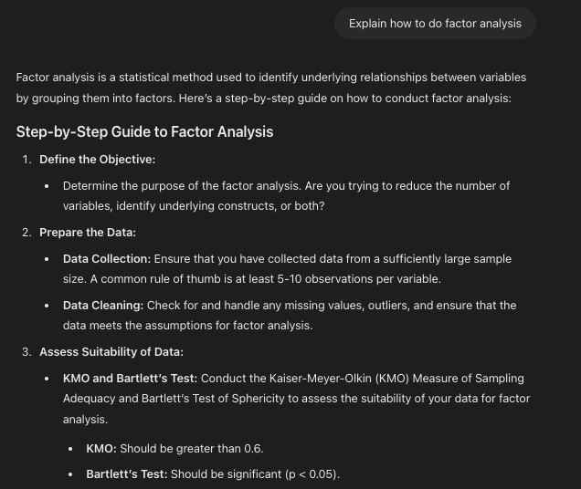

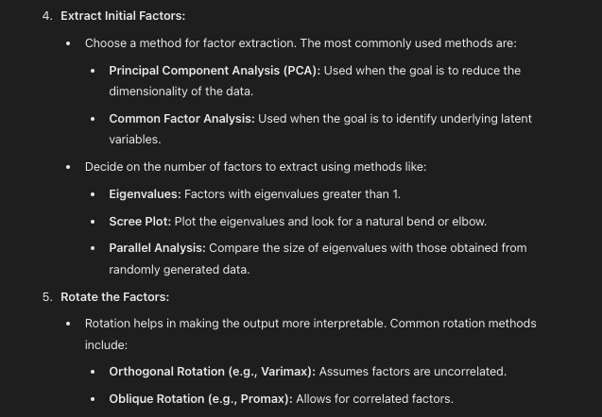
Analysis Results
4o
Explain the method
Notes:
If you want to know anything, ask again, such as "Explain how to do factor analysis”

Slide 36

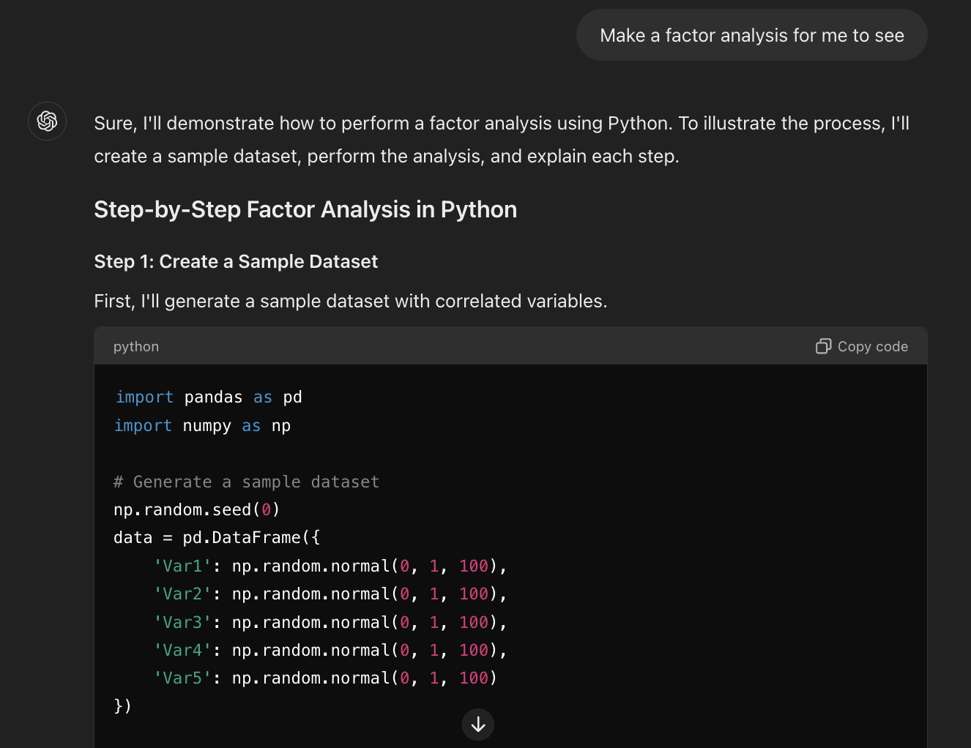

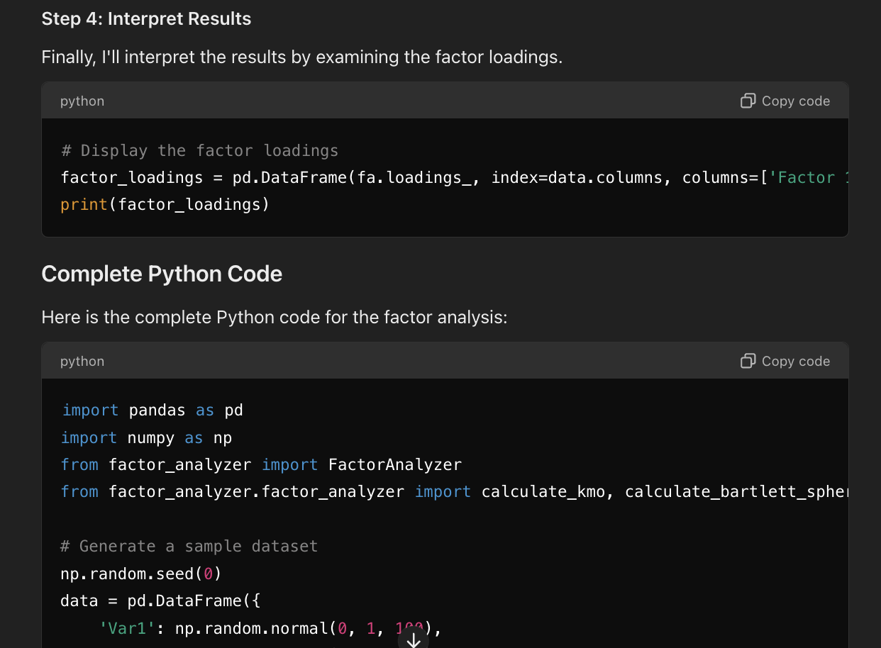
Analysis Results
4o
Make it look (1)
Notes:
You can order it to be viewed.
Ask again "Make a factor analysis for me to see.”
Will get the following results.

Slide 37

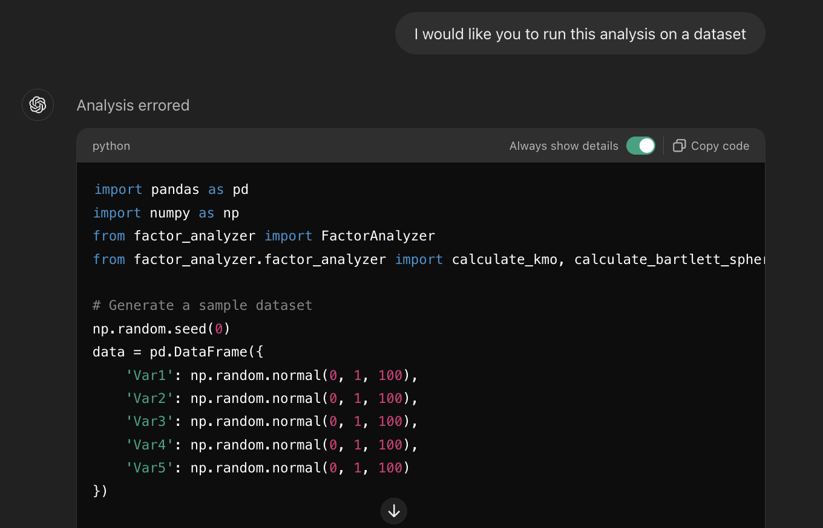

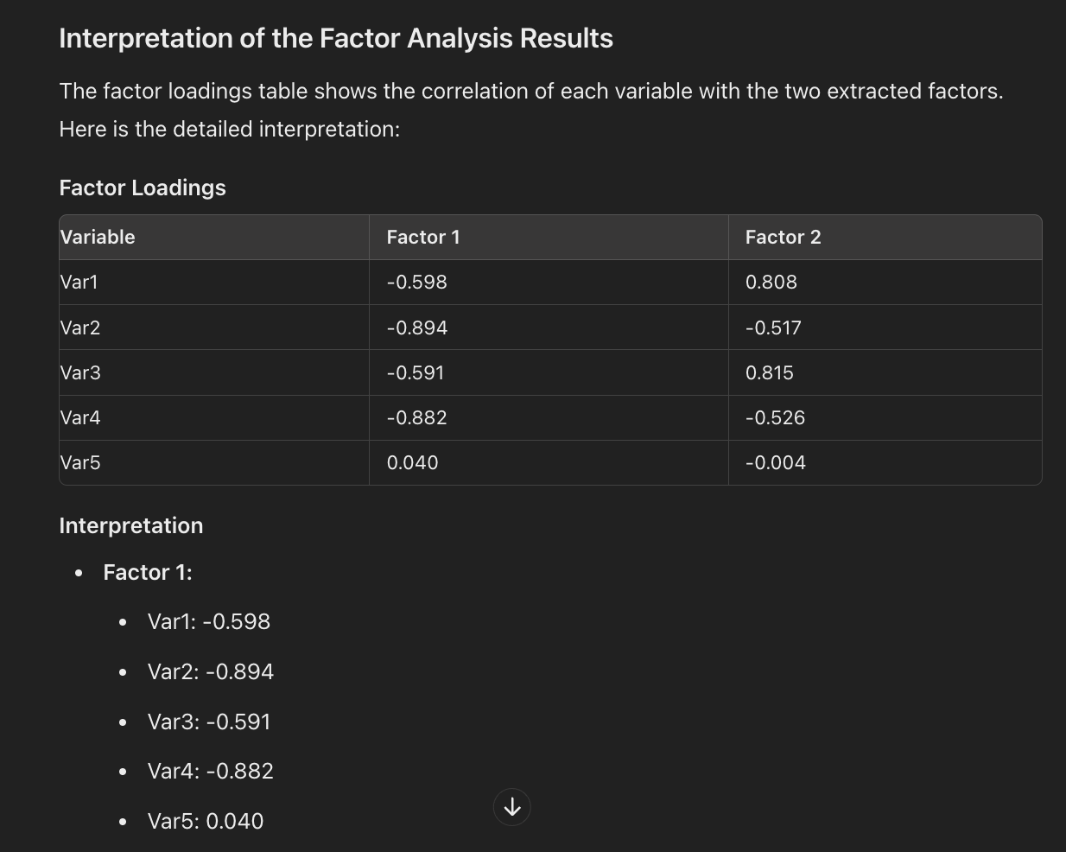

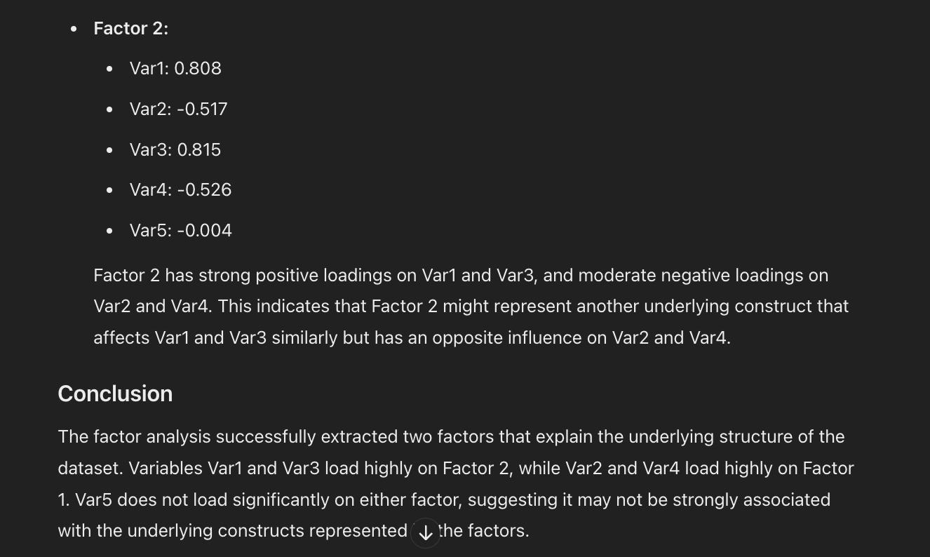
Analysis Results
4o
Make it look (2)
Notes:
Will get the following results.
************
It appears that the `factor_analyzer` package is not available in the current environment. Instead, I will use an alternative approach using the `sklearn` library, which can perform similar analyses. Here’s how you can perform factor analysis using `sklearn`.

