Slide 1

Notes:
Later, look at this Scispace

Slide 2

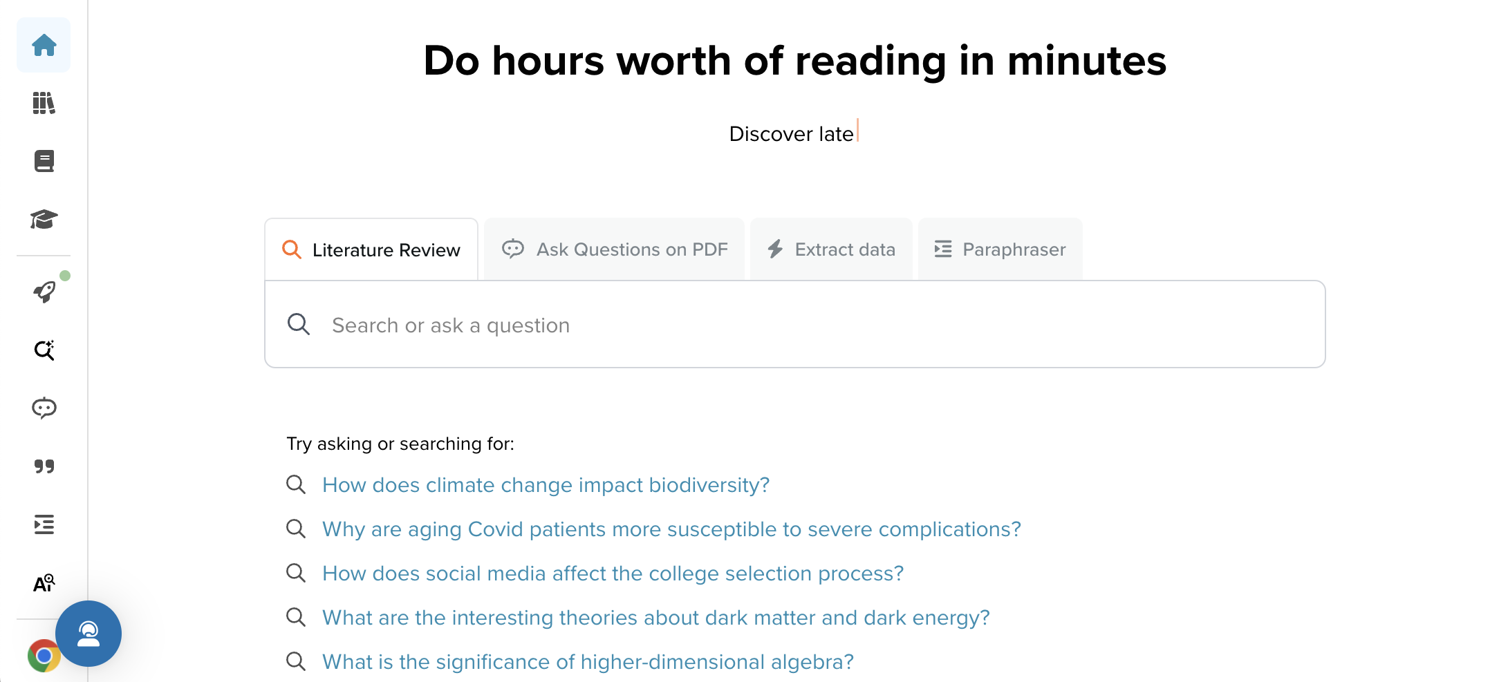
https://typeset.io

Slide 3
Literature Review (1)

Slide 4

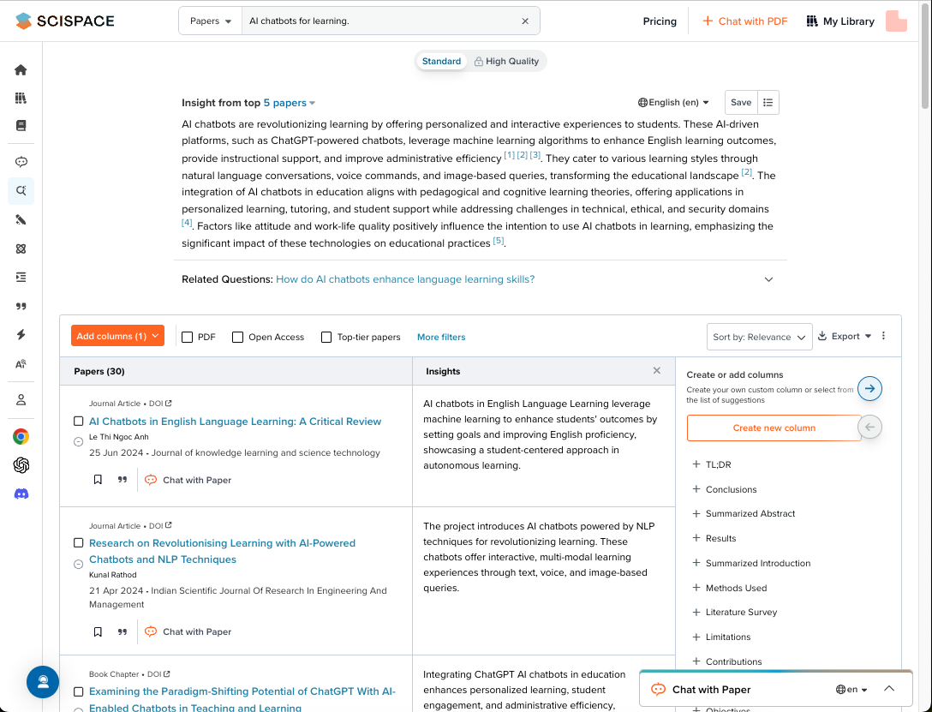

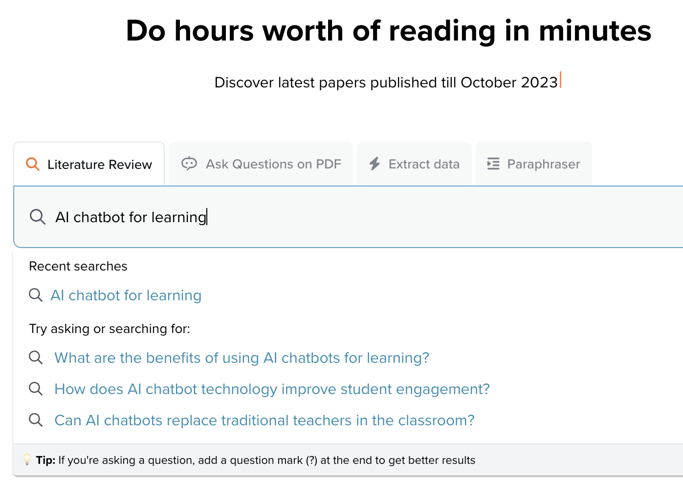
Literature Review (2)

Slide 5


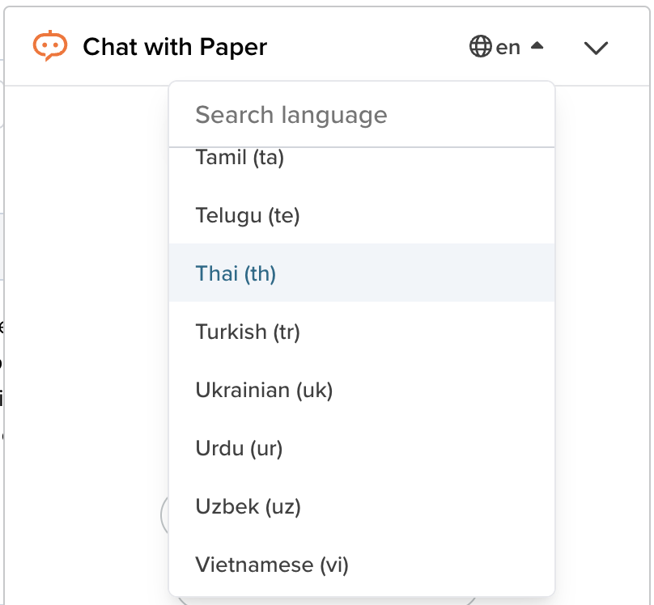
Literature Review (3)

Slide 6

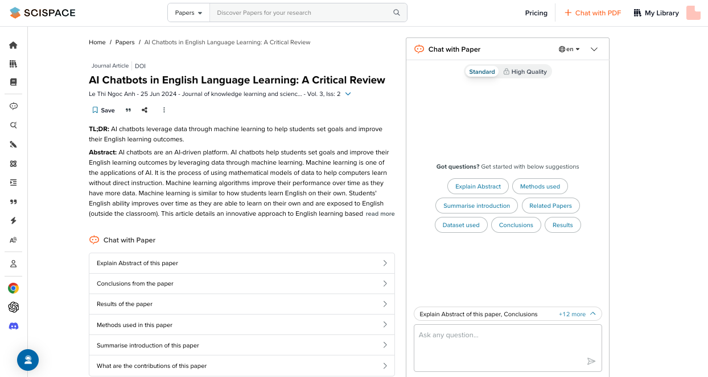
Literature Review (4)

Slide 7

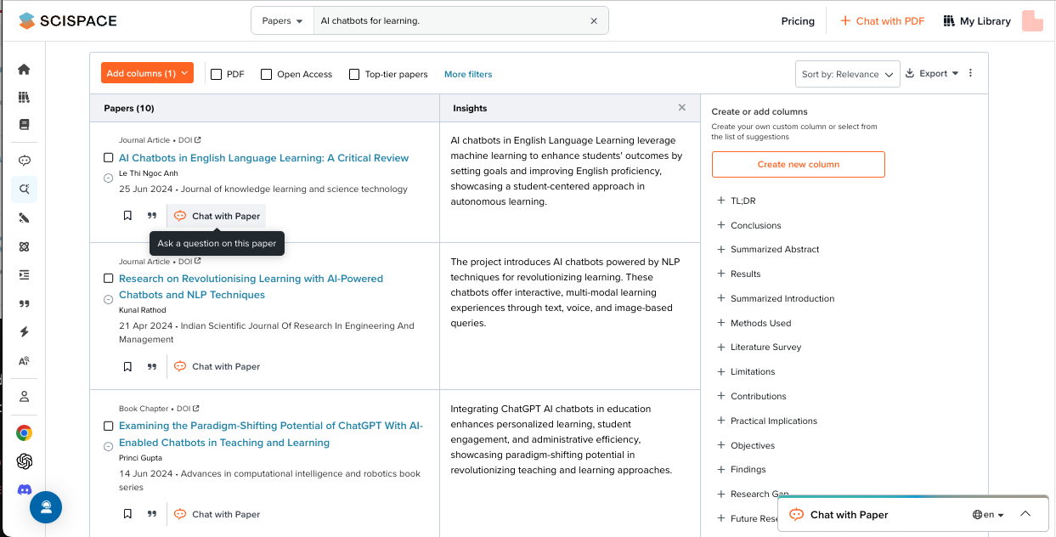
Literature Review (Ask Copilot) (1)

Slide 8

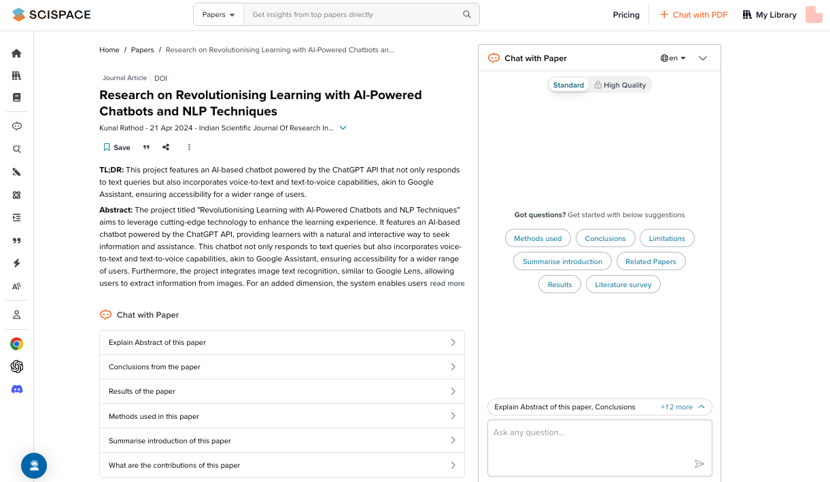
Literature Review (Ask Copilot) (2)

Slide 9

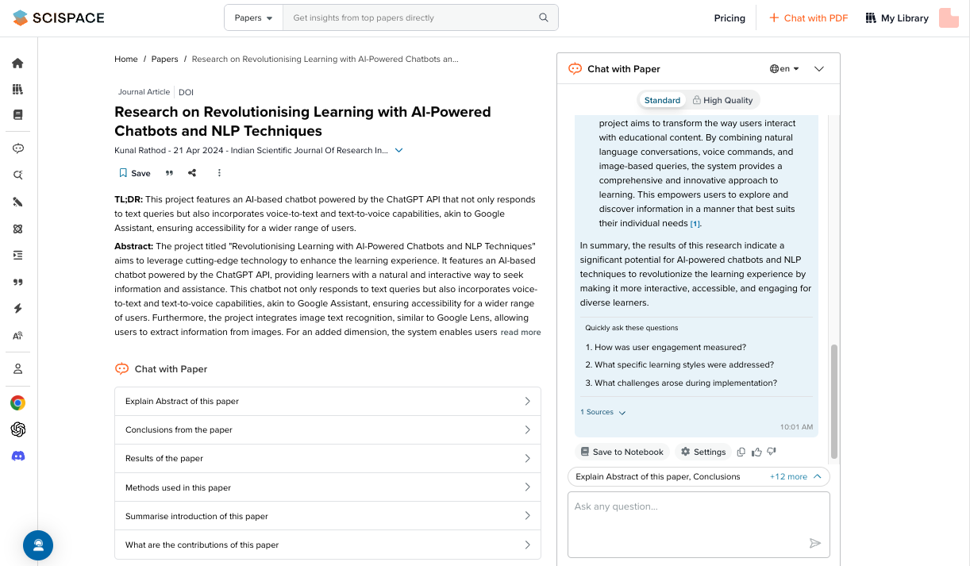
Literature Review (Ask Copilot) (3)

Slide 10

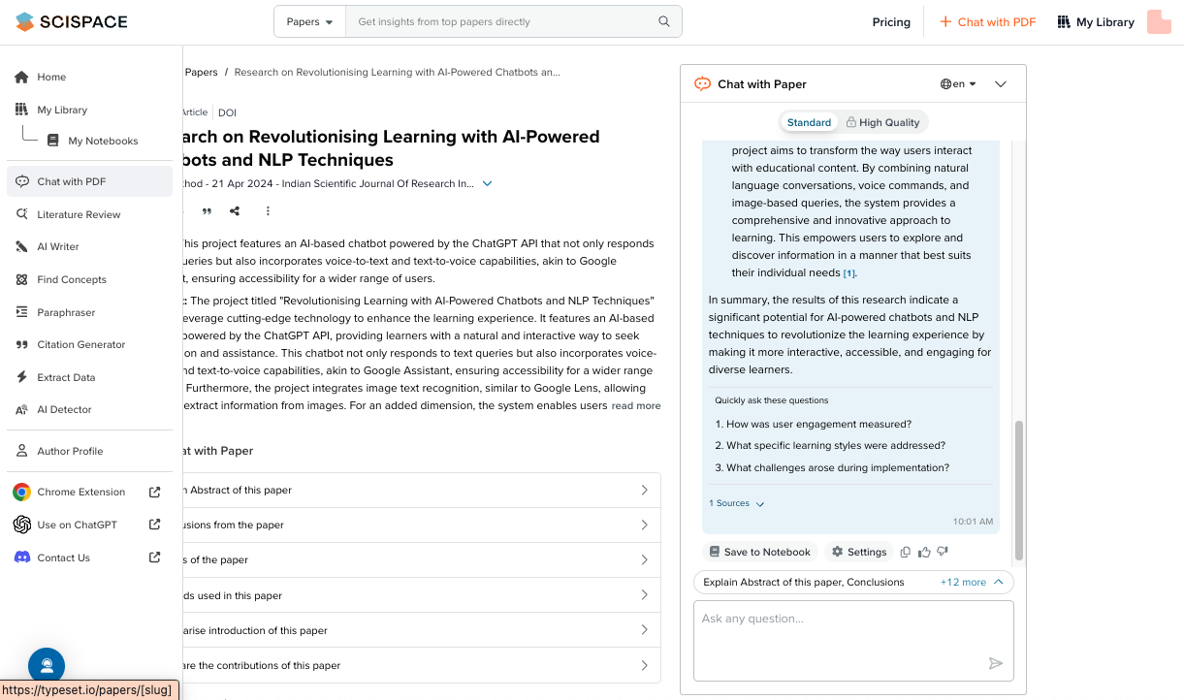
Literature Review (Ask Copilot) (4)

Slide 11

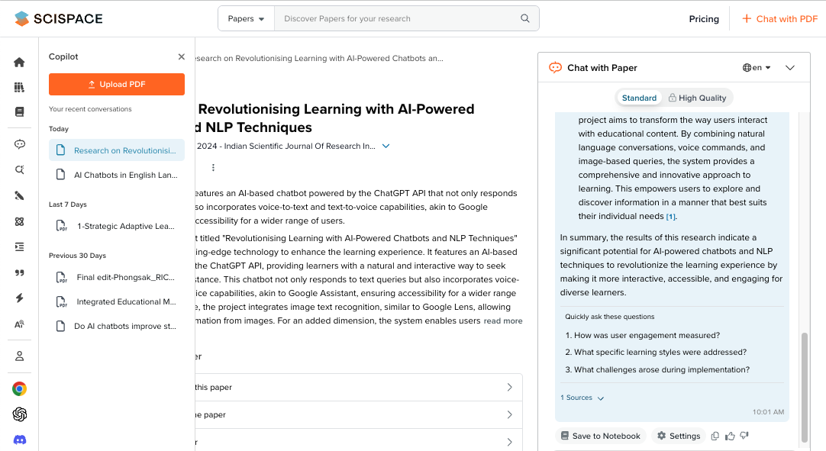

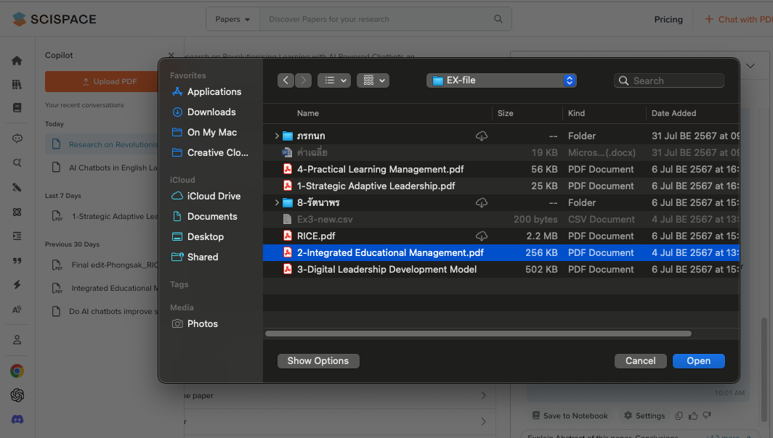
Literature Review (Ask Copilot) (5)

Slide 12

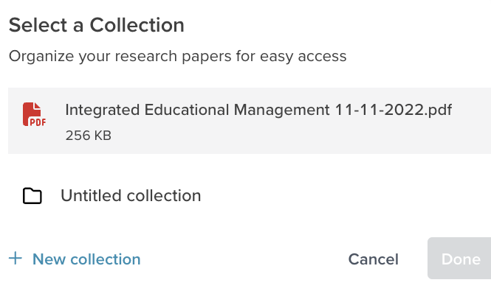

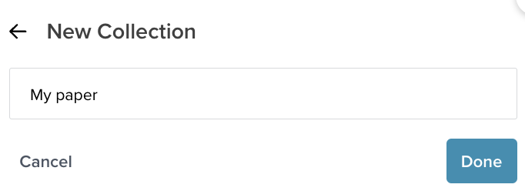
Literature Review (Ask Copilot) (6)

Slide 13

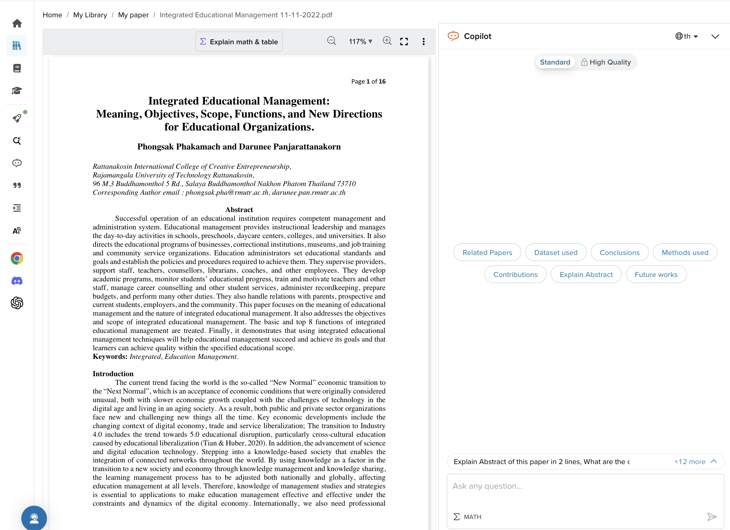
Literature Review (Ask Copilot) (7)

Slide 14

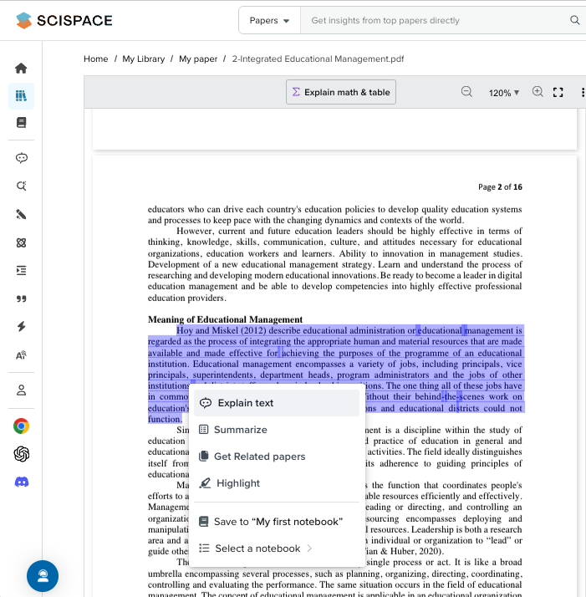

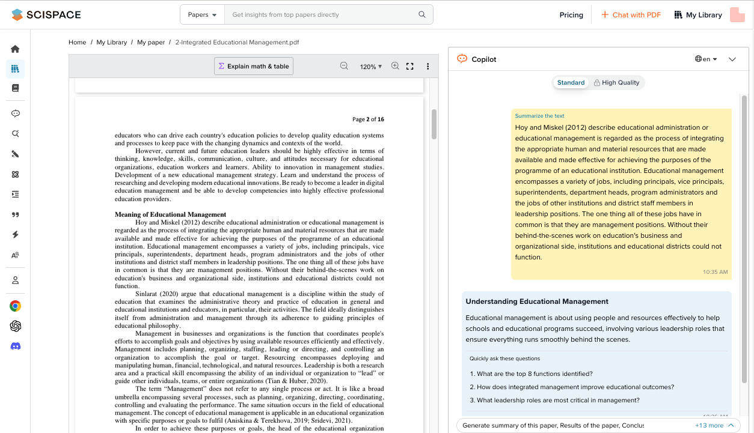
Literature Review (Ask Copilot) (8)
(Summarizs)

Slide 15

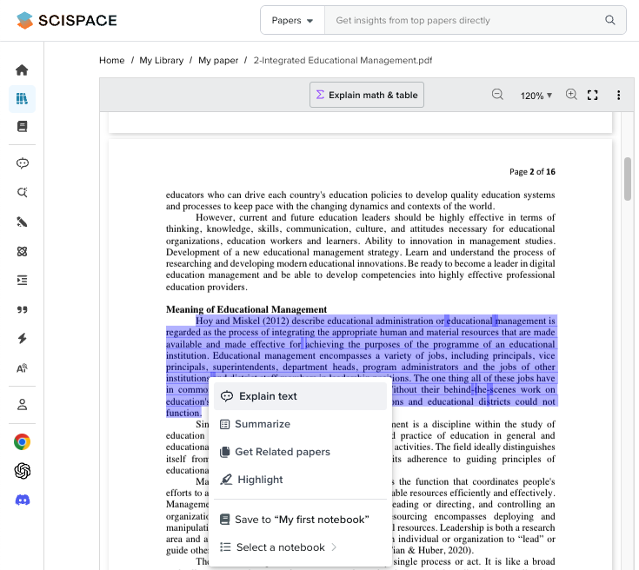

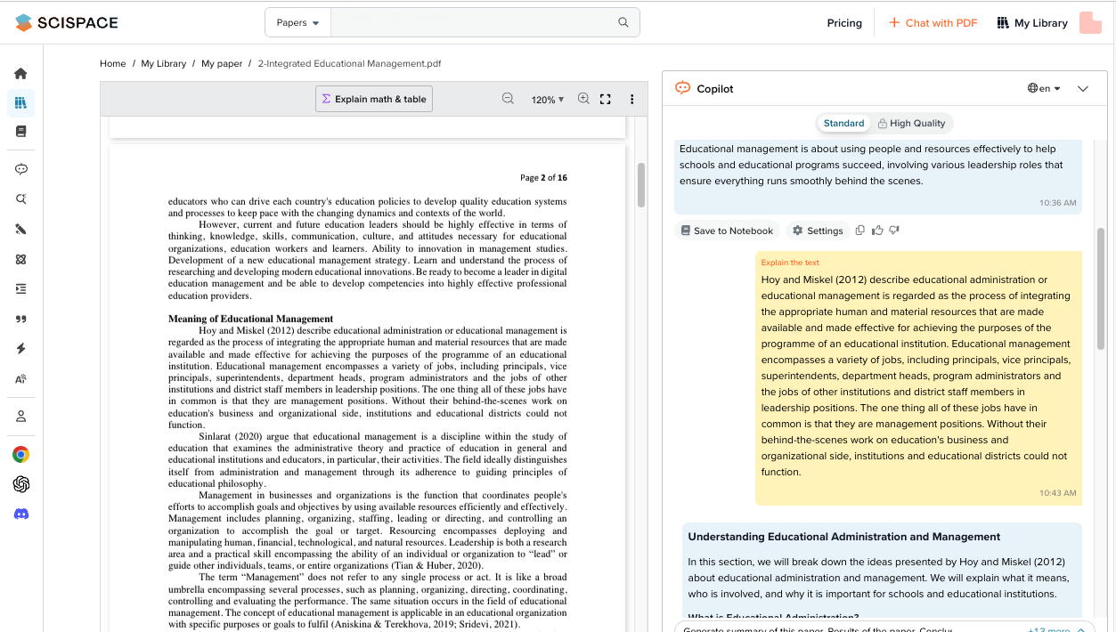
Literature Review (Ask Copilot) (9)
(Explain text)

Slide 16
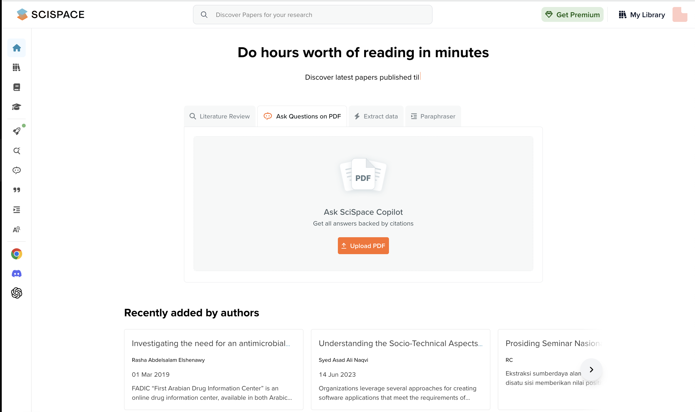
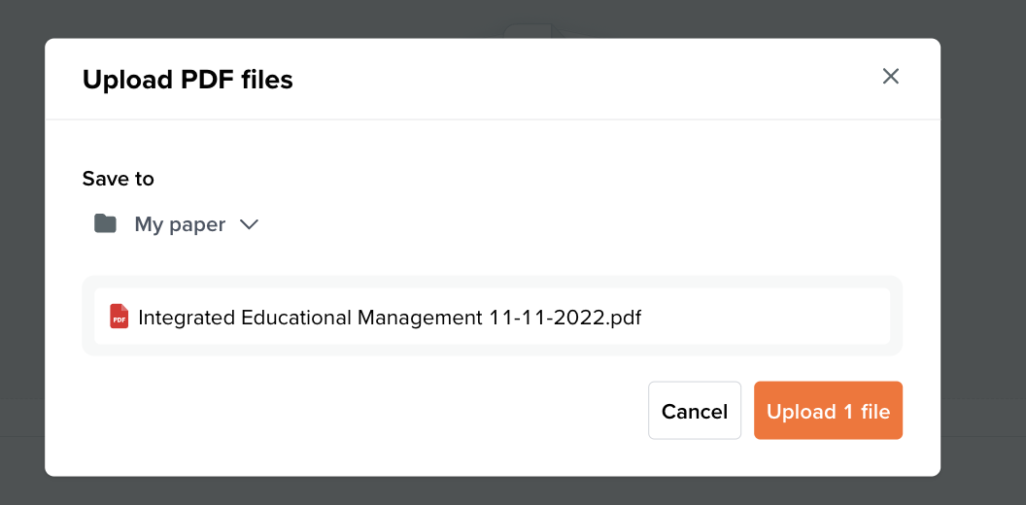
Ask Questions on PDF (1)

Slide 17
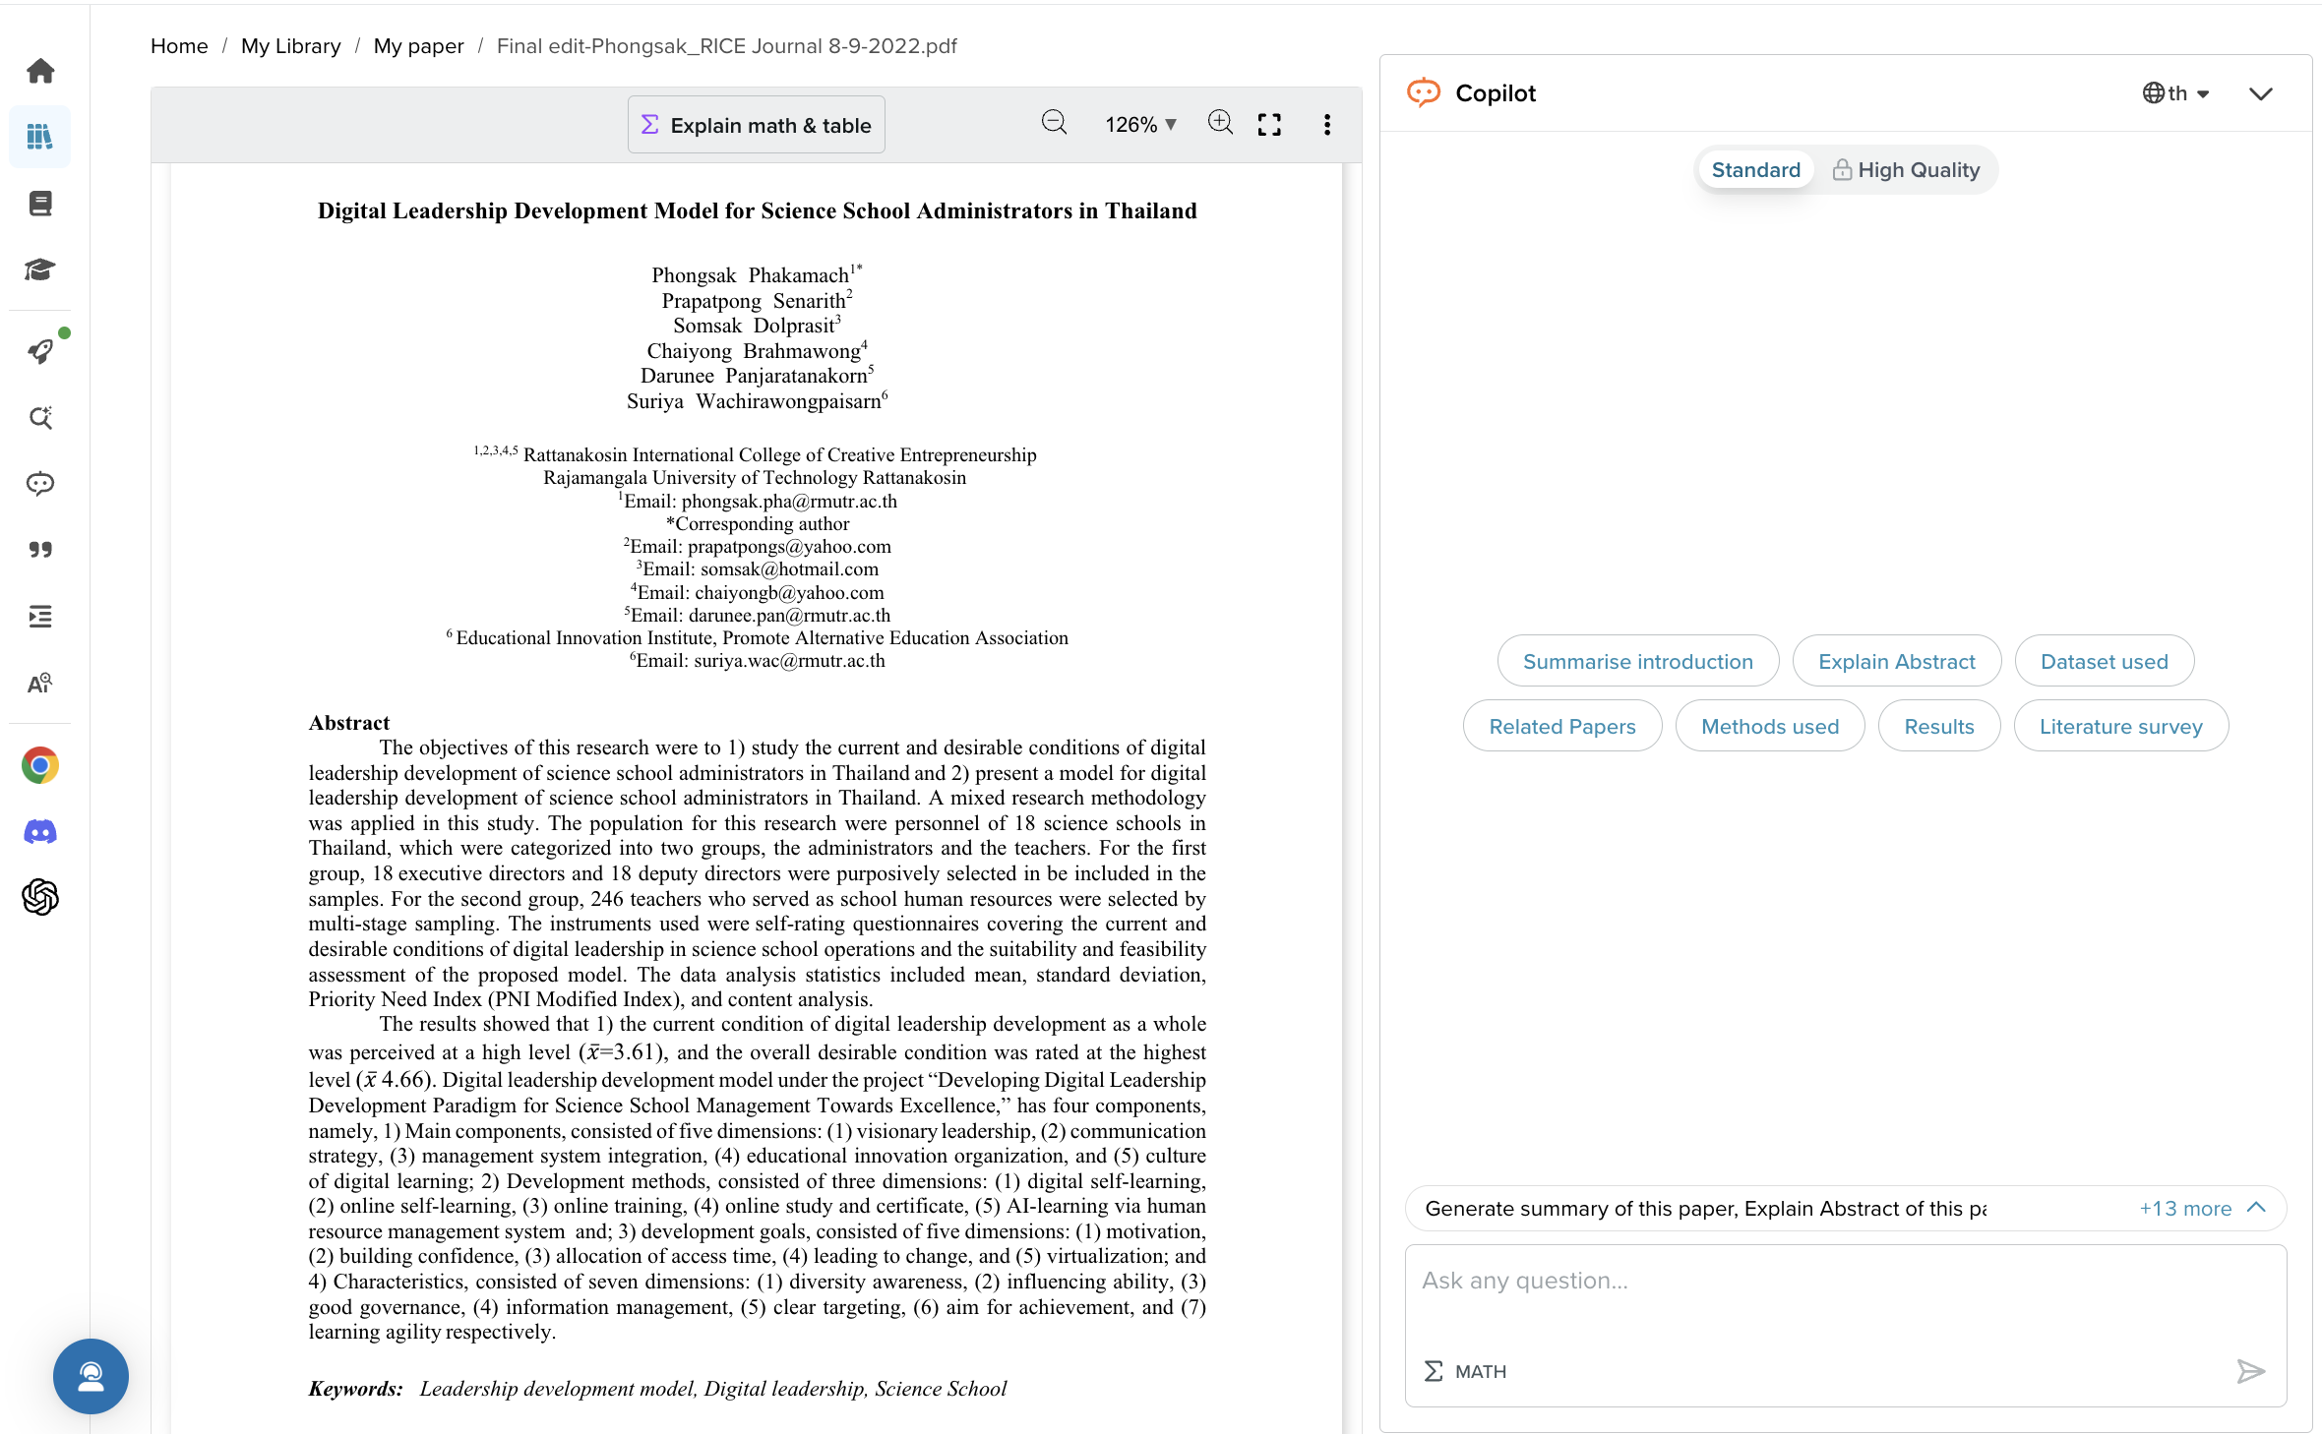
Ask Questions on PDF (2)

Slide 18
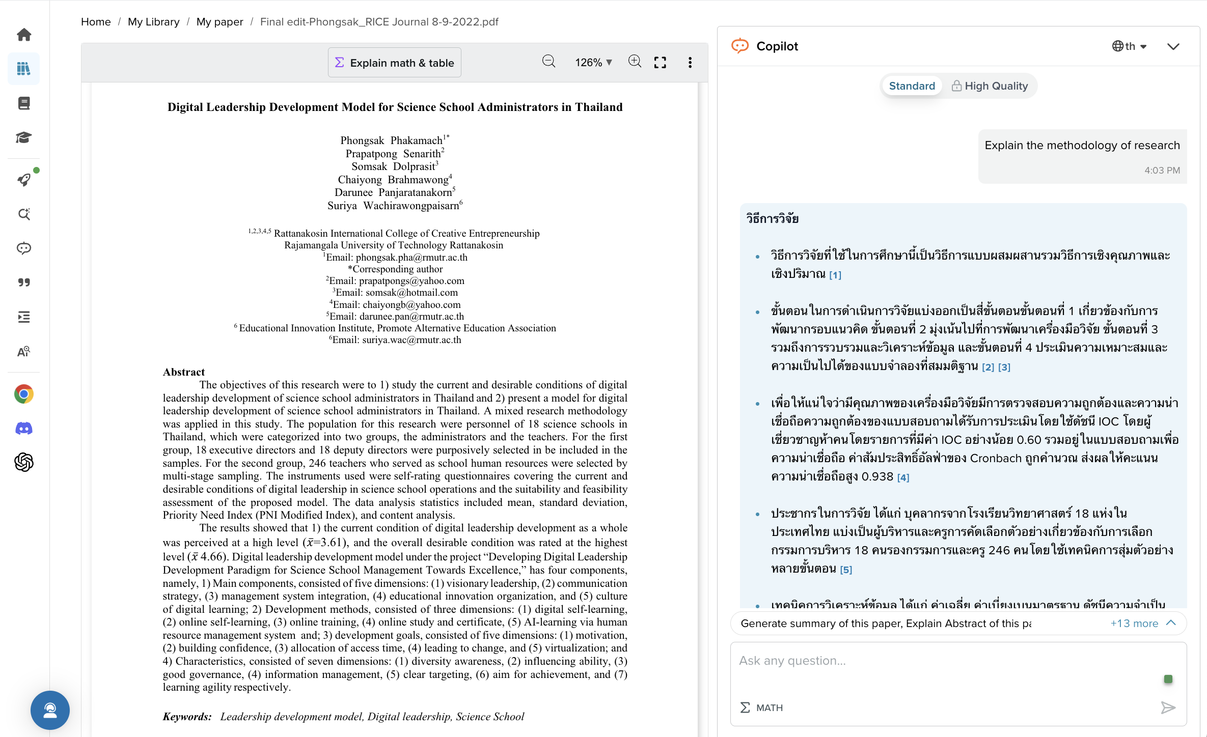
Ask Questions on PDF (3)

Slide 19
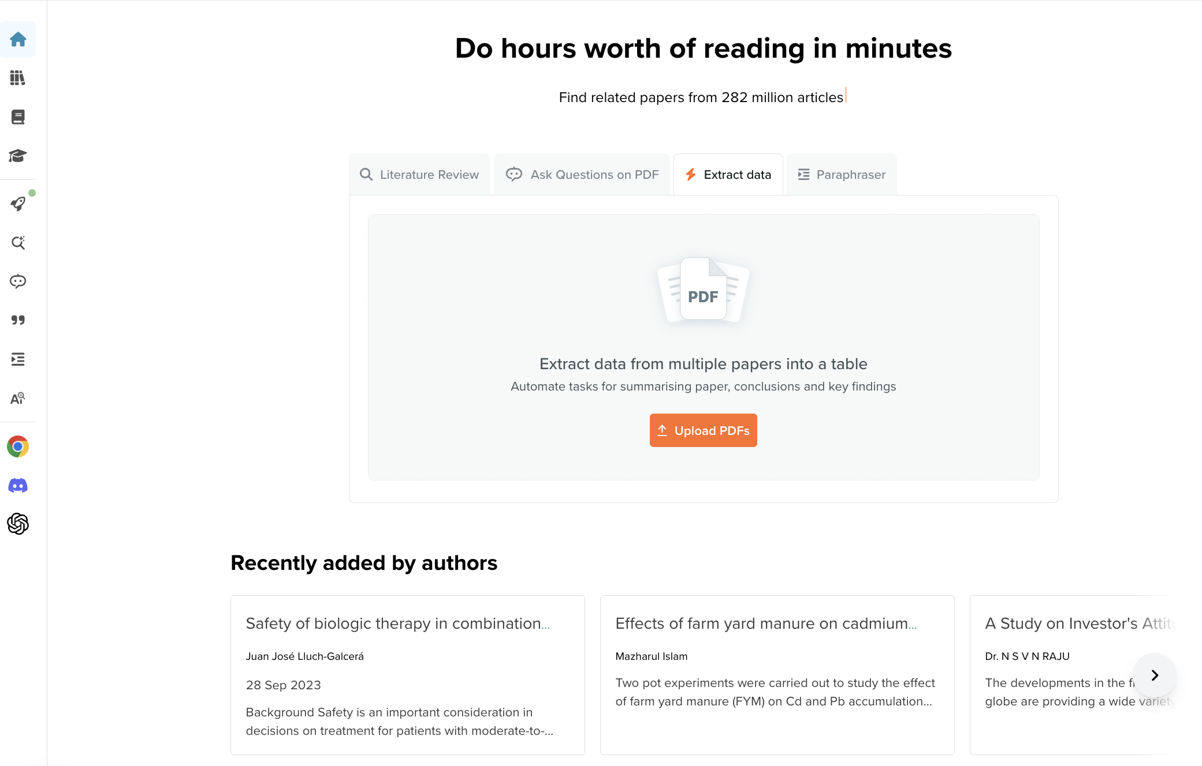
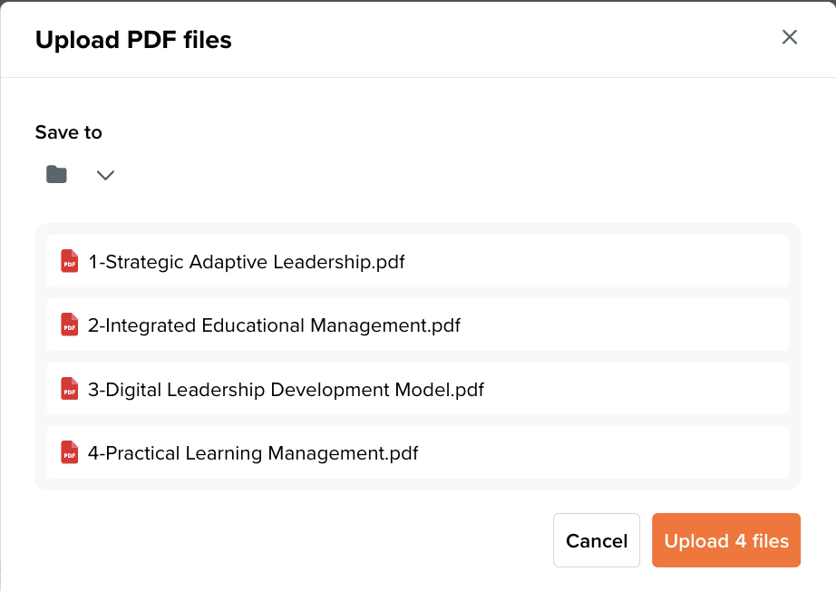
Extract data (1)

Slide 20
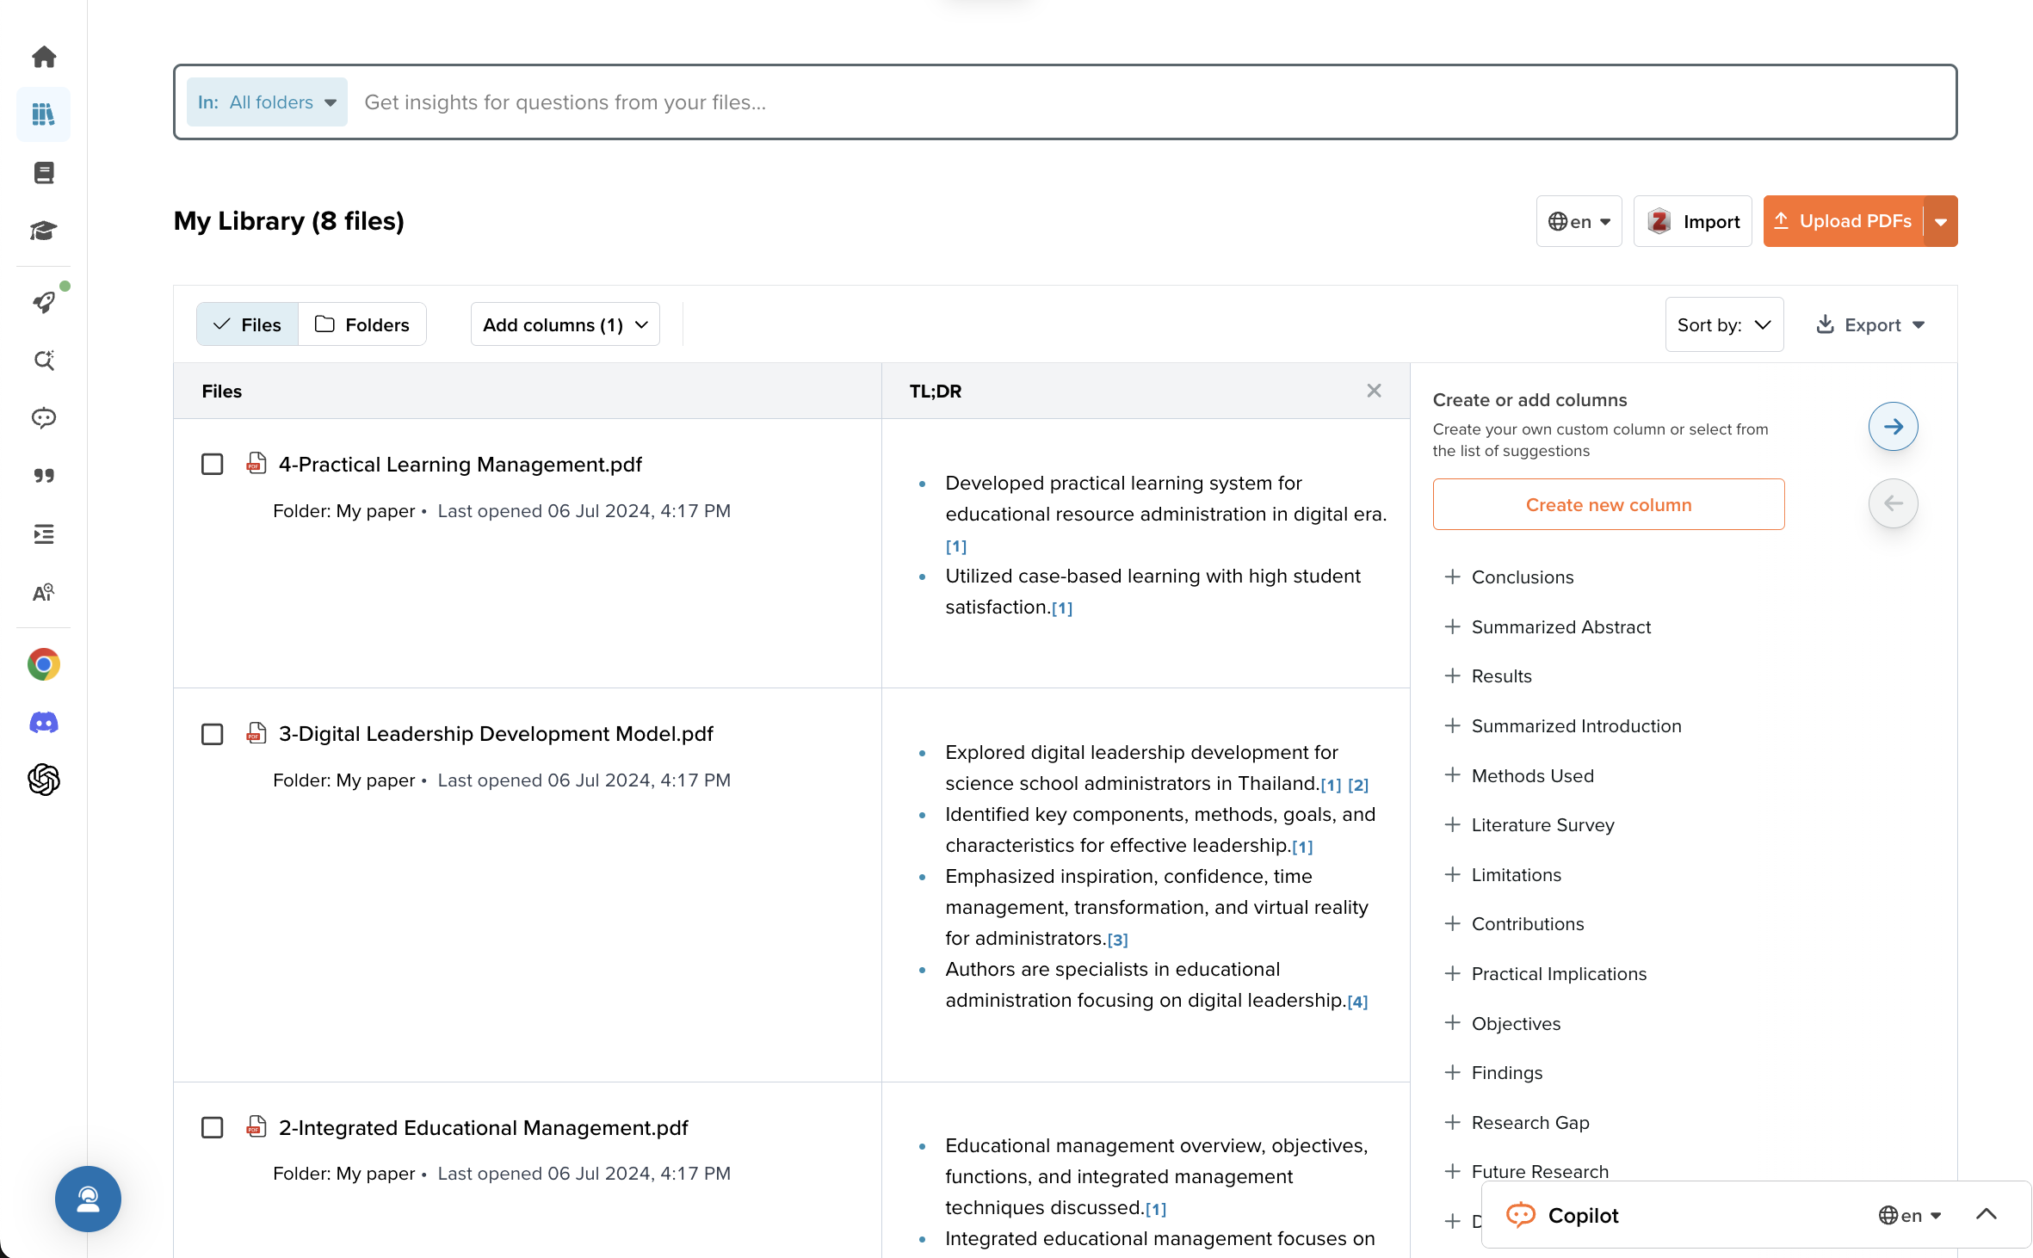
Extract data (2)

Slide 21
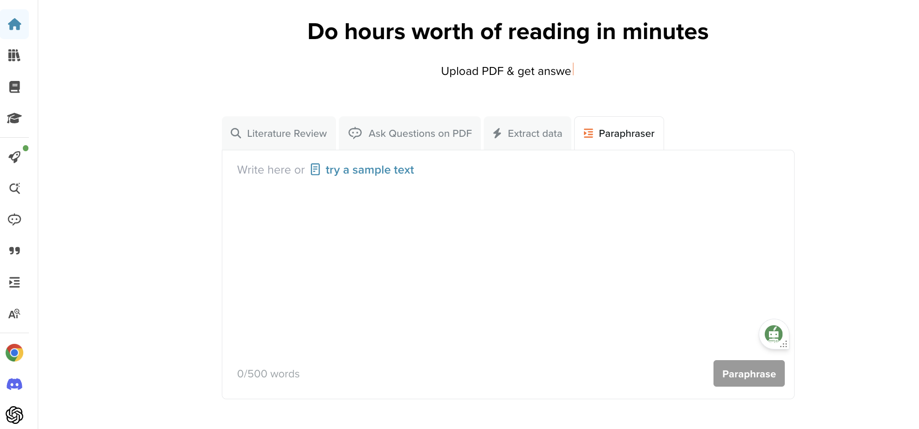
Paraphraser (1)

Slide 22
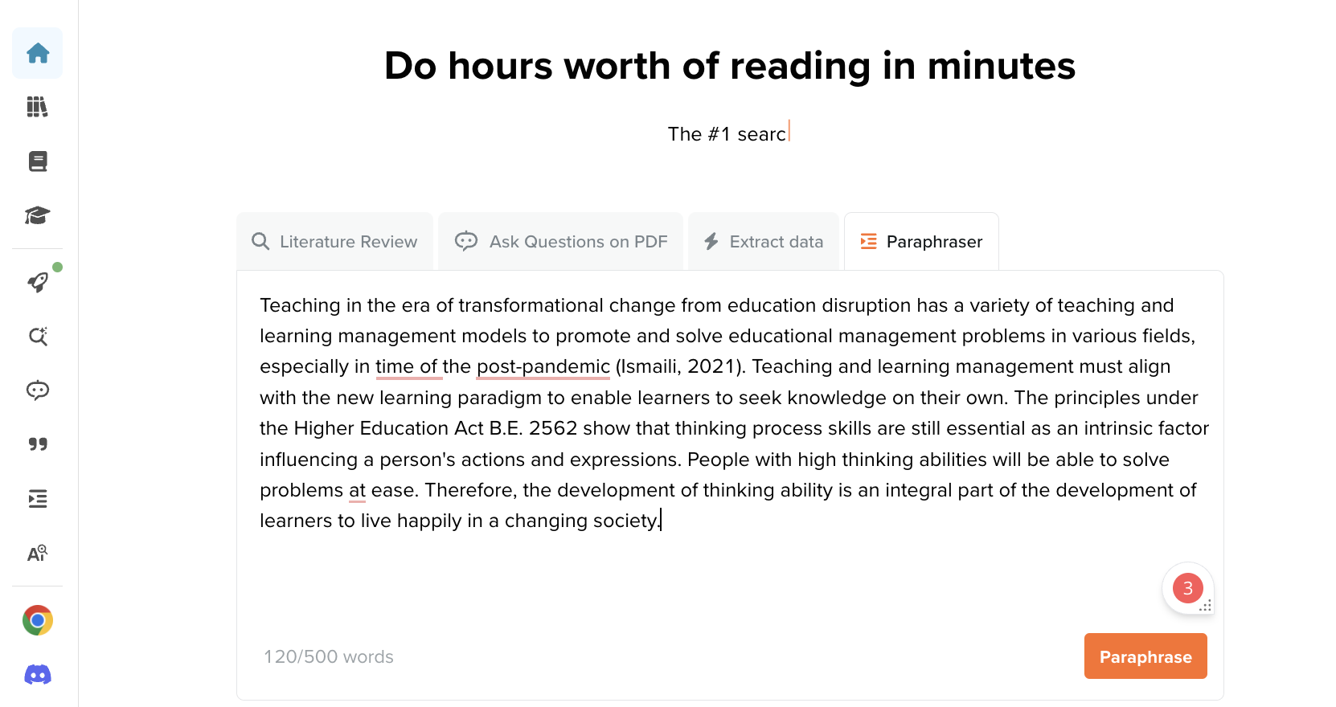
Paraphraser (2)

Slide 23
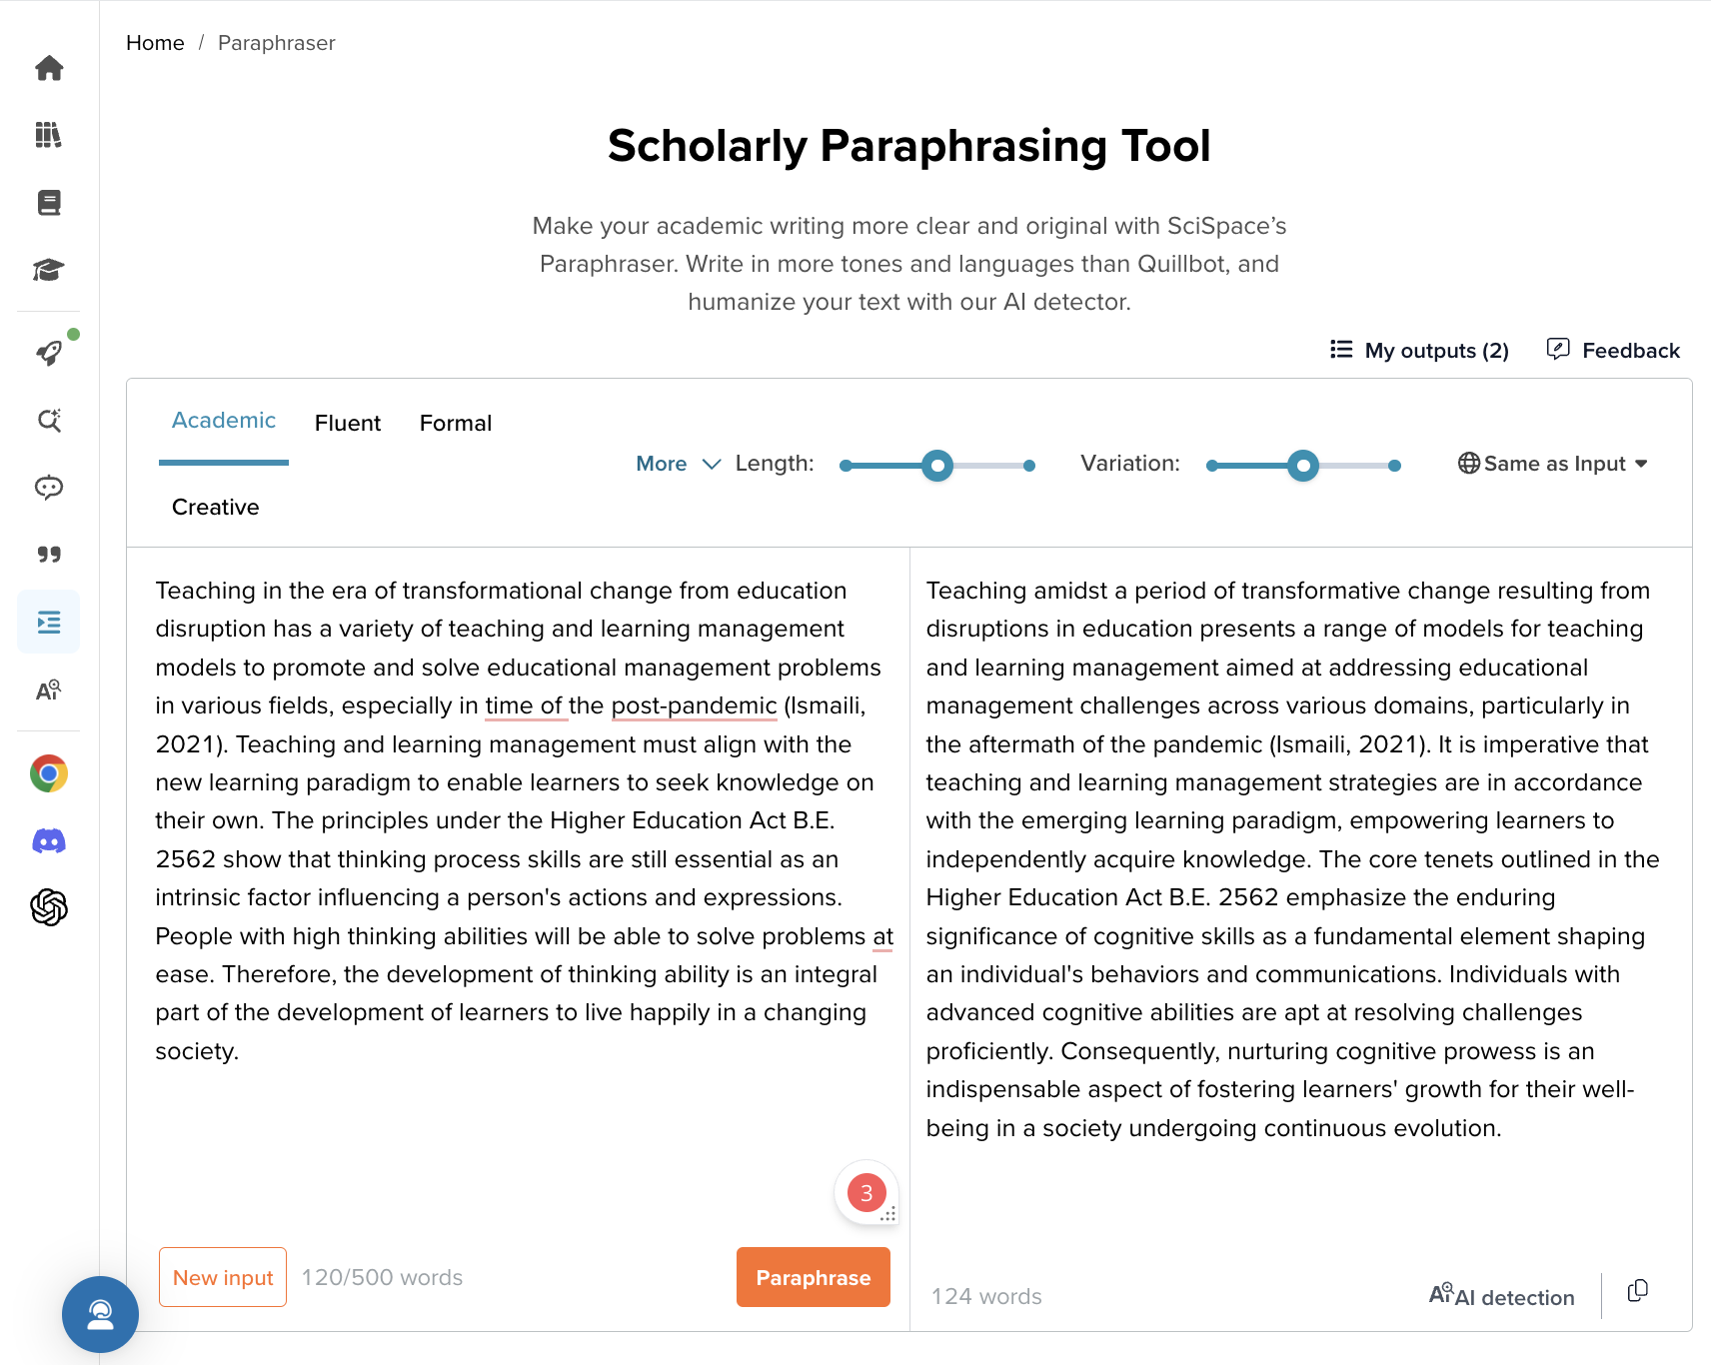
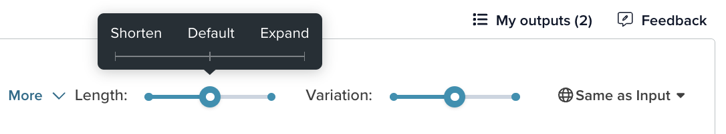
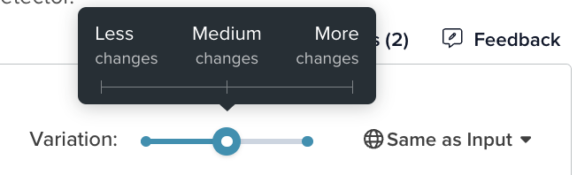
Paraphraser (3)

